Slide 1
Determining capacity and identifying capacity-building needs The CBIT self-assessment tool
Ana C. Henriques Cardoso
UNEP DTU Partnership
8th Annual Partnership Retreat 2019 of the Partnership on Transparency in the Paris Agreement

Slide 2
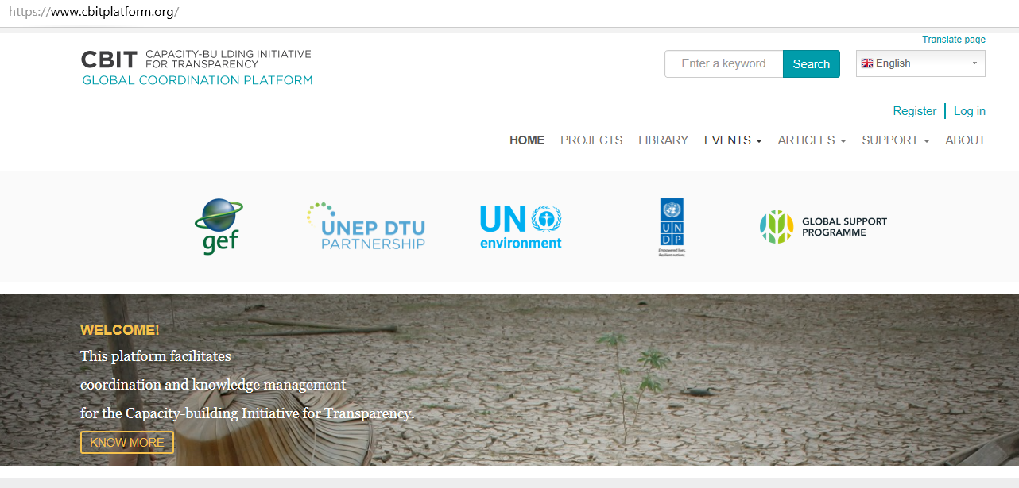
Background: The CBIT Global Coordination Platform project
Notes:
Decision on adoption of PA, on the section about transparency of action and support, to establish a CBIT to build institutional and technical capacity
To support developing countries upon request in meeting the ETF requirements in a timely manner
The GEF was requested to support the establishment of the CBIT
So far, GEF has approved 51 national projects, 1 regional, and 4 global projects
The global projects aim to improve knowledge sharing, coordination, and facilitate additional capacity-building
The CBIT platform project was established to support CBIT management and engage countries, agencies, and other relevant institutions to enhance partnership of national, multilateral, and bilaterally-supported capacity-building initiatives
Joint project implemented by UN Environment and UNDP, and UNEP DTU Partnership is the executing agency
We have the responsibility for the development and maintenance of the platform, limited influence on what the platform is about

Slide 3
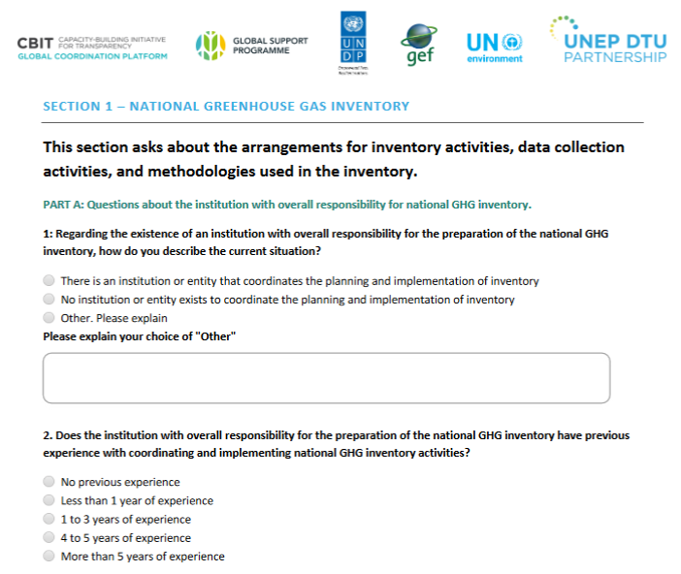
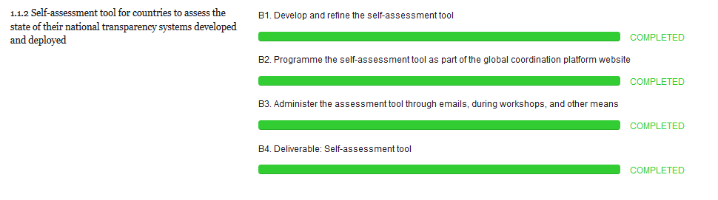
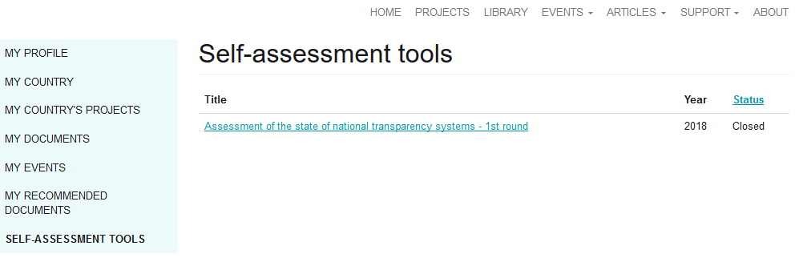
The self-assessment tool
Notes:
The assessment tool will support the assessment of GEF indicators for CBIT - “Quality of MRV Systems” and the “Qualitative Assessment of Institutional Capacity for Transparency Related Activities”
The self-assessment tool is an input to a broader exercise of global analysis of needs and gaps faced by Parties in the implementation of the ETF (component 3 of the CBIT GCP project, done by UNDP)
Objective: baseline of capacity and understand the impact of the project
See the progress of capacities throughout the implementation of the project
It's a tool for documenting progress in capacity development through the CBIT projects
Short story
The CBIT indicators on quality of MRV systems and institutional capacity for transparency-related activities
Engagement of the first few countries that had a CBIT project in 2017
Need to be broad and need to be an unique tool for all - not each country doing its own way
Comments from CGE, UNFCCC, and internal

Slide 4
The challenge of capacity assessments
Multiple levels of capacity: individual, organizational, systemic (what)
Different development organizations, different methodologies to assess capacity and to approach capacity development (who and how)
Multiple capacity assessments done for multiple purposes (why)
Difficult to compare the multiple assessments (who, what, how, when, why)
Notes:
GIZ developed a framework for practitioners working on capacity development
UNDP developed methodology for assessing capacity (individual, organizational, and enabling environment
JICA: Capacity assessment handbook -
US AID: global climate change institutional capacity assessment - tool for assessing an organization's capacity to address climate change issues
More specific, FAO developed a capacity needs assessment methodology in agricultural water management (irrigation and drainage)
A workshop to share knowledge and develop common approaches for achieving the goal of capacity development in that sector, with 25 participants (5 papers)

Slide 5
The structure of the self-assessment tool
National greenhouse gas inventory
43
Climate change impacts and adaptation
21
Responsible institution - 5 questions
Engagement of stakeholders - 9 questions
Data collection and management - 12 questions
Methodologies used - 6 questions
QA&QC procedures - 11 questions
Institutional arrangements - 8 questions
Data collection and procedures - 7 questions
Methodologies for planning and monitoring - 6 questions
Progress made in implementing and achieving NDCs
20
Financial, technology transfer, and capacity-building support needed and received
19
Institutional arrangements - 7 questions
Data collection and management - 5 questions
Procedures for monitoring progress - 8 questions
Institutional arrangements - 5 questions
Procedures for reporting support needed - 7 questions
Procedures for reporting support received - 7 questions
Notes:
CBIT projects are technical assistance projects
What needs to be in place for the countries to have a minimum viable system to report the information specified in the ETF
Look at the functional capacity rather than the soft skills and intangible aspects that create or undermine the enabling environment for change
What is capacity for climate transparency?
What are the reporting requirements of the ETF?
What needs to be in place for these reporting requirements to be met?
Balance between length and broadness
Developed and deployed before the MPGs were agreed
The tool can be delegated to other country representatives, it allows to get answers from the most relevant people because the focal point does not always know about all aspects
The concept of a minimum viable product - just enough "features" to validate the idea
Keep iterating (evolving) after considering the feedback received
Not the absolute number of questions that matters
Are we asking the right questions?
Can we infer about the state of national transparency systems from the answers?

Slide 6



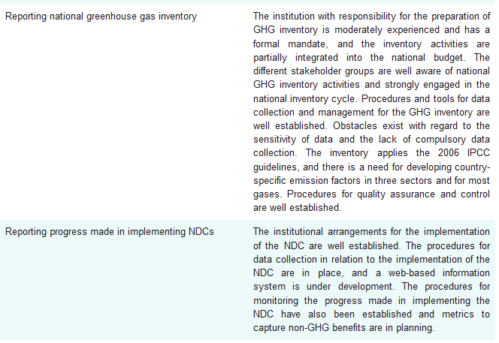
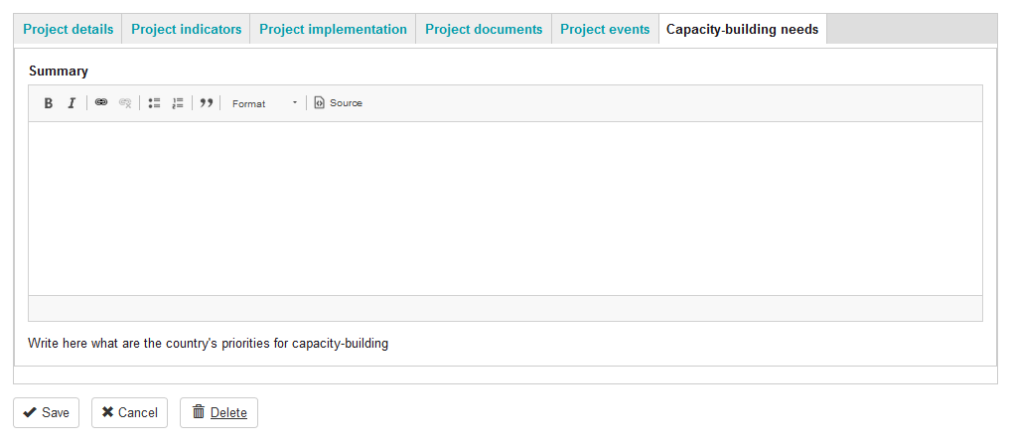
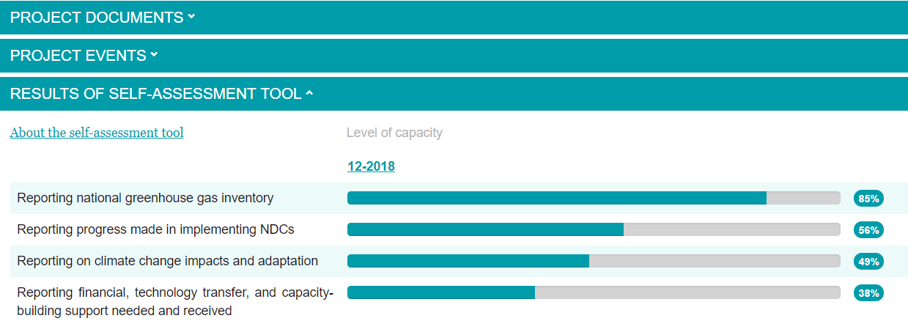
Focal point of CBIT project
Notes:
40 countries (out of 42) submitted answers between Nov 2018 and April 2019
Presented the results of that round of answers in CBIT Workshop in Rome (May this year)
11 more country projects by now
The analysis of data:
summarizing the responses and presenting the summary to CR, asking on whether the summary reflects the situation in the country
Making changes and revision of summary based on feedback
Publish in the CBIT platform
Developed recently a space for countries to write what are their priorities for CB. The needs identified are not necessarily in line with the priorities for the country

Slide 7
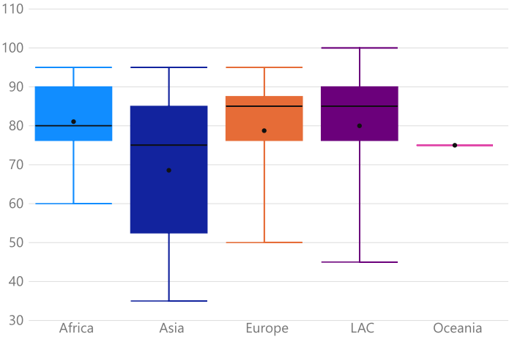
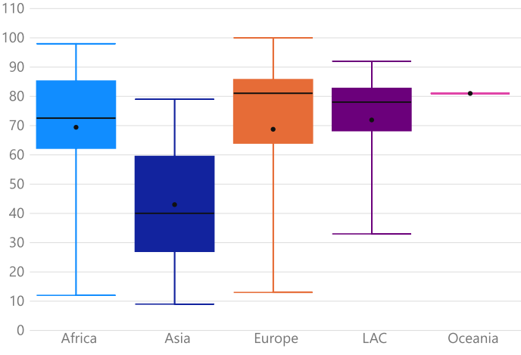
Results Inventory: institutional arrangements
These box and whisker charts show how the perceived level of capacity is distributed among the group of countries in each region: the extremes (min and max), the median as a black horizontal line, the average as a dot, and the distance between the first and third quartile filled out
Max
Average
Median
Min
N=14
N=7
N=4
N=14
N=1
N=14
N=7
N=4
N=14
N=1
Responsible institution
Engagement of stakeholders
Notes:
Number of countries
Africa: 14
Asia: 7
Europe: 4
LAC: 14
Oceania: 1
Box and whisker chart showing the extremes (min and max) for the group of countries in each region, the median as a line, the average as a dot, and the 1st and third quantile distance filled out
25% of occurrences below q1
75% occurrences below q3

Slide 8
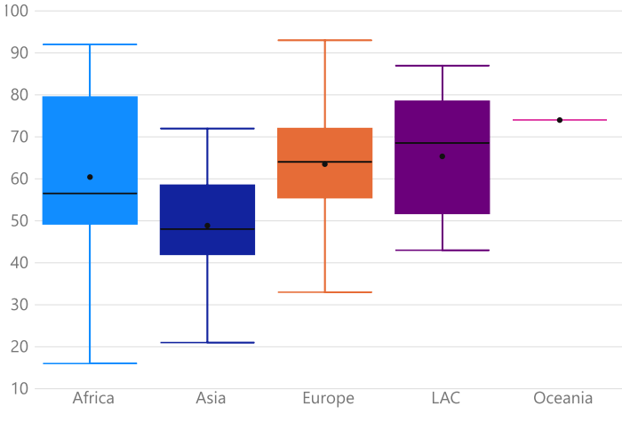
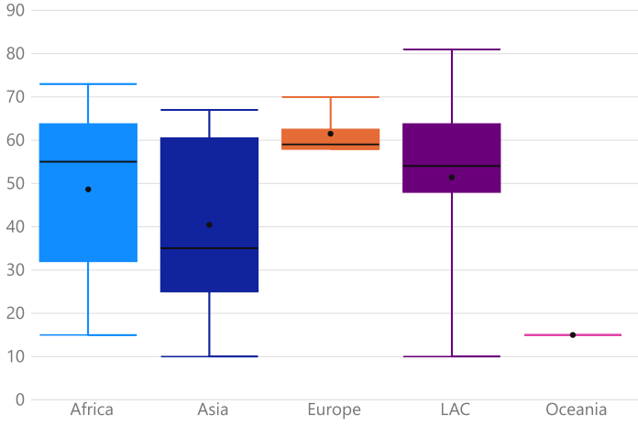
Results Inventory: data collection and management, and methodologies
N=14
N=7
N=4
N=14
N=1
N=14
N=7
N=4
N=14
N=1
Data collection and management
Methodologies
Notes:
Number of countries
Africa: 14
Asia: 7
Europe: 4
LAC: 14
Oceania: 1
Box and whisker chart showing the extremes (min and max) for the group of countries in each region, the median as a line, the average as a dot, and the q1 and q3 distance filled out
25% of occurrences below q1
75% occurrences below q3

Slide 9
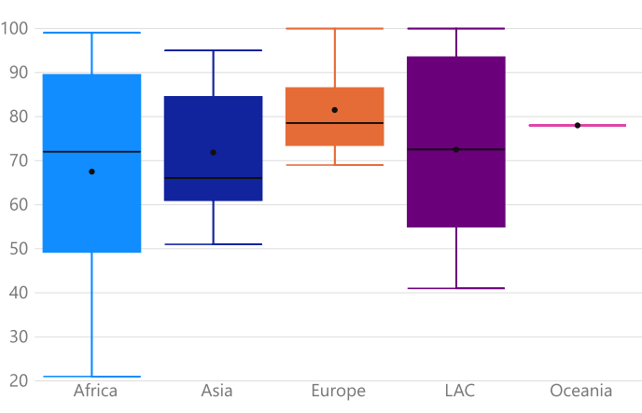
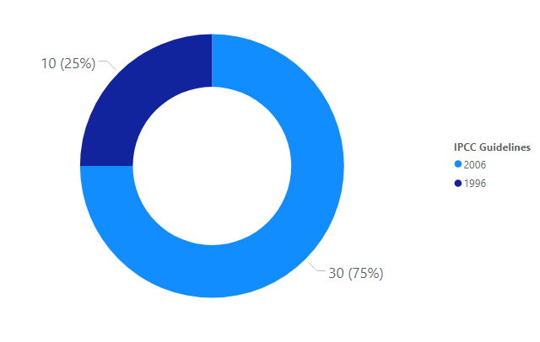
Results Inventory: quality assurance and control procedures
N=14
N=7
N=4
N=14
N=1
Which IPCC inventory guidelines countries use
QA & QC procedures
Notes:
Number of countries
Africa: 14
Asia: 7
Europe: 4
LAC: 14
Oceania: 1
Box and whisker chart showing the extremes (min and max) for the group of countries in each region, the median as a line, the average as a dot, and the q1 and q3 distance filled out
25% of occurrences below q1
75% occurrences below q3

Slide 10
Key findings: GHG inventory
Still work to do on institutional arrangements, with CBIT countries from Asia with more variability in terms of capacity for working institutional arrangements
Gaps on capacity for data collection and management in all regions, and especially in CBIT countries from Asia. More variability in Africa and LAC
On methodologies, there's large variability in capacity across CBIT countries in Africa and Asia. Much less in CBIT countries from Europe
For QA&QC, larger variability in capacity in Africa and LAC
For all areas, there are countries with high capacity

Slide 11
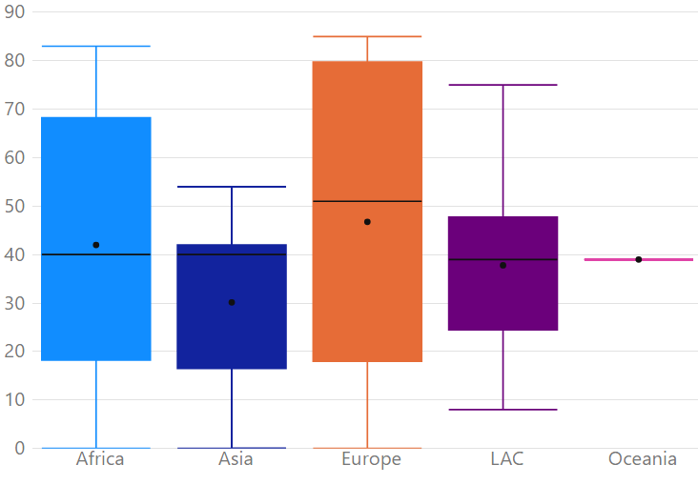
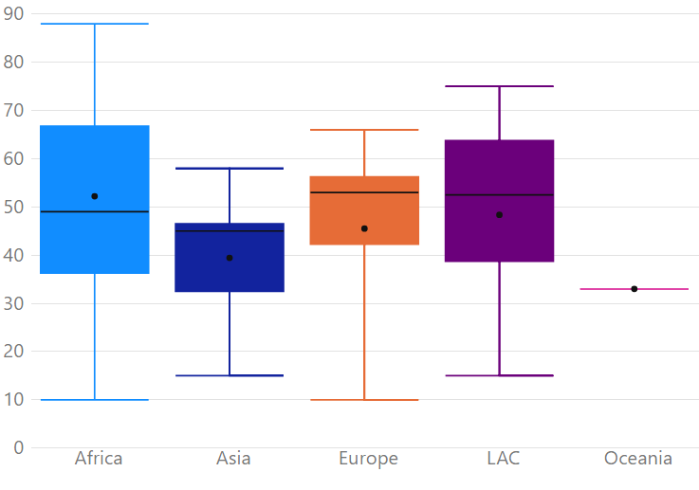
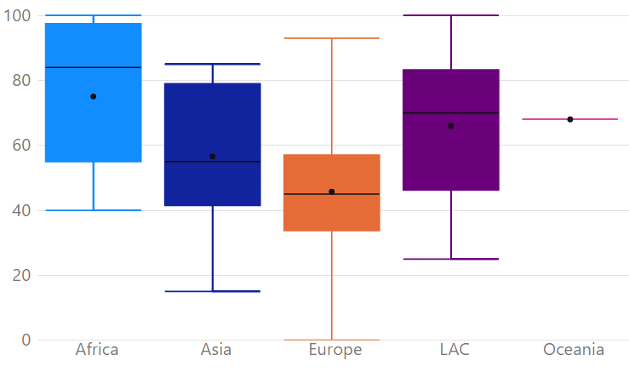
Results Reporting progress made in implementing and achieving NDCs
N=14
N=7
N=4
N=14
N=1
N=14
N=7
N=4
N=14
N=1
N=14
N=7
N=4
N=14
N=1
Institutional arrangements for tracking progress in implementing NDC
Data collection and management for tracking progress in implementing NDC
Procedures for monitoring progress in implementing NDC
Notes:
Number of countries
Africa: 14
Asia: 7
Europe: 4
LAC: 14
Oceania: 1
Box and whisker chart showing the extremes (min and max) for the group of countries in each region, the median as a line, the average as a dot, and the q1 and q3 distance filled out
25% of occurrences below q1
75% occurrences below q3

Slide 12
Key findings: reporting NDC implementation
In all regions, there is capacity to be built on institutional arrangements, though less in African countries
High variability on capacity for data collection and management - especially in Africa and Europe
Less variability on capacity related to procedures for monitoring, but significant work to be done there

Slide 13
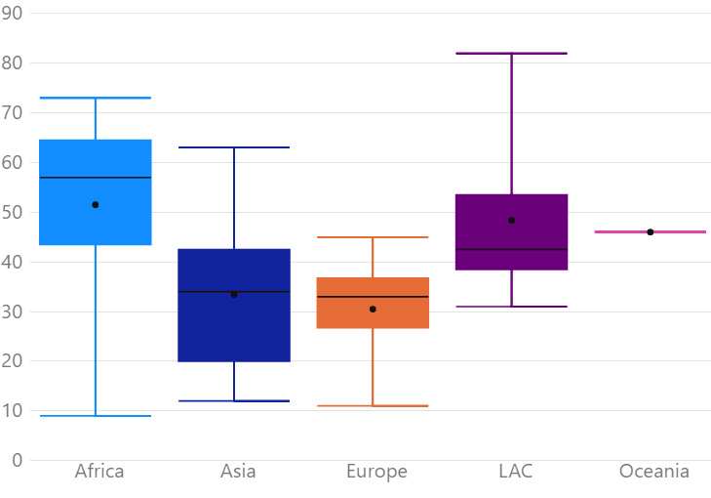
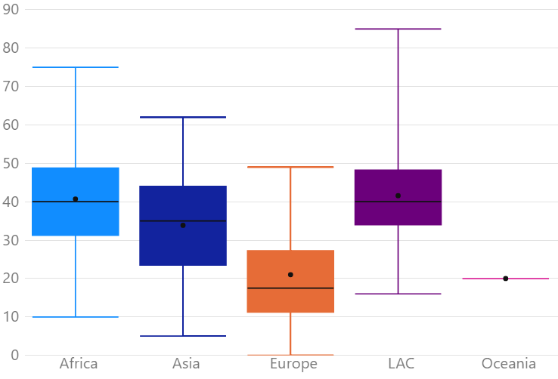
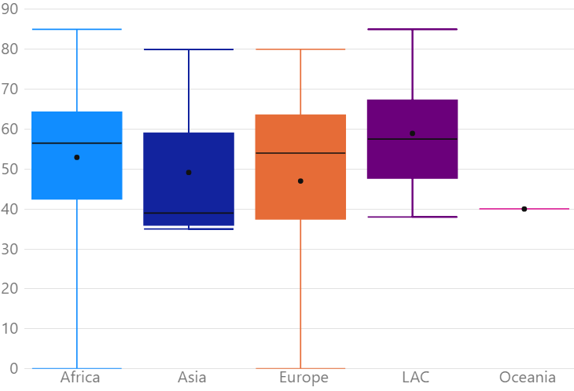
Results Reporting on climate change impacts and adaptation
N=14
N=7
N=4
N=14
N=1
N=14
N=7
N=4
N=14
N=1
N=14
N=7
N=4
N=14
N=1
Institutional arrangements for M&E climate change impacts and adaptation
Data collection and procedures for M&E climate change impacts and adaptation
Methodologies for planning & monitoring climate change impacts and adaptation
Notes:
Number of countries
Africa: 14
Asia: 7
Europe: 4
LAC: 14
Oceania: 1
Box and whisker chart showing the extremes (min and max) for the group of countries in each region, the median as a line, the average as a dot, and the q1 and q3 distance filled out
25% of occurrences below q1
75% occurrences below q3
P&M planning and monitoring

Slide 14
Key findings: climate change impacts & adaptation
In general lower capacity in all regions
Significant need for capacity building on institutional arrangements and on data collection and procedures for CBIT countries in Asia and Europe
There are capacity gaps also in terms of methodologies for planning and monitoring adaptation actions, but here the countries are more similar across regions

Slide 15
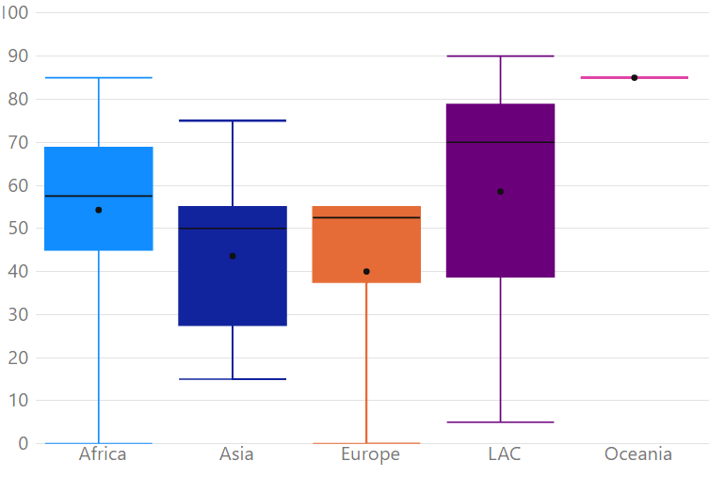
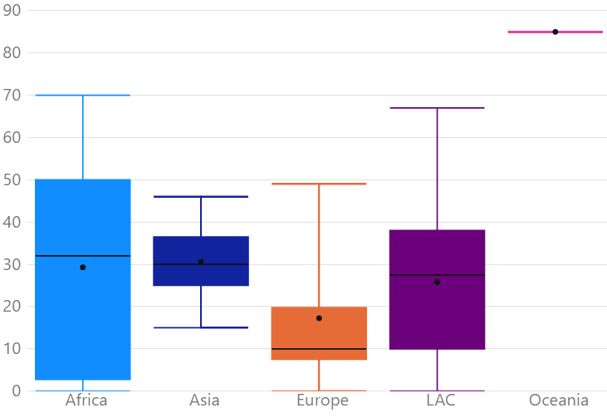
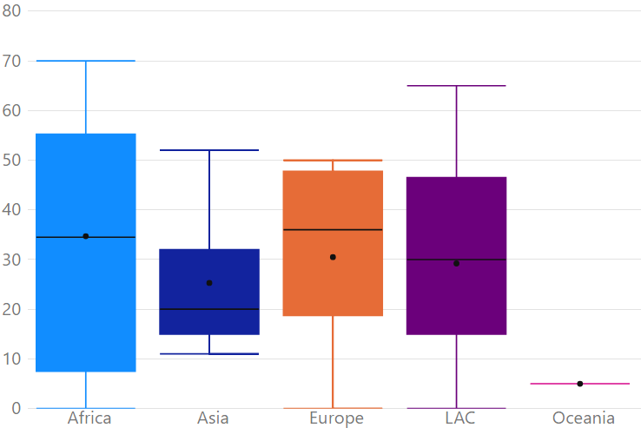
Results Reporting on financial, tech transfer, and CB support needed and received
N=14
N=7
N=4
N=14
N=1
N=14
N=7
N=4
N=14
N=1
N=14
N=7
N=4
N=14
N=1
Institutional arrangements for monitoring & reporting support needed and received
Procedures - support needed
Procedures - support received
Notes:
Number of countries
Africa: 14
Asia: 7
Europe: 4
LAC: 14
Oceania: 1
Box and whisker chart showing the extremes (min and max) for the group of countries in each region, the median as a line, the average as a dot, and the q1 and q3 distance filled out
25% of occurrences below q1
75% occurrences below q3

Slide 16
Key findings: reporting support needed & received
Progress to be done on institutional arrangements, higher variability in LAC region
Significant capacity gaps at the procedural level, which is quite low in all regions
Also high variability in terms of capacity for reporting support needed and received, especially in Africa and also a bit in LAC region and in Europe (for support received)

Slide 17
Future work
Revision of the tool, to integrate feedback from countries and MPGs
Clarity for users on what constitutes capacity for climate transparency
Possibility to mark answers to sections of the tool as unchanged
Notes:
GEF suggested to have a graphical depiction of what it means to have 100% in each part of the self-assessment.
Revise both the substance and the methodology of analysis
12 out of 40 said the tool reflected well the capacity in the country (30%). The others did not comment on this

