Slide 1







Tracking Progress of the Mitigation Commitments of Nationally Determined Contributions (NDCs)
Presentation: Summary of filling reporting tables using
GACMO and LEAP
Dr Aiymgul Kerimray
Mitigation specialist
UNEP Copenhagen Climate Centre

Slide 2
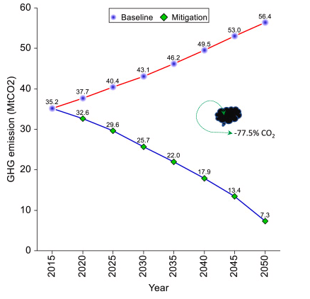
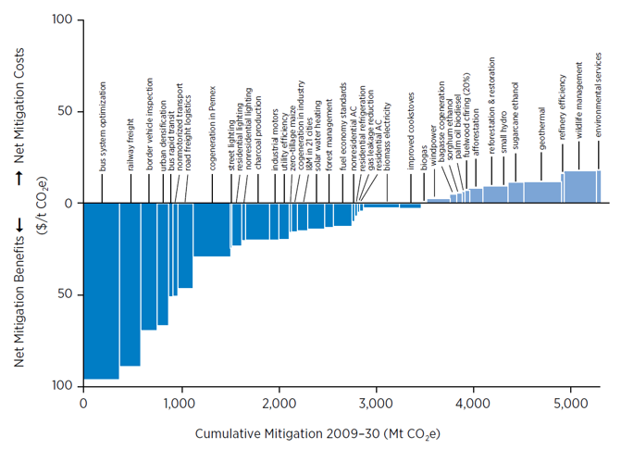
GACMO and LEAP can support to define the target level for the NDC
GACMO/LEAP models can be useful to identify NDC target levels:
  Sectoral targets consistent with the economy-wide targets
  MACC/MARC curves can be useful to select the set of mitigation options
Marginal Abatement Cost Curve (MACC) Summary Reports (sei.org)
Energy system analysis with a focus on future energy demand projections: The case of Norway - ScienceDirect

Slide 3
CTF tables for the electronic reporting of the information necessary to track progress made in implementing and achieving NDCs
NDC definition and methods
Appendix: Description of a Party´s NDC
Current mitigation status and tracking progress
Table 4: Tracking progress
Projections and expected emissions reduction
Table 7: Projections “with measures” scenario
Table 1: Description of selected indicators
Table 2: Definitions needed to understand the NDC
Table 3: Methodologies and accounting approaches
Table 5: Mitigation policies, measures, actions and plans (Achieved)
Table 6: Inventory summary
Table 8: Projections “with additional measures” scenario
Table 9: Projections “without measure” scenario
Table 10: Projections of key indicators
Table 11: Key underlying assumptions and parameters of projections
Table 5: Mitigation policies, measures, actions and plans (expected)
Response measures
Table 12. Information necessary to track progress on the implementation and achievement of the domestic policies and measures implemented to address the social and economic consequences of response measures

Slide 4
Projections of GHG emissions
GACMO:
GHG emissions projections by sectors
CO2 emissions
Other Gases
Two scenarios: BAU scenario, mitigation scenario
Projections
(with and without LULUCF)
With measures (shall)
Implemented and adopted policies and measures
Without measures (may)
Excludes all policies and measures after the cut-off date
With additional measures (may)
Implemented, adopted and planned policies and measures
CTF tables 7, 8, 9
LEAP:
GHG emissions projections by sectors
Projections by gases
(user defines the selection of the gases)
Number of scenarios defined by the user

Slide 5
CTF Table 10. Projections of key indicators
Table 1.
Description of selected indicator
Table 2.
Definitions needed to understand NDC
Table 4.
Track progress
Table 10. Projections of key indicators
LEAP
GACMO

Slide 6
Assessment of the impact of the individual policies and measures
GACMO, LEAP
Objectives
Sectors affected
Gases affected
Mitigation policy and measure
Estimates of GHG emissions reductions
Expected
Achieved
CTF Table 5. Mitigation policies, measures, actions and plans
GACMO and LEAP can be used to estimate individual effect of mitigation policy

Slide 7
Summary of filling reporting tables using
GACMO and LEAP
Results of the models
Input data to the model
GACMO, LEAP can support filling in several CTF tables
CTF Table 7. Projections ‘with measures’ scenario
CTF Table 8. Projections ‘with additional measures’ scenario
CTF Table 9. Projections ‘with additional measures’ scenario
CTF Table 10. Projections of key indicators
CTF Table 3. Methodologies
CTF Table 11. Key underlying assumptions used for projections
CTF Table 5. Mitigation policies and measures (emission reduction)

Slide 8

Thank you!
Aiymgul Kerimray – aiymgul.kerimray@un.org

