Slide 1


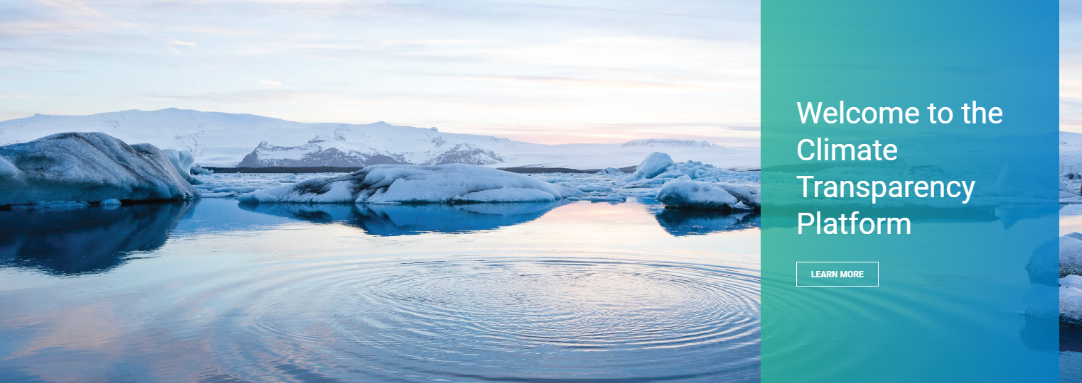


Introduction to the Climate Transparency Platform
Fatima Zahra Taibi & Jaypalsinh Chauhan
UNEP Copenhagen Climate Centre

Slide 2











CBIT-GSP at a Glance
Main Project Information
Project duration: 2022-2026 Project budget: ~ 9 Million USD
Merging and Continuation of Previous Transparency Programmes
Funded by:
Implemented by: Executed by:
CBIT-GSP Objectives
Support developing countries in the transition to the BTRs,
Provide the global transparency community with a
Help countries with
mainstreaming gender
and with the submission of NCs and last BURs
one-stop shop for transparency (Online Platform)
considerations in
climate transparency

Slide 3







Gender and Knowledge
Gender
Knowledge Products
Update of the Gender Toolkit
Trainings
Assistance to countries in integrating the UNFCCC Gender Action Plan into enhanced transparency frameworks
Different knowledge products: good practice briefs, guidance documents, summaries of important COP and SB decisions
Guidance material is needs-based
Close coordination with other partners to avoid duplication of products
Different webinars, e.g., Closing Conversations with CBIT Countries

Slide 4
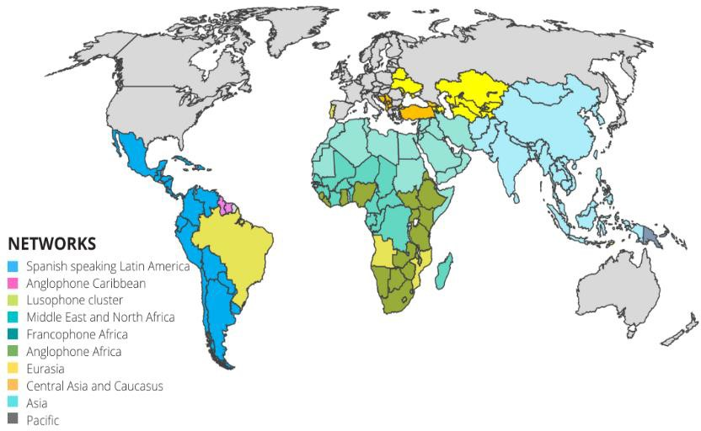
CBIT-GSP Support Modalities
Main Mediums of Support
Regional Transparency Networks
Regional Transparency Networks
Direct Support to Countries in Prioritized Areas In-Country Trainings & Activities
Regional and Global Workshops Quality Review of Transparency Reports
Knowledge Products
Updated Gender Toolkit and support for ímplementation

Slide 5

CBIT-GSP : Networks
Main medium to provide support and foster south-south collaboration and knowledge exchange
Nomination of Focal Points
Capacity Needs Assessment
Development of Network Workplan
Launch of 8 Transparency Networks
Regional and In-country Support
Countries nominated Focal Points for the project and the different ETF reporting areas (GHG inventory, NDC tracking, adaptation, and support needed and received)
Comprehensive survey with all countries in 8 network to determine their needs and priorities
Development of the Networks workplans based on capacity needs assessment
Launch of the Networks with countries and collecting feedback on workplans
Implementation of activities, both at regional and national activities, according to workplans and incoming support requests by countries

Slide 6
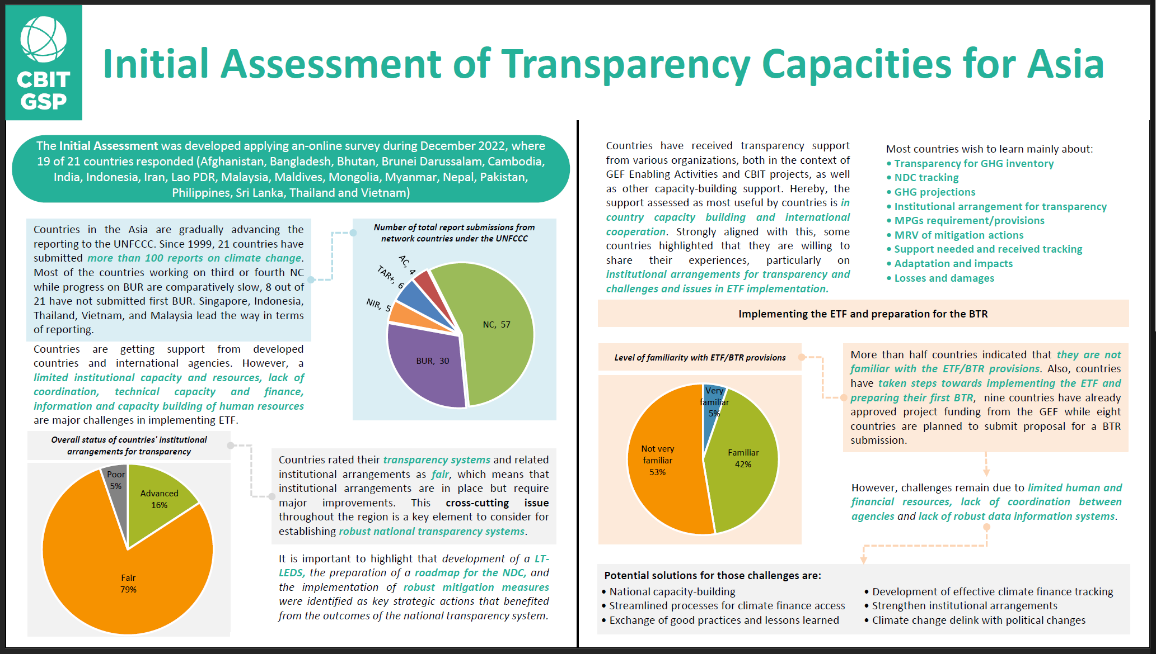
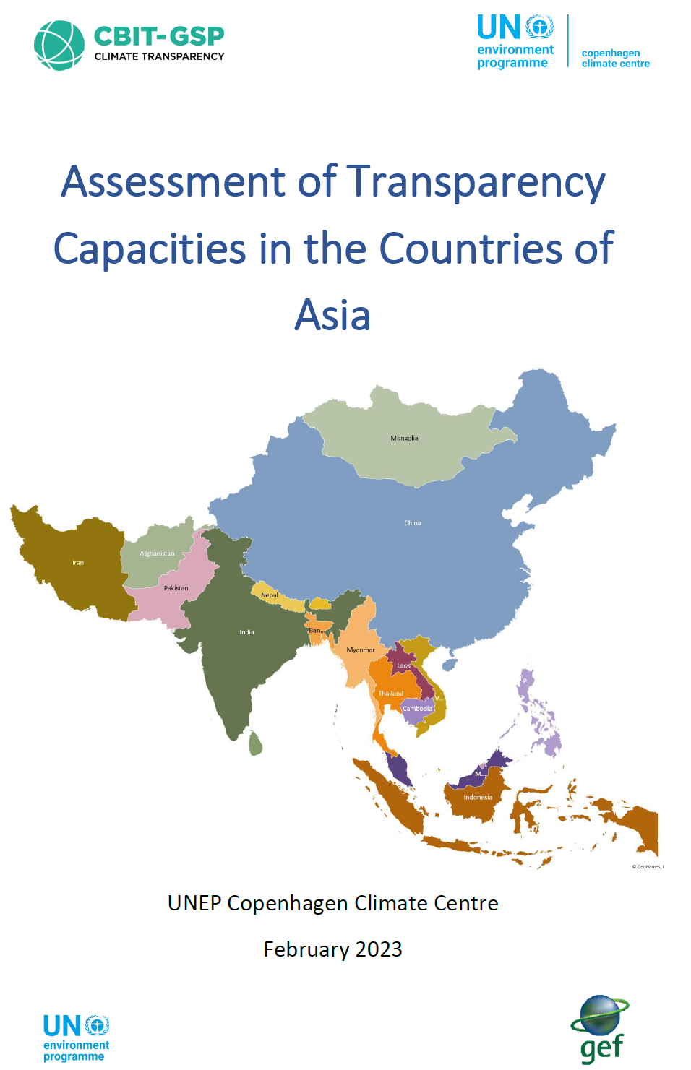
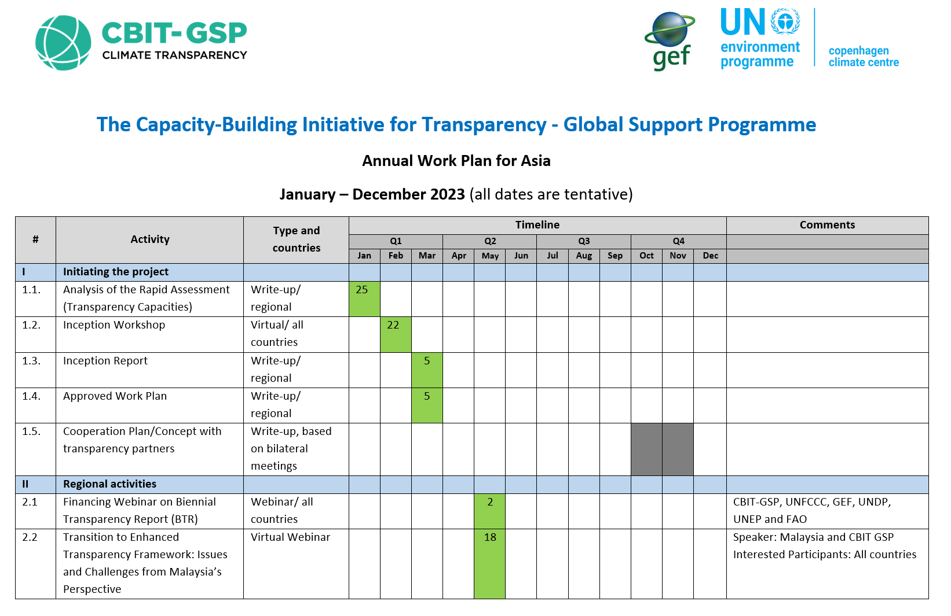
Activities in Asia
Virtual/Physical events:
Capacity need assessment Survey
Kick-off Meeting: Initiating the Global Capacity-Building Initiative for Transparency - 22 February 2023
Training workshop on transitioning to the ETF and tracking of progress in implementing and achieving
NDCs for Asia Region – 8 - 10 March 2023
Webinar on GEF Support for BTR Financing and Access Modalities (for Asia and Pacific) - 2 May 2023
Transition to Enhanced Transparency Framework: Issues and Challenges from Malaysia’s Perspective - 18 May 2023
Institutional Arrangements for Transparency: Best Practices and Lessons Learned from Singapore - 25 May 2023
Benefits and Outcomes of Capacity Building Initiative for Transparency (CBIT) Project: Lessons Learned from Bangladesh -
22 June 2023
Introductory Webinar on Tracking Progress of the Mitigation Commitments of Nationally Determined Contributions (NDCs)
- 16 August 2023
Introduction to the Climate Transparency Platform for the Asia Transparency Network - 24 August 2023
In-country support:
Mongolia: Technical analysis of Mongolia’s Second BUR and NIR – May June 2023
India: Technical review of GHG inventory chapter of TNC – March April 2023
Nepal: Enhancing National Greenhouse Gas Inventory Management System for Nepal – August 2023

Slide 7





















CBIT-GSP Activities so far: Quality Review of Transparency Reports
23 Quality Reviews conducted so far
How to access support for the quality
review of BUR/NC/NIR/BTR
Samoa, NIR & BUR1
Niger, BUR1
Saint Kitts & Nevis, NC3
Guinea, NIR
Burundi, BUR1
Contact your GEF Implementing Agency (UNEP, UNDP, FAO…)
Contact the CBIT-GSP Team directly
Brunei, NC3
Zimbabwe, NC
Micronesia, NIR & NC3
Democratic Republic
Of Congo, BUR1
Kiribati, NC3 & BUR1
Mali, BUR1
Jordan, NC4
Zimbabwe, NC4
Solomon Islands, NC3
Peru, BUR3
Suriname, NC3
Guatemala, BUR1
Panama, NC4
Mongolia, BUR2, NIR2
India, GHG Inventory of TNC

Slide 8

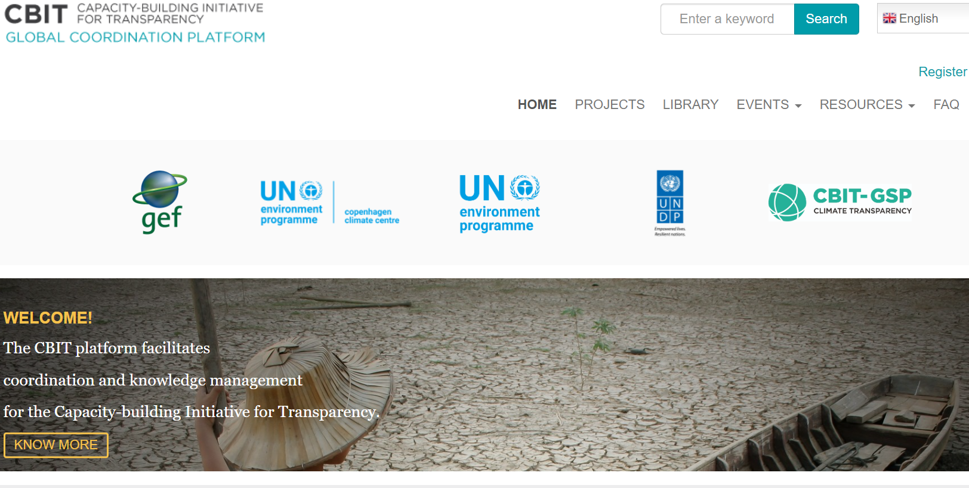

The Climate Transparency Platform in a Nutshell
CBIT Global Coordination Platform
Global Support Programme
Funded by:
Implemented by:
Executed by:
Climate Transparency Platform

Slide 9
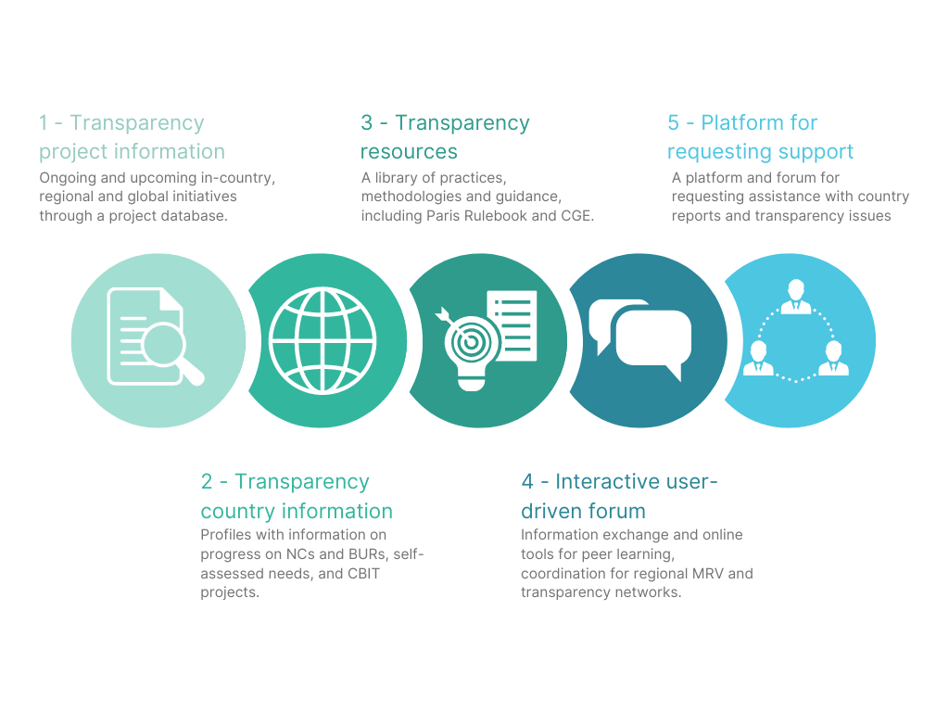
Objective of the Climate Transparency Platform
Provide countries and support providers with a one-stop knowledge clearing house on climate transparency

Slide 10

Stakeholder Consultations for the Platform
During Q2 2022, 5 consultations held with transparency experts, country & project focal points, and international agencies & initiatives
Objective:
  Identify and define key functionalities
  Identify challenges and areas to address, from experience in previous platforms
  Define new features e.g., request for support, stakeholder roles, forum, and regional transparency networks
  Identify useful features to show in the main pages and interactive maps
  Agree on national transparency information relevant to feature in country pages

Slide 11
Functionalities of the Climate Transparency Platform
Global overview of transparency
At a glance global transparency information through dynamic maps
Latest information on transparency events, news, opportunities and knowledge products
Detailed transparency information
Staying up-to-date on the latest development in the transparency space
Country Profiles with information on transparency reports, events, news and all projects in the country
Project database of all transparency projects
Project Profiles with relevant project details, project news & events, project documents, and implementation progress
Peer-to-peer exchange and learning
Dedicated spaces for Transparency Networks, including Network Forum
Communities of Practice place (still under development) for all registered users as a dynamic hub for thematic discussions, knowledge sharing, and important announcements
Agency Pages with detailed information on projects and how to access support
Coordination among support providers
Planning tool for support providers on upcoming trainings, events and knowledge products
Country profiles with list of all transparency projects
One-Stop Shop for Transparency -
Owned by all Climate Transparency Stakeholders

Slide 12

Climate Transparency Platform – Built by the Global Transparency Community
A platform for and by the Climate Transparency Community
  The Climate Transparency Community has an integral role in building and improving the Platform
  Shared responsibility among all to keep it updated and useful for everyone
Please engage in the platform and make it your own space. We are very curious to hear your feedback and ideas!

Slide 13

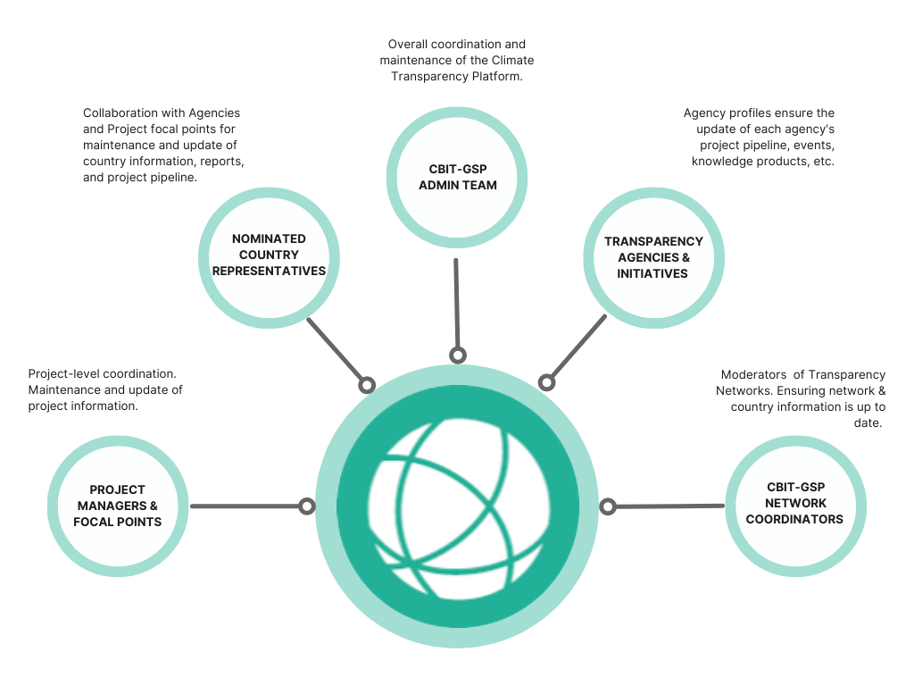

Different User Groups
  Content Editors
  Network Users and Other Users
Engage in the forums

Slide 14
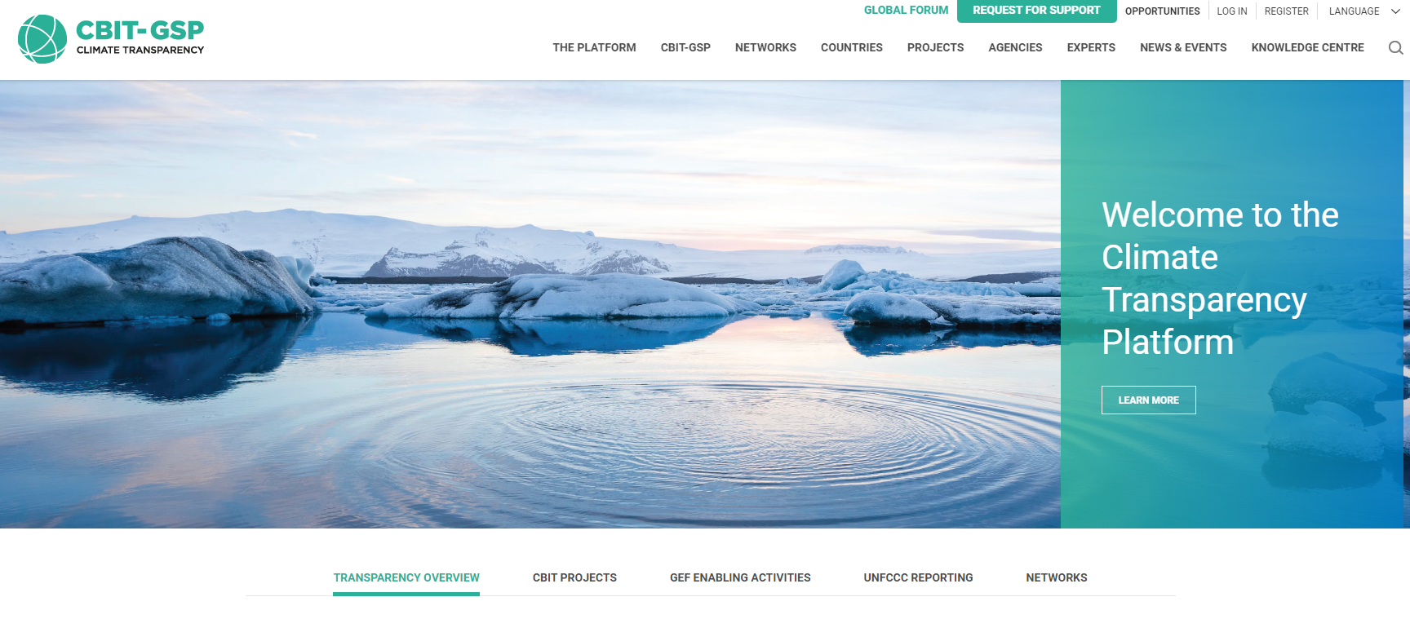

Demonstration of the Climate Transparency Platform
www.climate-transparency-platform.org

Slide 15
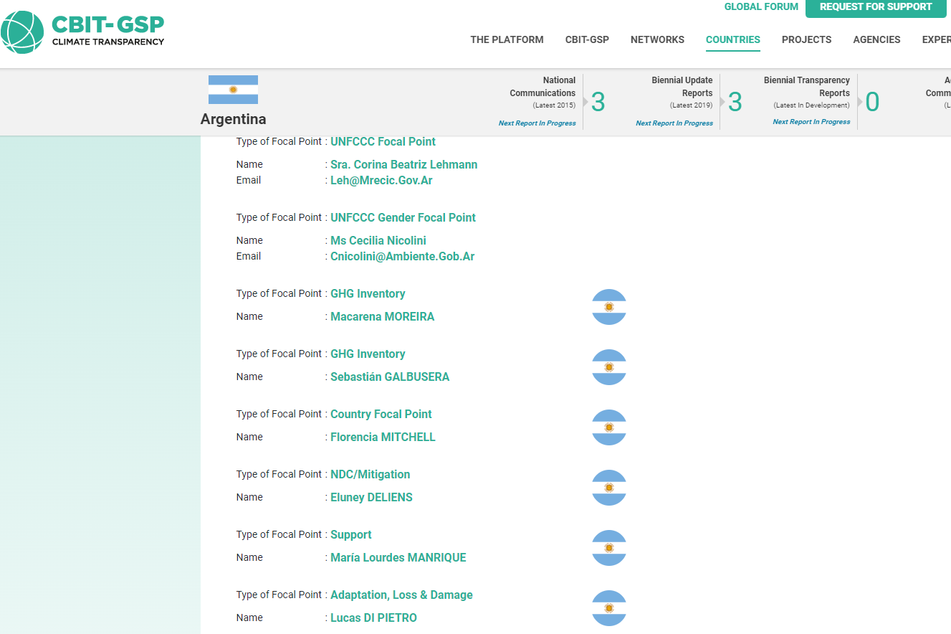
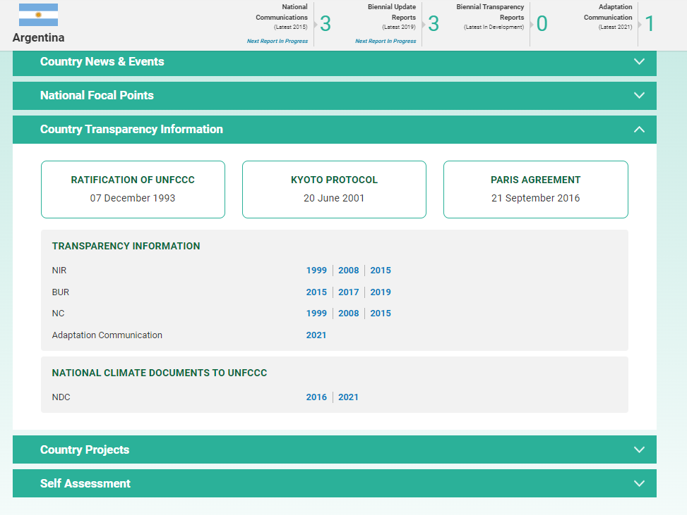
User Role: Nominated Country Focal Points under the CBIT-GSP
  Nominated Focal Points under the CBIT-GSP:
  General CBIT-GSP Project Focal Point, called “Country Focal Point”
  Thematic Focal Points:
    GHG Inventory
    NDC/Mitigation
    Adaptation
    Loss & Damage
    Support
Editing rights for the Country Profile

Slide 16
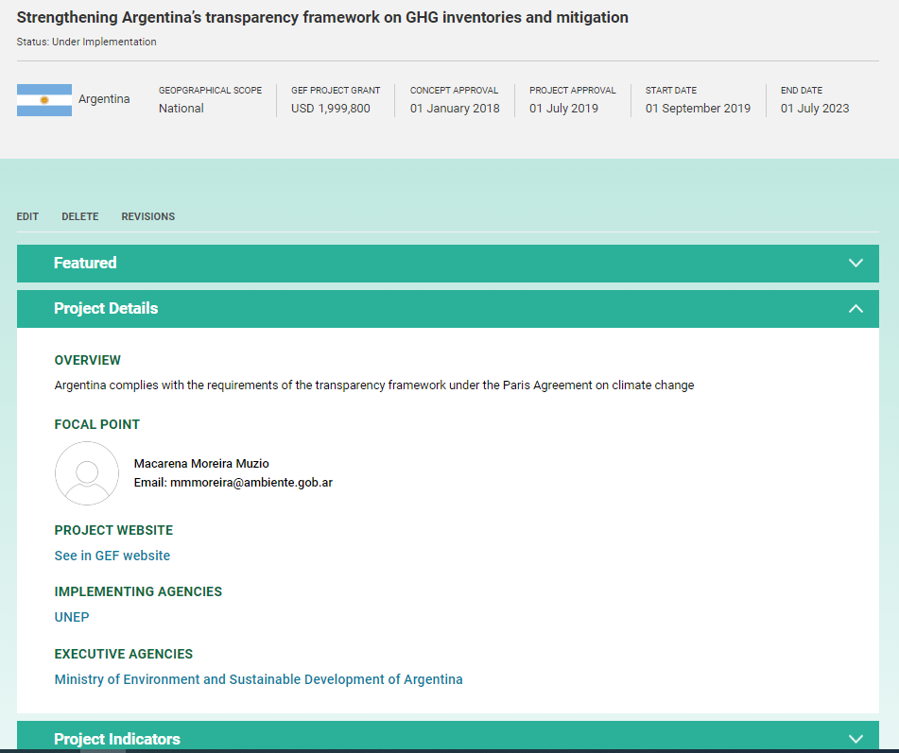
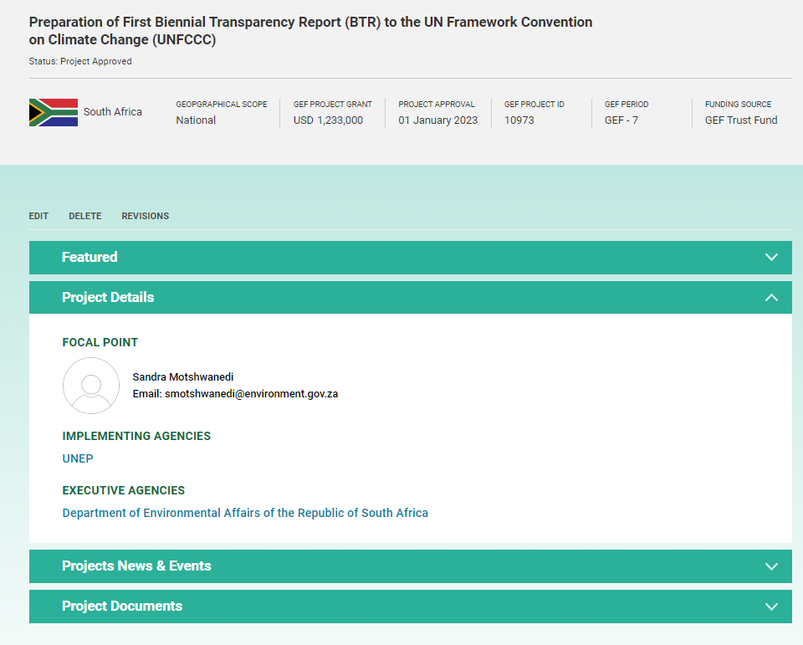
User Role: Project Manager for CBIT Projects or GEF Enabling Activities
  Project Manager for CBIT Projects
  Project Manager GEF Enabling Activities
Editing rights for the CBIT Project
Editing rights for the GEF EA Project

Slide 17
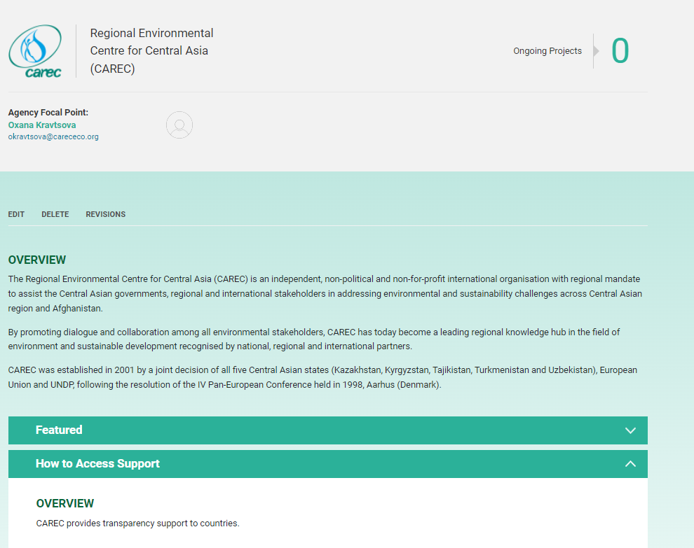
User Role: Agency Focal Point
  Agency Focal Points
Editing rights for the Agency Page and relevant project pages

Slide 18

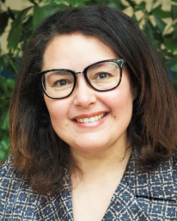
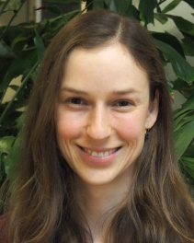
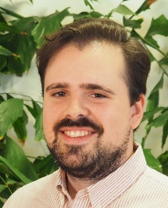

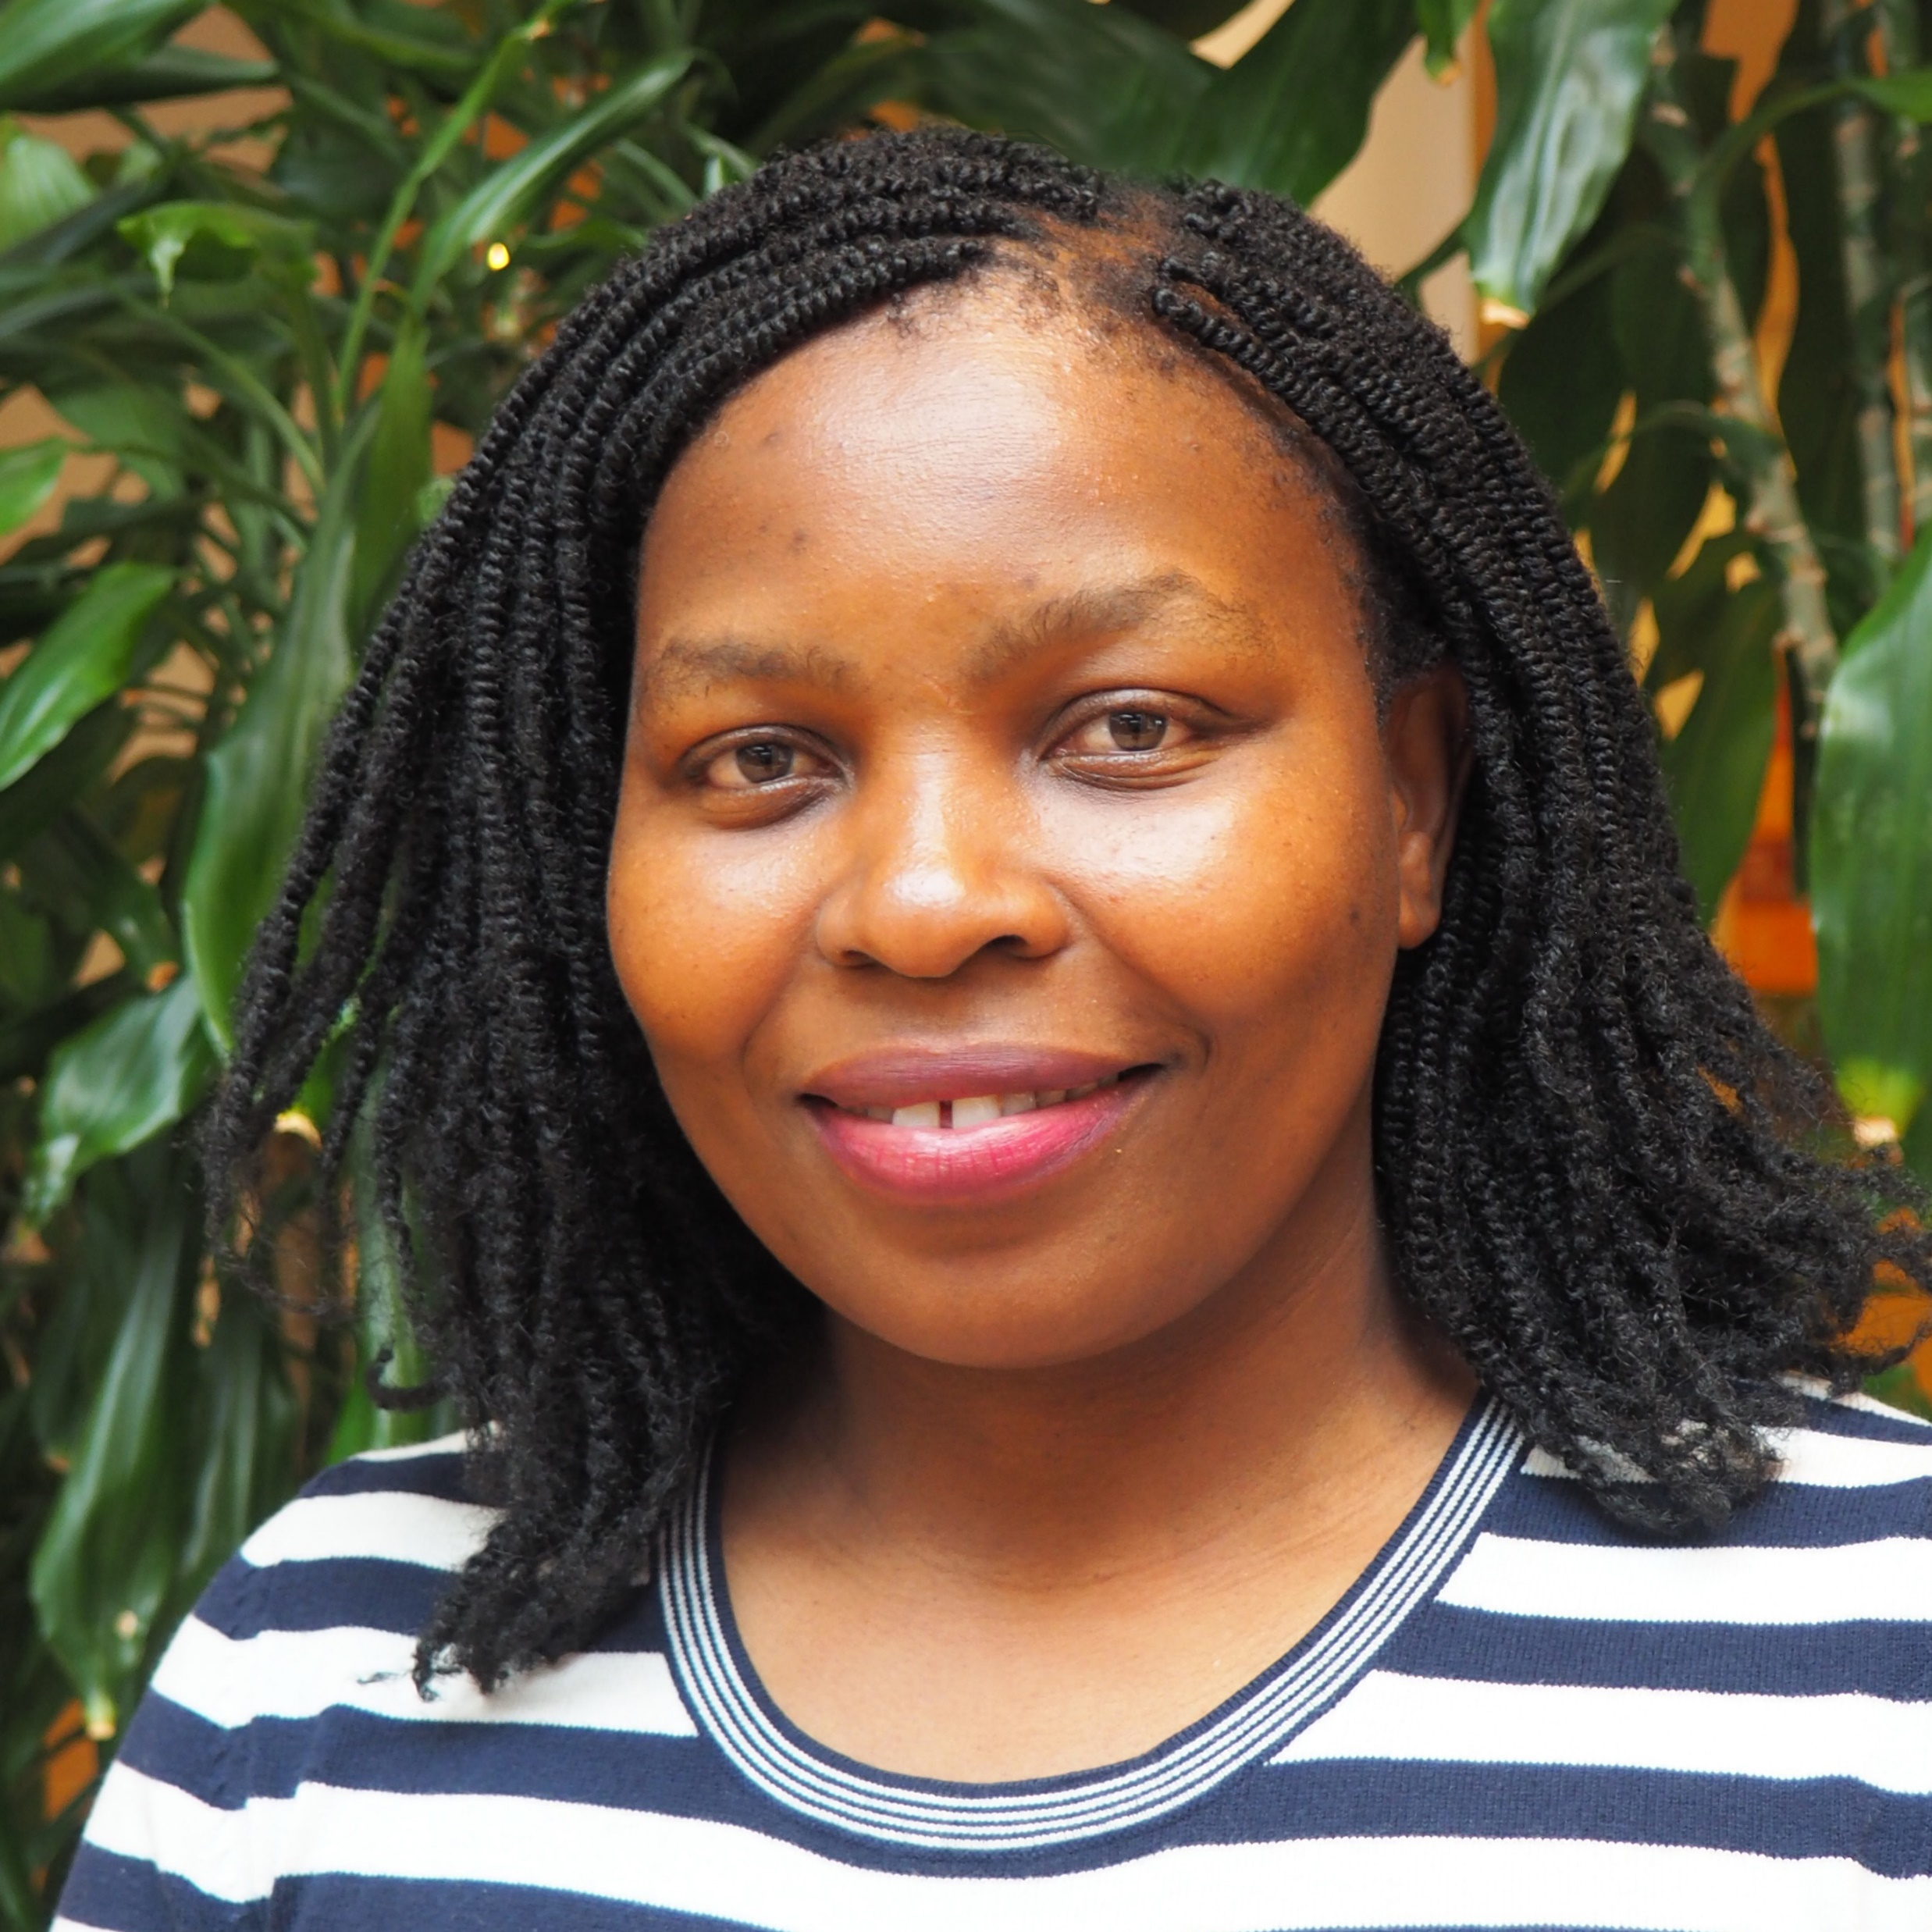
Thank you for your attention
Please reach out to us for any question, comments or suggestions!
Asia Network Coordinator
Jaypalsinh CHAUHAN
jaypalsinh.chauhan@un.org
Global CBIT-GSP
Coordinator
Fatima-Zahra TAIBI
fatima-zahra.taibi@un.org
CBIT-GSP Project Officer
Susanne KONRAD
susanne.konrad@un.org
CBIT-GSP Project Officer
Alejandro REGATERO
alejandro.regaterolabadia@un.org
CBIT-GSP Transparency Officer
Khetsiwe KHUMALO
khetsiwe.khumalo@un.org
CBIT-GSP Project Officer
Juliette LUNEL

