Slide 1








Introduction and Explanation of CTF Tables and Exercise:
Filling CTF Tables 3 and 4: Methodologies, Accounting and Tracking progress of NDC
Tracking Progress of the Mitigation Commitments of Nationally Determined Contributions (NDCs)
11 September 2023
Seoul, Republic of Korea
Aiymgul Kerimray
Mitigation specialist
UNEP Copenhagen Climate Centre

Slide 2
CTF tables
Appendix
NDC description (targets)
Table 1
Structured summary:
Indicators
Table 2
Structured summary:
Definitions
Table 3
Table 4
Table 10
Structured summary:
Methodologies
Structured summary:
Tracking progress
Projections:
Key projection indicators

Slide 3
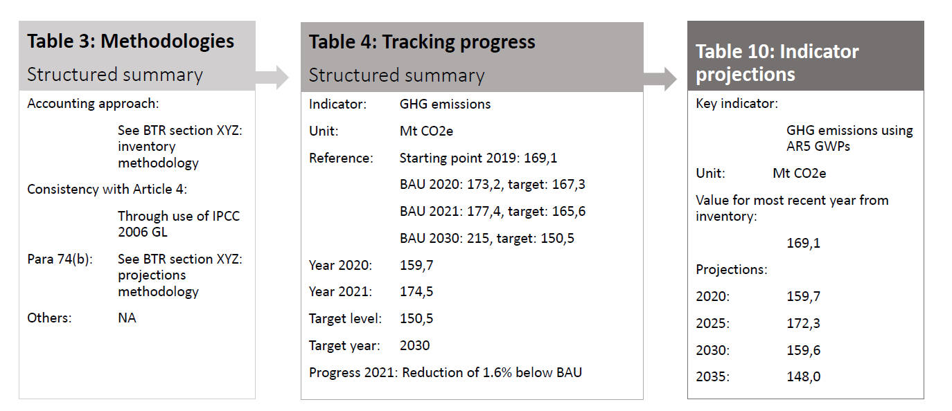
Examples of CTF tables 3, 4 and 10
Source: UNFCCC, CGE Training materials. Mitigation Assessment

Slide 4
CTF tables to fill with country dataлнения
CTF Table 4
Structured Summary: Tracking Progress Made in Implementing and Achieving NDCs
CTF Table 3
Structured summary: Methodologies and approaches to accounting

Slide 5
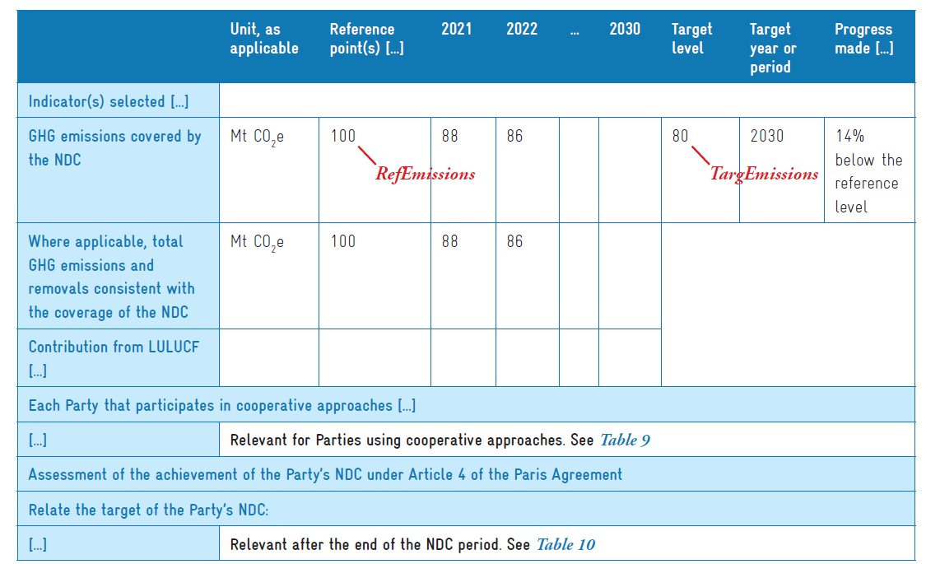
Example of a completed CTF table 4 for tracking progress
Source: Partnership on Transparency in Paris Agreement, Accounting for National Determined Contributions

Slide 6
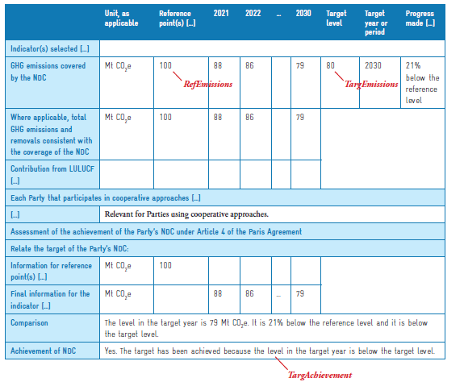
Example of completed table 4 (after the end of the NDC period)
Source: Partnership on Transparency in Paris Agreement, Accounting for National Determined Contributions

Slide 7
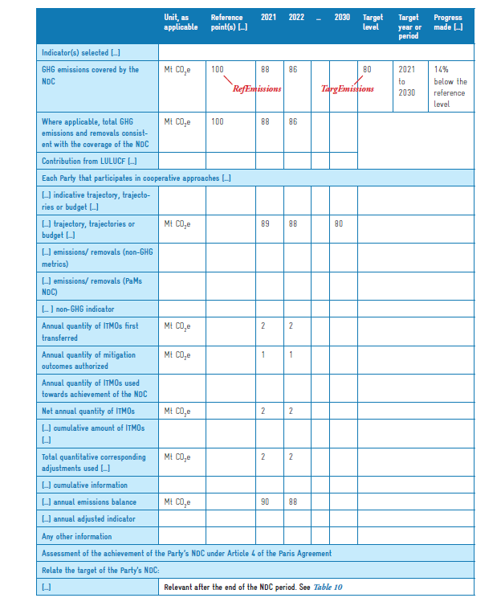
Example of a completed table 4 (with ITMOs)
Source: Partnership on Transparency in Paris Agreement, Accounting for National Determined Contributions

Slide 8
Table 4 CTF. Structured Summary: Tracking Progress Made in Implementing and Achieving NDCs
Complete CTF Table 4 using data for your country and examples of completed tables.
 | Unit, as applicable | Reference point(s), level(s), baseline(s), base year(s) or starting point(s) | Implementation period of the NDC covering information for previous reporting years and the most recent year, including the end year or end of period |  |  |  |  |  | Target level | Target year or period | Progress made towards the NDC, as determined by comparing the most recent information for each selected indicator, including for the end year or end of period, with the reference point(s), level(s), baseline(s), base year(s) or starting point(s)
 |  |  | Year 1 | Year 2 | … | … | … | End Year
Indicator(s)

Slide 9
CTF Table 3. Structured summary: Methodologies and accounting approaches
Information can be reported in the common tabular format or a reference to the relevant section of the BTR can be provided:
Methodologies and accounting approaches
Metrics and IPCC guidelines
Assumptions, key parameters, definitions, data sources, models
Consistency (communicated and implemented NDC; accounting for NDC and GHG inventory)
Changes (corrections, improvements, updates)
Inclusion of all relevant categories, and exclusions
Information associated with any cooperative approaches that involve use of ITMOs, if applicable

Slide 10
Table 3. Methodologies and accounting approaches
Article 4, para 13-14 Paris Agreement
13. Parties shall account for their nationally determined contributions. In accounting for anthropogenic emissions and removals corresponding to their nationally determined contributions, Parties shall promote environmental integrity, transparency, accuracy, completeness, comparability and consistency, and ensure the avoidance of double counting, in accordance with guidance adopted by the Conference of the Parties serving as the meeting of the Parties to this Agreement.
14. In the context of their nationally determined contributions, when recognizing and implementing mitigation actions with respect to anthropogenic emissions and removals, Parties should take into account, as appropriate, existing methods and guidance under the Convention, in the light of the provisions of paragraph 13 of this Article.
Accounting approaches:
Not official definition, but useful to work with Table 3 of the CTF:
In the case of NDC and tracking mitigation
Accounting approaches:= how the variety of elements that can be used to estimate numerical values of GHG emissions and mitigation potentials are used, including methodologies (IPCC), metrics (GWP), baselines, definitions..

Slide 11
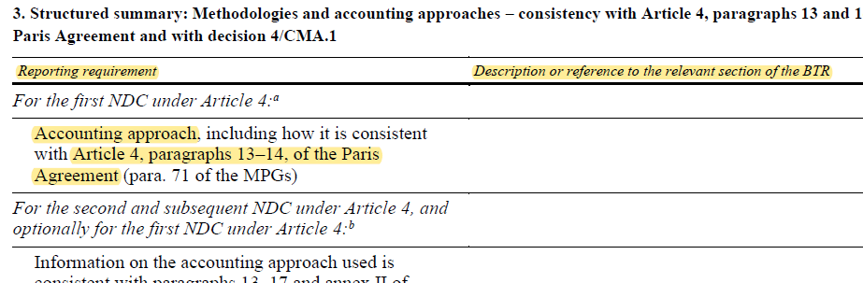
CTF Table 3. (1)

Slide 12
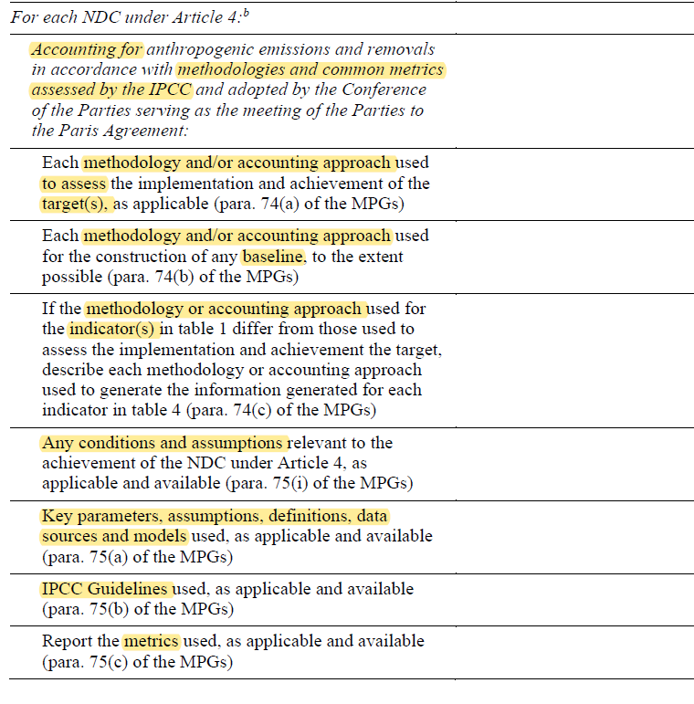
CTF Table 3. (2)

Slide 13
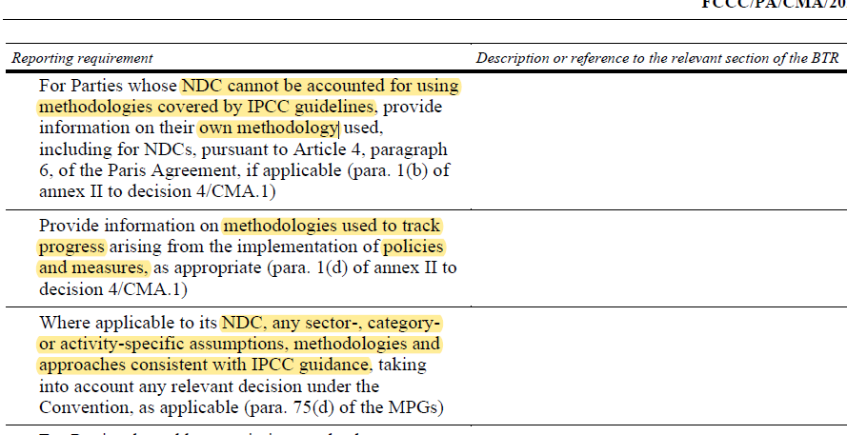
CTF table 3 (3)

Slide 14
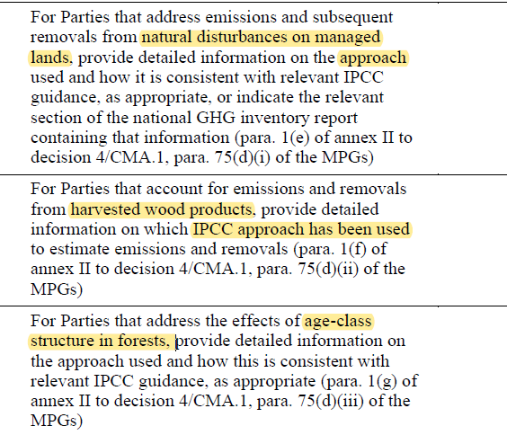
CTF table 3 (4)

Slide 15
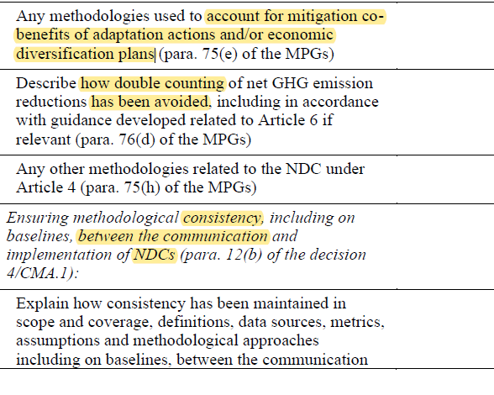
CTF table 3 (5)

Slide 16
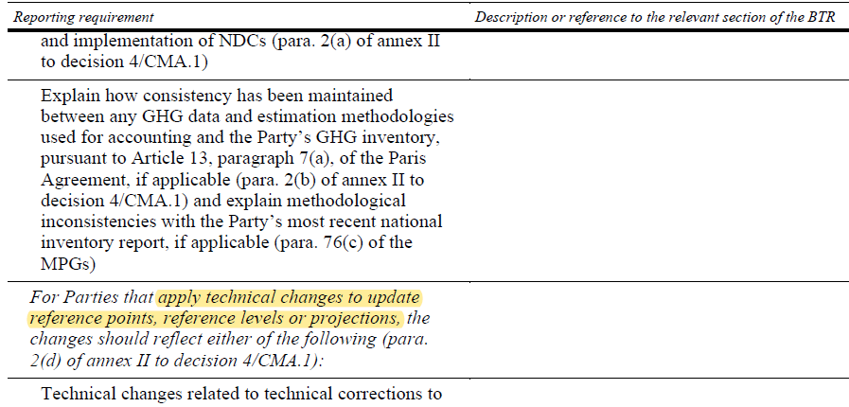
CTF table 3 (6)

Slide 17
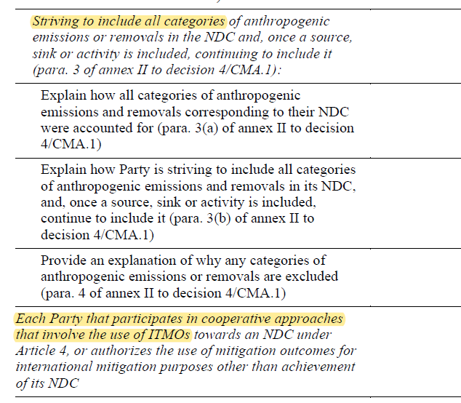
CTF table 3 (7)

