Slide 1








Tracking Progress of the Mitigation Commitments of Nationally Determined Contributions (NDCs)
Introduction and explanation of tables and Exercise:
Filling CTF Table 5: Mitigation policies and measures, actions and plans
Dr Aiymgul Kerimray
Mitigation specialist
UNEP Copenhagen Climate Centre

Slide 2
Content
Exercise 1 with filling in CTF Table 5: Mitigation policies and measures, actions and plans
Exercise 2 with estimating CO2 emissions reduction from mitigation measure

Slide 3
CTF Table 5: Mitigation policies and measures, actions and plans
Appendix: Description of a Party´s NDC
Table 1: Description of selected indicators
Table 2: Definitions needed to understand the NDC
Table 3: Methodologies and accounting approaches
Table 4: Tracking progress
Table 5: Mitigation policies, measures, actions and plans
Table 6: Inventory summary
Table 7: Projections “with measures” scenario
Table 8: Projections “with additional measures” scenario
Table 9: Projections “without measure” scenario
Table 10: Projections of key indicators
Table 11: Key underlying assumptions and parameters of projections
Table 12. Response measures

Slide 4
CTF Table 5: Mitigation policies and measures, actions and plans, including those with mitigation co-benefits resulting from adaptation actions and economic diversification plans, related to implementing and achieving a nationally determined contribution under Article 4 of the Paris Agreement
Name | Description | Objectives | Type of instrument | Status | Sector(s) affected | Gases affected | Start year of implementation | Implementing entity or entities | Estimates of GHG emission reductions
 |  |  |  |  |  |  |  |  | Achieved | Expected

Slide 5
CTF Table 5
Parties should focus on information that has the most significant impact on GHG emissions or removals and that affects key categories in the national GHG inventory.
Information that parties “shall” provide in a tabular format | Information that parties “may” provide
Name | Costs
Description | Non-GHG mitigation benefits
Objectives | How the mitigation actions interact with each other, as appropriate
Type of instrument (regulatory, economic or other)
Status (planned, adopted or implemented)
Sector(s) affected (energy, transport, industrial processes and product use, agriculture, LULUCF, waste management or other)
Gases affected
Start year of implementation
Implementing entity or entities

Slide 6
Estimates of expected and achieved GHG emission reductions as a result of its PAMs
“Shall” requirement
Those developing country Parties that need flexibility in the light of their capacities with respect to this provision are instead encouraged to report such information.
Parties must describe the methodologies and assumptions used to estimate the GHG emission reductions or removals resulting from each PAM.

Slide 7
Fill in the CTF Tables 5
Data for your country Table C "Tables to be filled by participants“, Table C
Fill in CTF Table 5 CTF_Tracking_Progress_NDC_Template_Clean
Example of Table 5 for Mauritius
Example for Belize

Slide 8
Example of the CTF Table 5 for Mauritius
Name | Description | Objectives | Type of instrument | Status | Sector(s) affected | Gases affected | Start year of implementation | Implementing entity or entities | Estimates of GHG emission reductions (kt CO2 eq)
 |  |  |  |  |  |  |  |  | Achieved | Expected in 2030
Improved fuel economy of vehicles | Improvements in the fuel intensity of vehicles at the rate of 0.5% per year between 2022 and 2030, decreasing to 0.25% per year after 2030. | Technological improvements, better fuel economies. | Regulatory, economic | Planned | Transport | CO2, CH4, N2O | 2021 | MLTLR; TMRSU; Mauritius Standards Bureau (MSB); National Land Transport Authority (NLTA). |  | 6.7

Slide 9
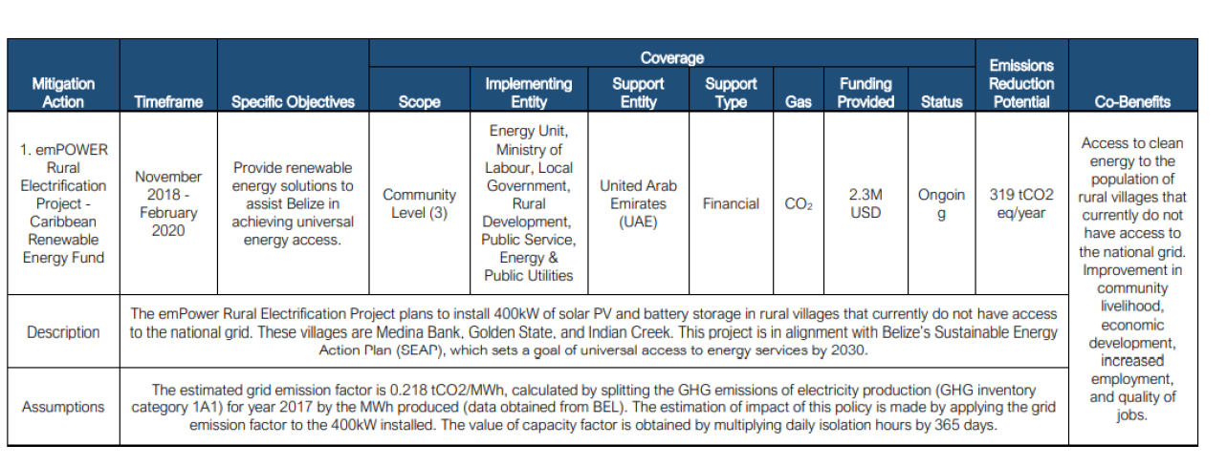
Example of Belize
Source: NC4

Slide 10
Exercise 2. Estimating CO₂ emissions reduction from the three mitigation measures
Estimate CO₂ emissions reduction for 3 mitigation measures using template provided
Template contains examples of three mitigation measures:
Open excel temple for estimating emissions reduction
Review the data in yellow cells and update it with your own country-specific data (Table C in Data Collection Table)
1000 LED lamps replacing 1000 incandescent bulbs
1MW Solar PV (on-grid)

Slide 11
Approach for the calculation of emission reduction for a mitigation option
Example of efficient lighting
LED lamps replacing incandescent light bulbs
Emissions in reference option (incandescent light bulbs)
Emissions in reduction option (LED lamps)
Emission reduction from mitigation measure

Slide 12
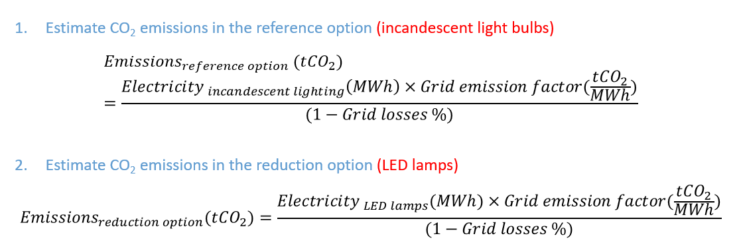
Approach for the calculation of emission reduction for a mitigation option

Slide 13
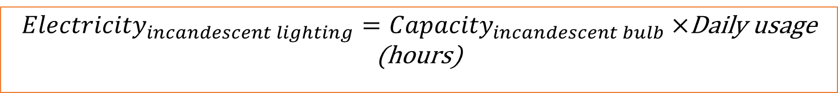
Estimation of the electricity consumption in the reference option and reduction option
${Electricity}_{incandescent lighting}={Capacity}_{incandescent bulb}×$Daily usage (hours)
${Electricity}_{ LED lighting}={Capacity}_{LED bulb}×$Daily usage (hours)
Reduction option: LEDs
Average W of LED lamps | 9.0 | W
Daily usage | 7.00 | hrs
Electricity for LED lighting | 23 | MWh/year
Reference option: Incandescent bulbs
Average W of replaced lamps | 60.0 | W
Electricity for incandescent lighting | 153 | MWh/year

Slide 14
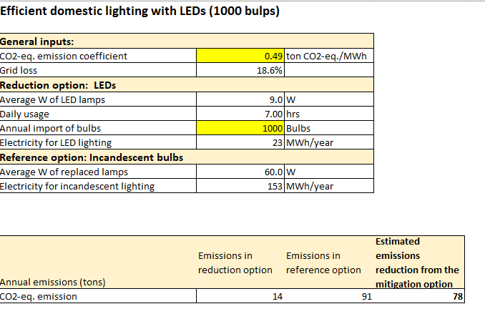
Example of the table for efficient domestic lighting with LEDs

Slide 15
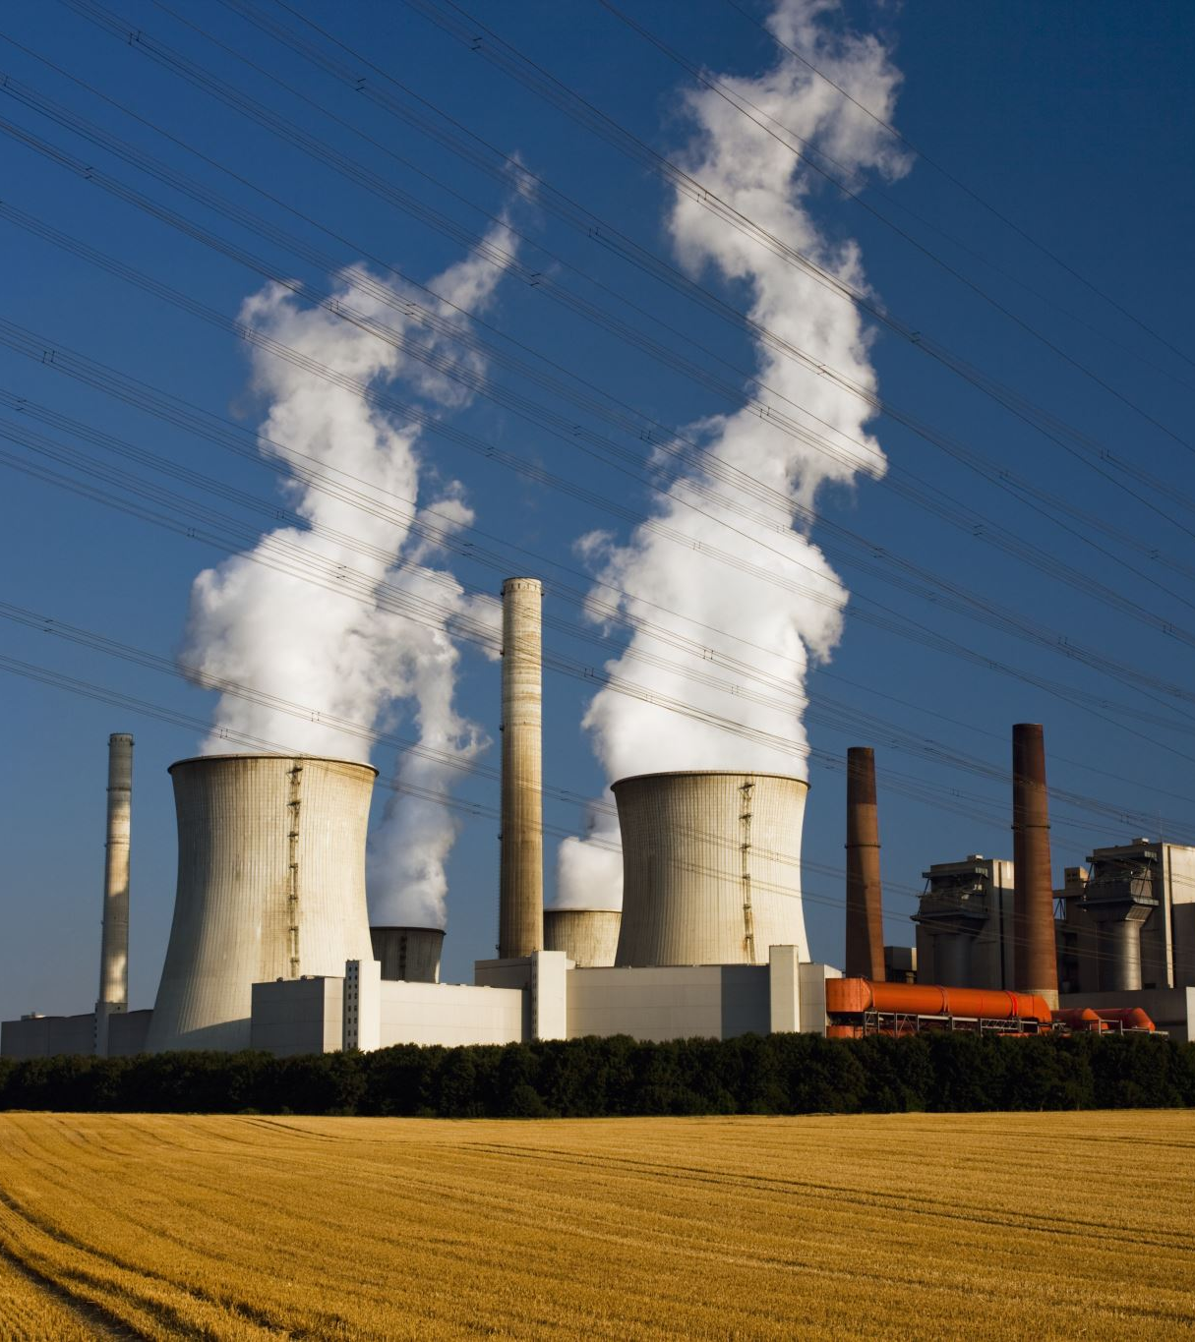
Grid emission factor
Emission factor describes the average CO₂ emitted per unit of electricity generated in the grid.
It is calculated by dividing the absolute CO₂ emissions of all power stations by the total net generation.
You can estimate Grid emission factor for your country (tCO₂/MWh) based on the data on:
CO2 emissions from electricity generation (t CO₂)
Electricity generation (MWh)

Slide 16
Grid emission factor
If data for your country is not available, use the data from this database Harmonized_Grid_Emission_factor_data_set.xlsx (live.com)

Slide 17
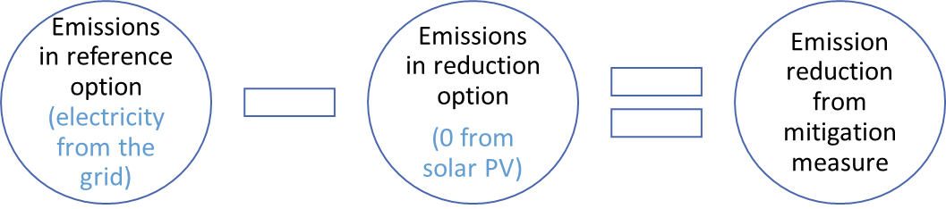
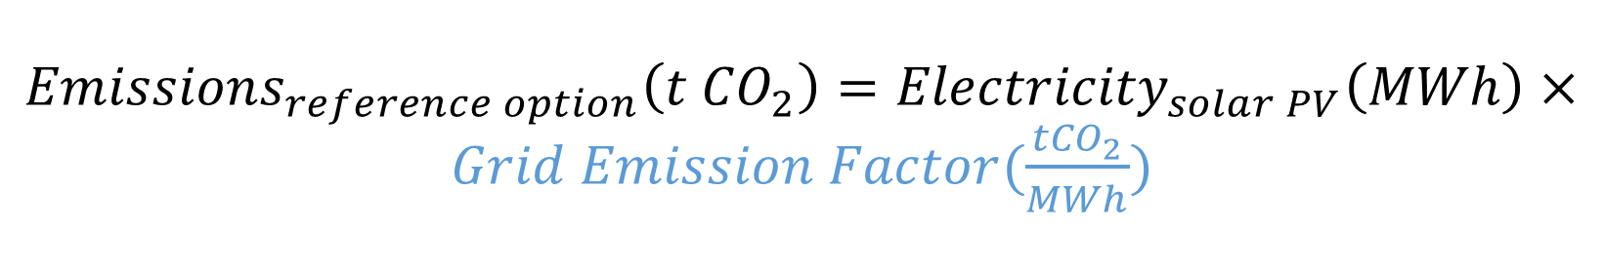
Mitigation measure – Solar PV (on grid)
${Emissions}_{reference option}\left(t {CO}_{2}\right)={Electricity}_{solar PV}\left(MWh\right)×Grid Emission Factor(\frac{{tCO}_{2}}{MWh})$

Slide 18
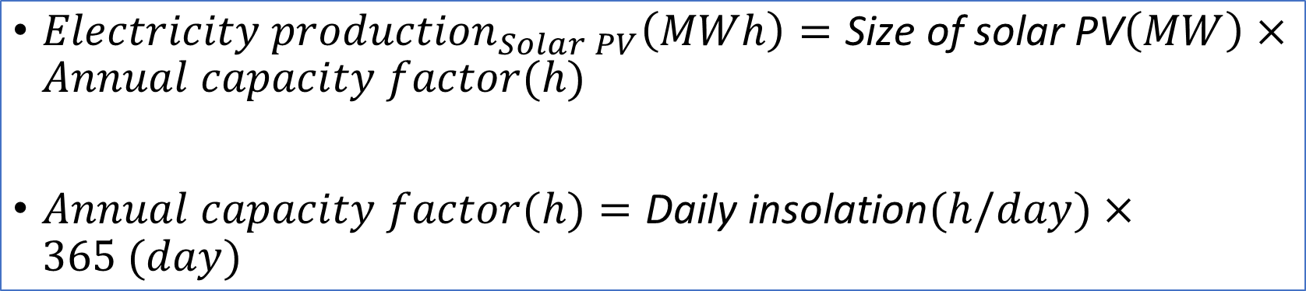
Electricity production from solar PV
${Electricity production}_{Solar PV}\left(MWh\right)=\text{Size} \text{of} \text{solar} \text{PV}\left(MW\right)×Annual capacity factor(h)$
$Annual capacity factor(h)=\text{Daily} \text{insolation}(h/day)×365 (day)$
Size of solar PV | 1.0 | MW
Daily insolation | 5 | hours
Annual capacity factor | 1825 | Full time hours
Efficiency factor | 1
Electricity production | 1825 | MWh

Slide 19
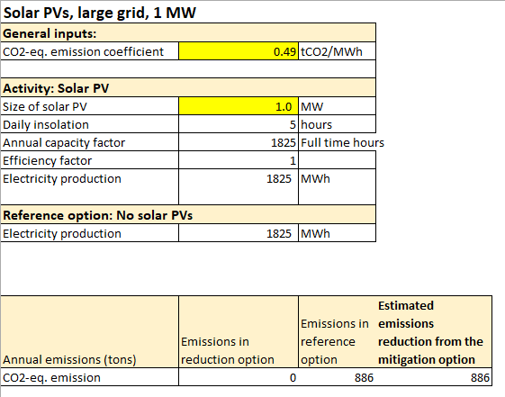
Example of the table for the Solar PV

