Slide 1
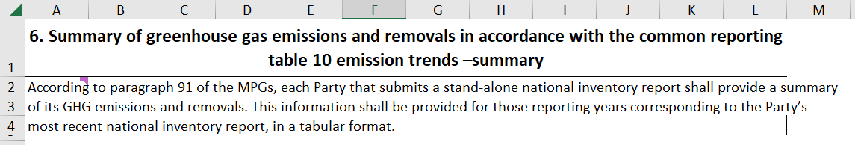
6. Summary of greenhouse gas emissions and removals in accordance with the common reporting table 10 emission trends –summary
National inventory report may be submitted as a stand-alone report or as a component of a biennial transparency report (paragraph 12 of chapter II of MPGs) and consists of a national inventory document and the common reporting tables (paragraph 38 of chapter II of MPGs).

Slide 2
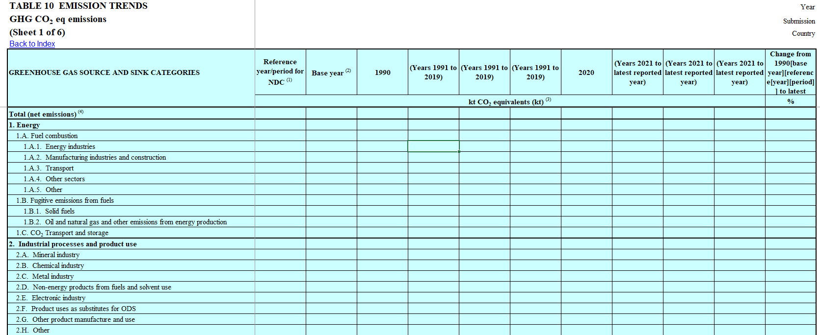

Slide 3
Reporting projections under the ETF
Para MPGs | Type | Requirement
92 | Shall / Encouraged | Report projections with flexibility for developing countries
93 | Shall | Indicative of the impact of PaMs, not for progress assessment unless specified
94 | Shall / May | Report 'with measures' projection and optionally others
95 | Shall | Projections to start from most recent year and extend at least 15 years, with flexibility for developing countries
96 | Should | Methodology description including models, changes, assumptions, and sensitivity analysis
97 | Shall | Provide projections of key indicators for NDC progress
98 | Shall | Include sectoral, by gas and national total projections using a consistent metric
99 | Shall | Present projections relative to actual inventory data
100 | Shall | Provide emission projections with and without LULUCF
101 | Shall | Present projections in graphical and tabular formats

Slide 4
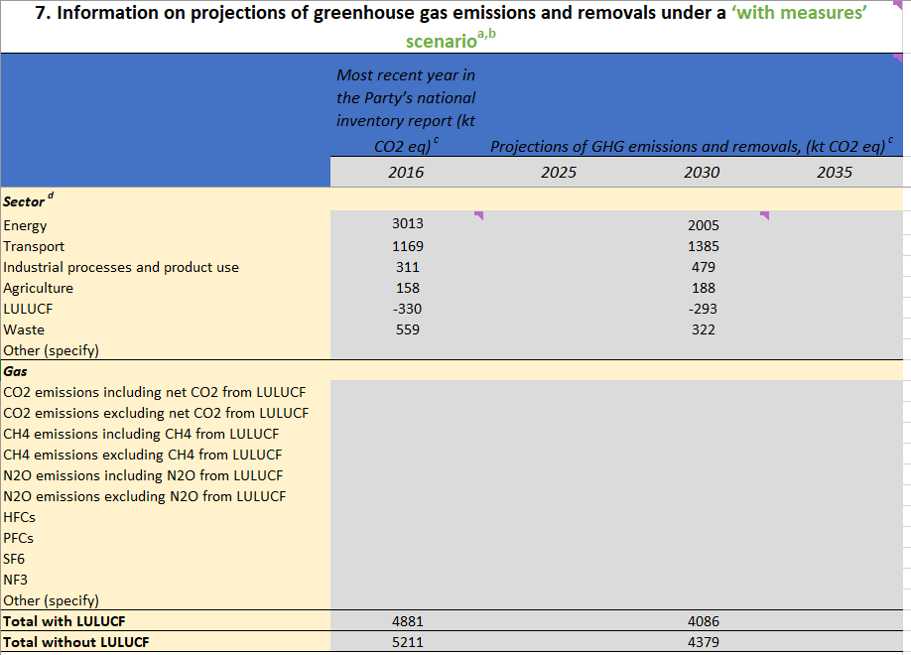
7. Information on projections of greenhouse gas emissions and removals under a ‘with measures’ scenario

Slide 5
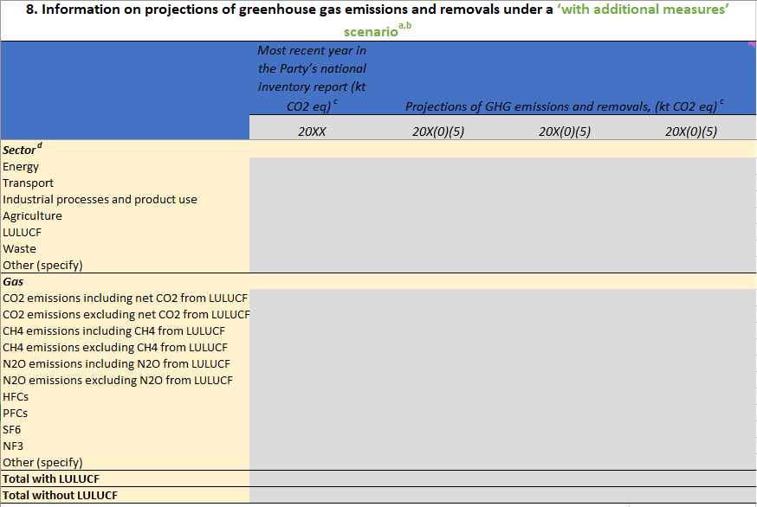
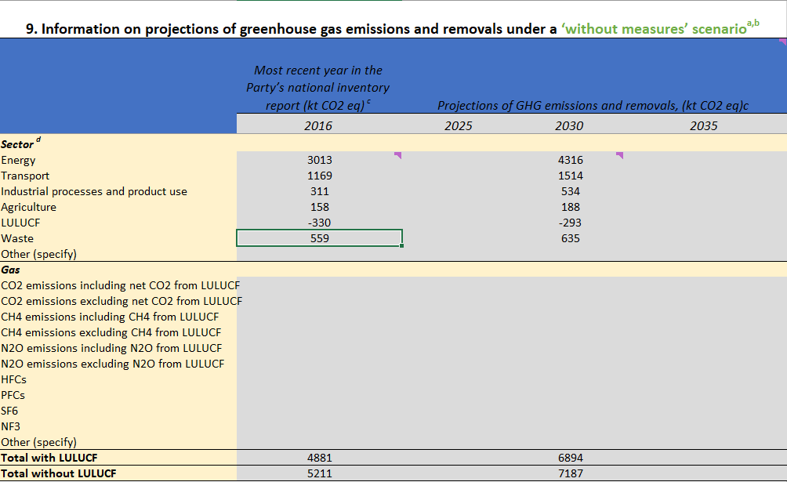
8. Information on projections of greenhouse gas emissions and removals under a ‘with additional measures’ scenario 9. Information on projections of greenhouse gas emissions and removals under a ‘without measures’ scenario

Slide 6
Fill in CTF Tables 7, 8 and 9 with data for your country
Data for your country: Table B: Projections in “Tables to be filled by participants”
Fill in Tables CTF 7,8 and 9 in the file “CTF_Tracking_Progress_NDC_Template_Clean”
Examples of completed tables: CTF_Tracking_Progress_NDC_Template_Tunisia Appendixes

Slide 7
Reporting projections under the ETF
Para MPGs | Type | Requirement
92 | Shall / Encouraged | Report projections with flexibility for developing countries
93 | Shall | Indicative of the impact of PaMs, not for progress assessment unless specified
94 | Shall / May | Report 'with measures' projection and optionally others
95 | Shall | Projections to start from most recent year and extend at least 15 years, with flexibility for developing countries
96 | Should | Methodology description including models, changes, assumptions, and sensitivity analysis
97 | Shall | 97. Each Party shall also provide projections of key indicators to determine progress towards its NDC under Article 4 of the Paris Agreement.
98 | Shall | Include sectoral, by gas and national total projections using a consistent metric
99 | Shall | Present projections relative to actual inventory data
100 | Shall | Provide emission projections with and without LULUCF
101 | Shall | Present projections in graphical and tabular formats

Slide 8
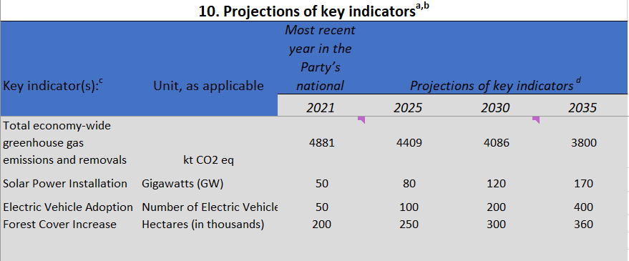
10. Projections of key indicators

Slide 9
Reporting projections under the ETF
Para MPGs | Type | Requirement
92 | Shall / Encouraged | Report projections with flexibility for developing countries
93 | Shall | Indicative of the impact of PaMs, not for progress assessment unless specified
94 | Shall / May | Report 'with measures' projection and optionally others
95 | Shall | Projections to start from most recent year and extend at least 15 years, with flexibility for developing countries
96 | Should | 96. Each Party should provide information in describing the methodology used to develop the projections. This information should include: (a) Models and/or approaches used and key underlying assumptions and parameters used for projections (e.g. gross domestic product growth rate/level, population growth rate/level);
97 | Shall | 97. Each Party shall also provide projections of key indicators to determine progress towards its NDC under Article 4 of the Paris Agreement.
98 | Shall | Include sectoral, by gas and national total projections using a consistent metric
99 | Shall | Present projections relative to actual inventory data
100 | Shall | Provide emission projections with and without LULUCF
101 | Shall | Present projections in graphical and tabular formats

Slide 10
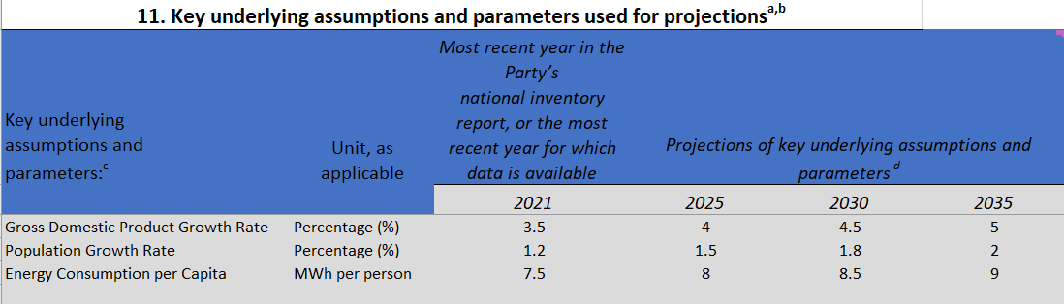
11. Key underlying assumptions and parameters used for projections

Slide 11
Fill in CTF Tables 10 and 11 with data for your country
Data for your country: Table B: Projections in “Tables to be filled by participants”
Fill in Tables CTF 10 and 11 in the file “CTF_Tracking_Progress_NDC_Template_Clean”
Examples of completed tables: CTF_Tracking_Progress_NDC_Template_Tunisia Appendixes

Slide 12




Thank you!
Dominic Sheldon – Dominic.Sheldon@Ricardo.com
Ricardo

