Slide 1
Global BTR Dialogue April 29th - May 3rd, 2024 Brussels

Slide 2
Solutions arena: NDC indicators
Day 2
30 April 2024
Cristina Urrutia, Ökoinstitut

Slide 3
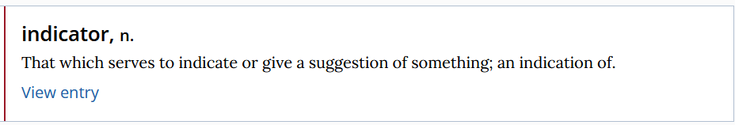
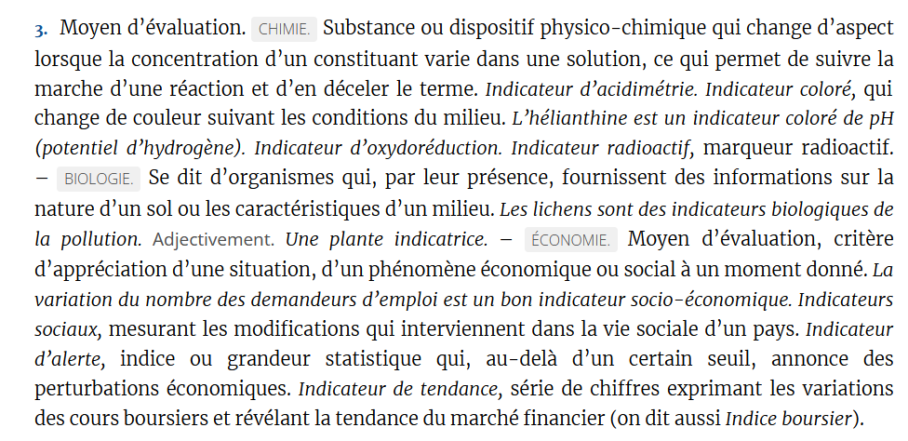
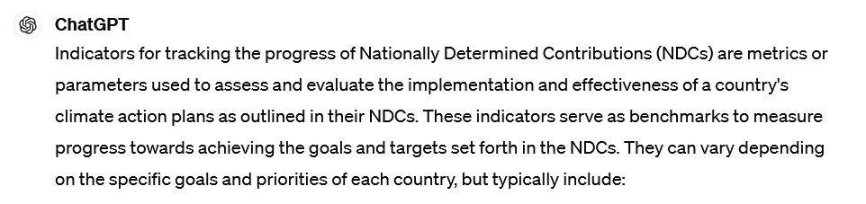
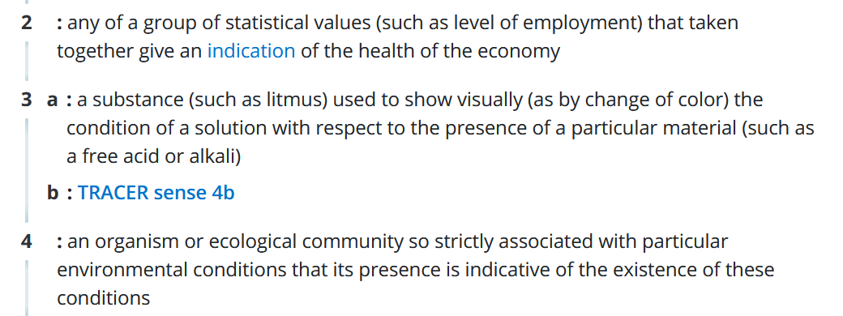
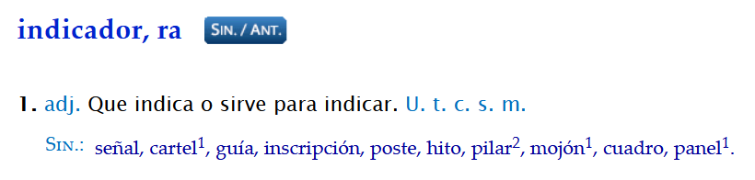

Slide 4
C. Information necessary to track progress made in implementing and achieving
Each Party shall identify indicator(s) (quantitative or qualitative; relevant to the NDC) to track progress towards implementation and achievement of its NDC (para. 69)
Each Party shall provide:
the information for each selected indicator for the reference point(s), level(s), baseline(s), base year(s); (para 67)
and the most recent information for each reporting year (para. 68); and compare these with start. (para. 69)
Each Party with an NDC that consists mitigation co-benefits from adaptation actions and economic diversification plans, shall provide information on domestic policies and measures implemented to address social and economic consequences of response measures.
CTF table 1
CTF table 4

Slide 5
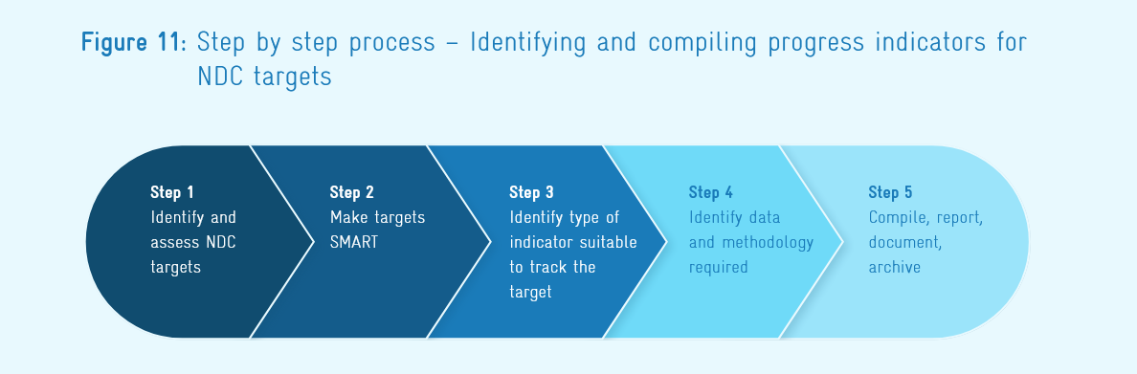
How to identify the right indicators?
What is your target?
Is the target clear? → SMART
What type of indicator is suited to your target?
Identify data requirements and the methodology to determine the value of the indicator
Compile, document, report archive

Slide 6
Example indicators (para. 66)
net GHG emissions and removals
percentage reduction of GHG intensity
relevant qualitative indicators for a specific policy or measure
mitigation co-benefits of adaptation actions and/or economic diversification plans
Other (e.g. hectares of reforestation, percentage of renewable energy use or production, carbon neutrality, share of non-fossil fuel in primary energy consumption and non-GHG related indicators).

