Slide 1
GHG Inventories – Dealing with data gaps
Sabino Del Vento – Ricardo
22/09/2024

Slide 2
Content
How to make use of limited data
Solutions/Examples
Summary

Slide 3
Solutions for data gap filling techniques for time series
Splicing
Overlap
Surrogate
Interpolation
Trend Extrapolation

Slide 4
Dealing with Data Gaps – Time Series
Splicing: combining or joining more than one method or data series to form a complete time series:
  Addresses a change in method (e.g., when Tier 2 method can only be applied to new data, but Tier 1 is still used for historical data)
  Fills gaps due to the collection of periodically collected data
Use surrogate or proxy data to “create” data that are otherwise missing

Slide 5
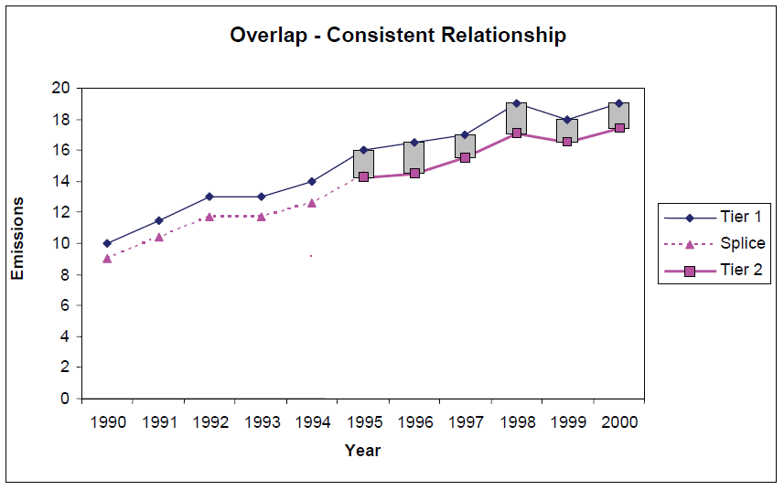
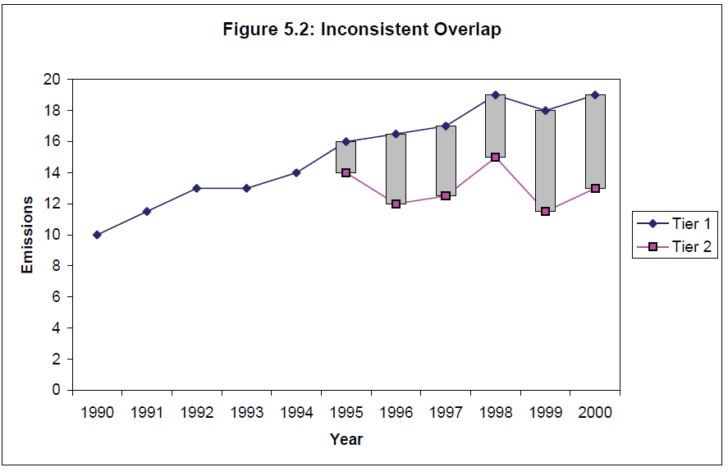
Dealing with Data Gaps – Time Series: Solution 1 - Overlap
Assessment of comparability of two datasets over a time series
Looking for consistent overlap or difference
Preferably for multiple years to avoid bias
Can either use comparable dataset or recalculate existing data on the basis of consistency
Where there is a consistent relationship, the default is to use a proportional adjustment of old estimates/data to be consistent with new
Figures Taken from 2006 IPCCC Guidelines for National Greenhouse Gas Inventories: Chapter 5 – Time Series Consistency
Notes:
Calculate emissions or collect data using both old and new methods/systems for several years:
Can be used with 1 year overlap, but should be done with great caution.
Investigate the relationship between old and new time series for years of overlap.
Develop a mathematical relationship and use it to recalculate historical data to be consistent with new methods/systems.
Remember, it is crucial to have multiple years of overlap to apply properly
This method should not be applied blindly. You should do your best to understand the relationship between the old and new methods:
E.g., why does the old method consistently give results that are 10 to 15% less than the new method?
If you cannot explain the difference then you are not sure that the new method is actually better!
Just because a method/model is more complicated does not mean it is more accurate

Slide 6
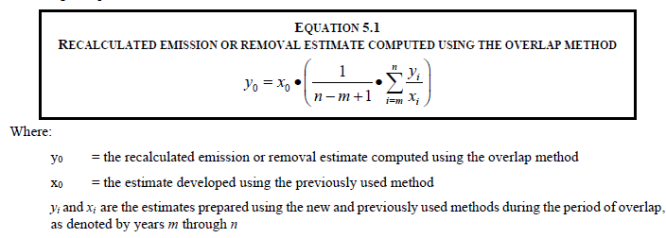
Overlap Approach
Notes:
Key difference between overlap and surrogate approaches is that overlap uses the substitute/ old data to fill the gaps

Slide 7
Overlap Approach
Example 1
Use the overlap approach to estimate GHG emissions for years 2001–2003, using the data below
 | 2001 | 2002 | 2003 | 2004 | 2005 | 2006 | 2007 | 2008 | 2009 | 2010
Tier 1 quantified | 4,000 | 4,000 | 4,100 | 4,200 | 4,800 | 4,900 | 5,000 | 4,800 | 4,900 | 5,000
Tier 2 quantified |  |  |  | 4,035 | 4,598 | 4,410 | 4,500 | 4,320 | 4,513 | 4,790

Slide 8
Overlap Approach
Example 1 – Step 1
 | 2001 | 2002 | 2003 | 2004 | 2005 | 2006 | 2007 | 2008 | 2009 | 2010
Tier 1 quantified | 4,000 | 4,000 | 4,100 | 4,200 | 4,800 | 4,900 | 5,000 | 4,800 | 4,900 | 5,000
Tier 2 quantified |  |  |  | 4,035 | 4,598 | 4,410 | 4,500 | 4,320 | 4,513 | 4,790
Ratio Tier 2 : Tier 1 |  |  |  | 0.96 | 0.96 | 0.90 | 0.90 | 0.90 | 0.92 | 0.96
For each year, calculate the ratio between Tier 2 and Tier 1
E.g. for year 2010:
4790/5000 = 0.96

Slide 9
Overlap Approach
Example 1 – Step 2
 | 2001 | 2002 | 2003 | 2004 | 2005 | 2006 | 2007 | 2008 | 2009 | 2010
Tier 1 quantified | 4,000 | 4,000 | 4,100 | 4,200 | 4,800 | 4,900 | 5,000 | 4,800 | 4,900 | 5,000
Tier 2 quantified |  |  |  | 4,035 | 4,598 | 4,410 | 4,500 | 4,320 | 4,513 | 4,790
Ratio Tier 2 : Tier 1 |  |  |  | 0.96 | 0.96 | 0.90 | 0.90 | 0.90 | 0.92 | 0.96
Calculate average and standard deviation
Average = 0.93
Standard deviation = 0.027
Low variability → Overlap approach seems appropriate

Slide 10
Overlap Approach
Example 1 – Step 3
 | 2001 | 2002 | 2003 | 2004 | 2005 | 2006 | 2007 | 2008 | 2009 | 2010
Tier 1 quantified | 4,000 | 4,000 | 4,100 | 4,200 | 4,800 | 4,900 | 5,000 | 4,800 | 4,900 | 5,000
Tier 2 quantified | 3,713 | 3,713 | 3,806 | 4,035 | 4,598 | 4,410 | 4,500 | 4,320 | 4,513 | 4,790
Ratio Tier 2 : Tier 1 |  |  |  | 0.96 | 0.96 | 0.90 | 0.90 | 0.90 | 0.92 | 0.96
Apply average to calculate missing data:
Year 2001: 4,000 * 0.93 = 3,713
Year 2002: 4,000 * 0.93 = 3,713
Year 2003: 4,100 * 0.93 = 3,806
This is the value of the mean from the previous slide

Slide 11
Overlap Approach – Considerations
Remember, it is crucial to have multiple years of overlap to apply properly
This method should not be applied blindly. You should do your best to understand the relationship between the old and new methods:
  E.g., why does the old method consistently give results that are 10 to 15% less than the new method?
If you cannot explain the difference, then you are not sure that the new method is actually better!
Just because a method/model is more complicated does not mean it is more accurate!

Slide 12
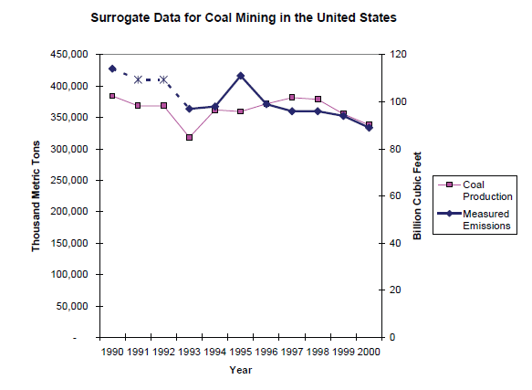
Dealing with Data Gaps – Time Series
Solution 2 – Surrogate Data
Using a dataset that is indicative of changes or trends to ‘fill in’ (or as a surrogate) data gaps
E.g. total vehicle km is indicative of road transport emissions or production output is indicative of industrial emissions
Need to understand relationship prior to using surrogate data – e.g. using regression analysis
Again, multiple years data desirable to avoid bias
Figure Taken from 2006 IPCCC Guidelines for National Greenhouse Gas Inventories: Chapter 5 – Time Series Consistency
Notes:
Find a surrogate (i.e., proxy) variable that is well-correlated with missing data:
Can be used for missing activity data, for EFs (that change each year) or for emission estimates:
Example: Automobile license payments may be well-correlated with petrol use. So license data may serve as a surrogate for petrol consumption.
This approach builds on techniques used in statistical (e.g., econometric) analysis:
Regression techniques are valuable to identify potential surrogate parameter(s)
Correlation analysis.

Slide 13
Surrogate Approach Steps
Identify potential surrogate/proxy variables
If you have some actual data, calculate simple correlation coefficients:
  You should have more than one year of actual data to establish a relationship with the surrogate parameter
If the correlation is not obvious, then consider more sophisticated regression techniques to see if a relationship between actual and surrogate parameter can be found
If you have no actual data, then you will need to justify why the surrogate parameter is a legitimate proxy for actual variable(s)

Slide 14
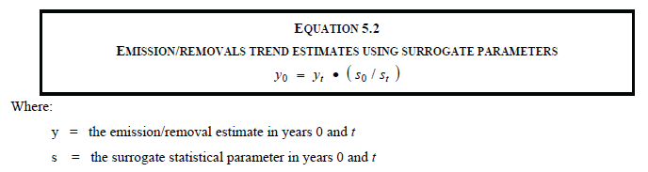
Surrogate Approach
This formula assumes a simple proportional relationship between the surrogate and actual variables
Data calculated for missing years is therefore an adjusted version of the preferred data

Slide 15
Example 2 – Using fishing landings as a surrogate for gas oil use by fishing vessels
Known data for target variable
Known surrogate variable
 | 2001 | 2002 | 2003 | 2004 | 2005 | 2006 | 2007 | 2008 | 2009 | 2010
Domestic fishing gas oil use (t) |  |  |  |  |  |  | 4,317 | 4,245 | 3,923
 | 2001 | 2002 | 2003 | 2004 | 2005 | 2006 | 2007 | 2008 | 2009 | 2010
Total landings into the UK by UK and foreign vessels (kt) | 530 | 538 | 557 | 584 | 584 | 530 | 546 | 537 | 505 | 519
Notes:
Fish landing: the part of the fish catch that is put ashore.

Slide 16
Example 2 – Step 1
Find the surrogate’s relationship to the target variable
Known data for target variable
Known surrogate variable
Ratio of two series
 | 2001 | 2002 | 2003 | 2004 | 2005 | 2006 | 2007 | 2008 | 2009 | 2010
Domestic fishing gas oil use (t) |  |  |  |  |  |  | 4,317 | 4,245 | 3,923
 | 2001 | 2002 | 2003 | 2004 | 2005 | 2006 | 2007 | 2008 | 2009 | 2010
Total landings into the UK by UK and foreign vessels (kt) | 530 | 538 | 557 | 584 | 584 | 530 | 546 | 537 | 505 | 519
 | 2001 | 2002 | 2003 | 2004 | 2005 | 2006 | 2007 | 2008 | 2009 | 2010
Tonnes gas oil use per kilotonne of landings (t/kt) |  |  |  |  |  |  | 7.91 | 7.90 | 7.77

Slide 17
Example 2 – Step 2
Apply the ratios forwards and backwards to gap fill the target variable
Known surrogate variable
 | 2001 | 2002 | 2003 | 2004 | 2005 | 2006 | 2007 | 2008 | 2009 | 2010
Total landings into the UK by UK and foreign vessels (kt) | 530 | 538 | 557 | 584 | 584 | 530 | 546 | 537 | 505 | 519
Ratio of two series
 | 2001 | 2002 | 2003 | 2004 | 2005 | 2006 | 2007 | 2008 | 2009 | 2010
Tonnes gas oil use per kilotonne of landings (t/kt) | 7.91 | 7.91 | 7.91 | 7.91 | 7.91 | 7.91 | 7.91 | 7.90 | 7.77 | 7.77
Projecting back using the 2007 ratio
Projecting forwards using the 2009 ratio
Gap filled time series for target variable (surrogate*ratio)
 | 2001 | 2002 | 2003 | 2004 | 2005 | 2006 | 2007 | 2008 | 2009 | 2010
Domestic fishing gas oil use (t) | 4192 | 4254 | 4408 | 4617 | 4616 | 4190 | 4,317 | 4,245 | 3923 | 4036

Slide 18
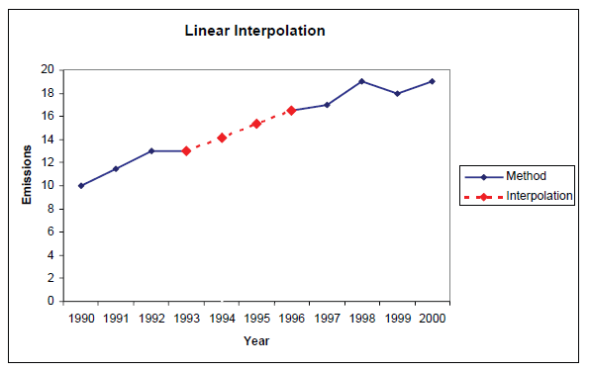
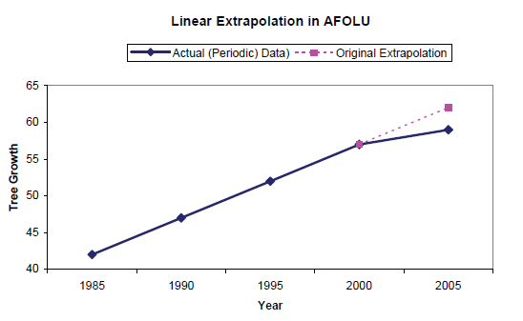
Dealing with Data Gaps – Time Series
Solution 3 - Interpolation
Solution 4 - Trend Extrapolation

Slide 19


Slide 20
Questions/ Menti
Do you face issues with data gaps?
Have you used any of these techniques with your data?
Do you think that these techniques can be useful in your circumstances?

Slide 21
Summary of splicing techniques – 1
Approach | Applicability | Comments
Overlap | Data necessary to apply both the previously used and the new method must be available for at least one year, preferably more | • Most reliable when the overlap between two or more sets of annual estimates can be assessed • If the trends observed using the previously used and new methods are inconsistent, this approach is not good practice
Surrogate Data | Emission factors, activity data or other estimation parameters used in the new method are strongly correlated with other well-known and more readily available indicative data | • Multiple indicative data sets (singly or in combination) should be tested in order to determine the most strongly correlated • Should not be done for long periods
2019 Refinement to the 2006 IPCC Guidelines for National Greenhouse Gas Inventories
Notes:
Non-Linear Trend Analysis (Interpolation/ Extrapolation)
Other Techniques The standard alternatives are not valid when technical conditions are changing throughout the time series (e.g., due to the introduction of mitigation technology).
• Document customised approaches thoroughly.
• Compare results with standard techniques.
Overlap
Data necessary to apply both old and new method must be available for at least one year, preferably more.
Only use when overlap shows pattern that appears reliable
Surrogate data
Missing data is strongly correlated with proxy data
Should test multiple potential proxy data variables
Interpolation
For periodic data or gap in time series
Linear or non-linear interpolation. Only use where data shows steady trend
Trend extrapolation
Beginning or the end of the time series is missing data
Only use where trend is steady and likely to be reliable. Should only be used for a very few years

Slide 22
Summary of splicing techniques – 2
Approach | Applicability | Comments
Interpolation | Data needed for recalculation using the new method are available for intermittent years during the time series | • Estimates can be linearly interpolated for the periods when the new method cannot be applied • The method is not applicable in the case of large annual fluctuations
Trend Extrapolation | Data for the new method are not collected annually and are not available at the beginning or the end of the time series | • Most reliable if the trend over time is constant • Should not be used if the trend is changing (in this case, the surrogate method may be more appropriate) • Should not be applied for long periods
2019 Refinement to the 2006 IPCC Guidelines for National Greenhouse Gas Inventories
Notes:
Non-Linear Trend Analysis (Interpolation/ Extrapolation)
Other Techniques The standard alternatives are not valid when technical conditions are changing throughout the time series (e.g., due to the introduction of mitigation technology).
• Document customised approaches thoroughly.
• Compare results with standard techniques.
Overlap
Data necessary to apply both old and new method must be available for at least one year, preferably more.
Only use when overlap shows pattern that appears reliable
Surrogate data
Missing data is strongly correlated with proxy data
Should test multiple potential proxy data variables
Interpolation
For periodic data or gap in time series
Linear or non-linear interpolation. Only use where data shows steady trend
Trend extrapolation
Beginning or the end of the time series is missing data
Only use where trend is steady and likely to be reliable. Should only be used for a very few years

Slide 23
Step change in data and lack of consistency between datasets – Gas leakage data
Example of data problems and solutions from the UK
Problem: In the UK there are 4 gas supply companies and each provides an annual estimate of leakage from its network and these are aggregated to provide the UK total. Estimates of leakage are based on periodic studies (every 10 years or so) resulting in step-changes in assumptions about leakage.
Solution: Detailed data QC and data adjusted using data splicing and interpolation in years between periodic leakage studies
  Assimilate and compare 4 datasets to identify outlier data – either adjusted using overlap, surrogate data etc techniques or removed data.
  Step changes ‘smoothed’ using interpolation between two years of detailed studies (i.e. replacing extrapolation)

Slide 24
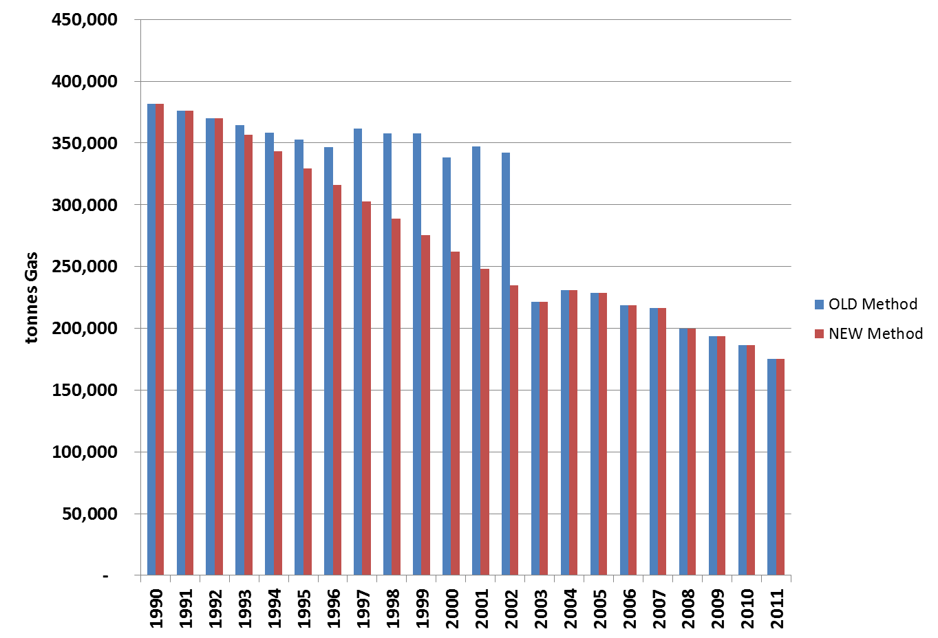
Example 4 – Gas leakage data
New gas leakage survey in 2002 led to sudden revision of assumptions regarding gas leakage rates from different parts of the UK network - leading to a large step-change, 2002-3.

Slide 25
Example 4 – Gas leakage data
New gas leakage survey in 2002 led to sudden revision of assumptions regarding gas leakage rates from different parts of the UK network - leading to a large step-change, 2002-3.
Interpolating 1992-2003 more realistic of actual changes through time

Slide 26
Summary Comments
Preferred approaches are overlap and surrogate, because:
  They are based on actual data
  Interpolation and extrapolation are effectively projections that assume certain trends in the absence of data.
Similarly in research, it is not good practice to simply apply a gap-filling method blindly:
You should understand why your approach is justified and be able to explain it transparently.
  Ask yourself: will what I am doing stand up to peer review in a technical journal?

Slide 27
Additional technical content
IPCC 2006 GLs – Vol. 1 General Guidance and Reporting – Chapter 5
  https://www.ipcc-nggip.iges.or.jp/public/2006gl/pdf/1_Volume1/V1_5_Ch5_Timeseries.pdf
2019 Refinement to the 2006 IPCC GLs – Vol. 1 General Guidance and Reporting – Chapter 5
  https://www.ipcc-nggip.iges.or.jp/public/2019rf/pdf/1_Volume1/19R_V1_Ch05_Timeseries.pdf
EMEP/EEA Guidebook – Part A.4 Time series consistency
  https://www.eea.europa.eu/publications/emep-eea-guidebook-2023/part-a-general-guidance-chapters/a-4-time-series-consistency-2023/view

Slide 28
Thank you

Slide 29
Dealing with Data Gaps – Time Series: Solution 3 - Interpolation
Filling gaps within datasets by estimating trends between two or more data points e.g. intermediate years where no data is available
Useful for datasets with regular gaps – e.g. periodic surveys
In its simplest for linear interpolation
To increase confidence and it is good QA/QC practice to compare interpolated data with surrogate data
Figure Taken from 2006 IPCCC Guidelines for National Greenhouse Gas Inventories: Chapter 5 – Time Series Consistency

Slide 30
Dealing with Data Gaps – Time Series: Solution 4 - Trend Extrapolation
Estimate trend and therefore actual value for a baseline by extending or ‘extrapolating’ trend backwards
Can also extrapolate forwards for projections
Similar to interpolation – although less known about the trend
Trend must be constant to apply extrapolation and not erratic
Should not be used for extended period of time – the longer the period the greater the uncertainty
Again, other splicing techniques should be used alongside to improve confidence
‘Actual’ data (when available) may differ from extrapolation
Figure Taken from 2006 IPCCC Guidelines for National Greenhouse Gas Inventories: Chapter 5 – Time Series Consistency

Slide 31
Example 3 – Using the interpolation technique, estimate the GHG emissions for years 2004–2006
 | 1999 | 2000 | 2001 | 2002 | 2003 | 2004 | 2005 | 2006 | 2007 | 2008 | 2009 | 2010
GHG emission source x | 3,800 | 3,920 | 4,030 | 4,135 | 4,235 |  |  |  | 4,655 | 4,770 | 4,880 | 4,975
Training Materials for National Greenhouse Gas Inventories

Slide 32
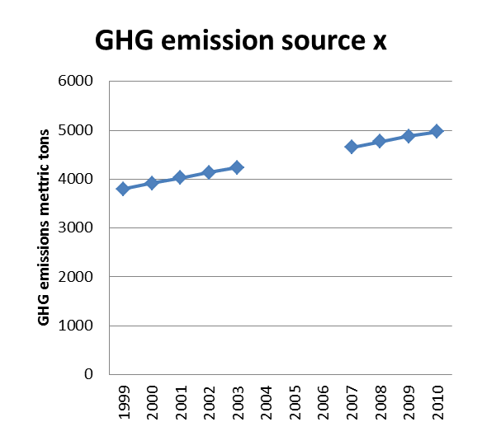
Example 3 – Step 1
 | 1999 | 2000 | 2001 | 2002 | 2003 | 2004 | 2005 | 2006 | 2007 | 2008 | 2009 | 2010
GHG emission source x | 3,800 | 3,920 | 4,030 | 4,135 | 4,235 |  |  |  | 4,655 | 4,770 | 4,880 | 4,975
Analyze data and assess applicability and type of interpolation technique desired
Linear interpolation seems appropriate for this data set

Slide 33
Example 3 – Step 2
 | 1999 | 2000 | 2001 | 2002 | 2003 | 2004 | 2005 | 2006 | 2007 | 2008 | 2009 | 2010
GHG emission source x | 3,800 | 3,920 | 4,030 | 4,135 | 4,235 |  |  |  | 4,655 | 4,770 | 4,880 | 4,975
Calculate difference in GHG emissions between last year before the gap and first year after the gap
→ 4,655 – 4,235 = 420

Slide 34
Example 3 – Step 3
 | 1999 | 2000 | 2001 | 2002 | 2003 | 2004 | 2005 | 2006 | 2007 | 2008 | 2009 | 2010
GHG emission source x | 3,800 | 3,920 | 4,030 | 4,135 | 4,235 |  |  |  | 4,655 | 4,770 | 4,880 | 4,975
Calculate difference in GHG emissions between last year before the gap and first year after the gap
→ 4655 – 4235 = 420
Calculate length of the gap
→ 2007 – 2003 = 4 years

Slide 35
Example 3 – Step 3
 | 1999 | 2000 | 2001 | 2002 | 2003 | 2004 | 2005 | 2006 | 2007 | 2008 | 2009 | 2010
GHG emission source x | 3,800 | 3,920 | 4,030 | 4,135 | 4,235 | 4,340 | 4,445 | 4,550 | 4,655 | 4,770 | 4,880 | 4,975
Calculate difference in GHG emissions between last year before the gap and first year after the gap
→ 4655 – 4235 = 420
Calculate length of the gap
→ 2007 – 2003 = 4 years
Calculate average change in emissions per gap year
→ 420 / 4 = 105
Calculate total emissions for gap year(s) by adding the average change per year
2004 emissions = 4235 + 105 = 4340
2005 emissions = 4340 + 105 = 4445
2006 emissions = 4445 + 105 = 4550
2019 Refinement to the 2006 IPCC Guidelines for National Greenhouse Gas Inventories

Slide 36
Data problems will likely be encountered
“What do we do when there are gaps in the data?”
“We only have data for 1995 and 2000”
“We want to switch to a Tier 2 method, but we only have disaggregated livestock data starting last year”
“The Energy Ministry stopped collecting data on natural gas flaring. What do we do?”

Slide 37

Barriers to Obtaining Available Data
Lack of awareness of what data might be available
Lack of structured data sharing processes
Timeliness – key datasets are not available at the time required
Sharing data may be viewed as losing power by individuals, departments or organisations
Restrictions on statistics data prior to official release
Commercially sensitive data – e.g. from individual companies or installations
Keeping up with the policy cycle – new measures and targets can be developed and implemented very quickly, sometimes without consulting data and technical experts

Slide 38
Summary
Approach data gathering, management and archiving in a structured way – transparency and completeness are the watch words
Make sure that YOU understand the data – coverage, time series, how it is compiled, QA/QC, uncertainty
Do not necessarily discount data that is incomplete or has gaps – many useful datasets will be associated with these issues
Understand uncertainty and seek identify or apply QA/QC processes to help minimise this

Slide 39
Examples of data problems and solutions from the UK
1. Time Series Consistency - Emissions from fuel combustion from upstream oil and gas sources
Source data: Activity data from energy statistics, Emissions data from operator information (later years) and periodic industry studies (earlier years)
Problem: The correlation between the energy statistics and periodic studies was poor for the period prior to the operator-reported emissions data.
  Very high implied emissions for early years, but more stable for later years and consistent with other countries.
Solution: Amend time series using extrapolation of robust data.
  Consultation with the industry and the energy statistics team identified a gap in the energy statistics for the early part of the time series.
  Good relationship between the three years of data where the operator-reported data over-lapped with the energy stats data identified.
  A 3-year average was derived and the activity data for the early years were corrected, by extrapolating this using the emissions data from the industry.

