Slide 1
GHG Inventories – Quality Assurance/ Quality Control
Sabino Del Vento – Ricardo
22/09/2024

Slide 2


Slide 3
Menti
Are you familiar with the concept of QA/QC?
What do you think QA/QC is?
Do you have a QA/QC plan in place?

Slide 4
Why is QA/QC necessary?
An inventory is only as reliable as its data and processes
Opportunities for errors exist at all stages of the project
An inadequate QA/QC process can result in:
Acquisition and use of wrong or erroneous activity data
Errors in activity data
Use of wrong emissions factors
Calculation errors
Reporting errors
Each element can impact inventory results – and affect credibility of effort
Without proper and thorough QA/QC processes, errors and omissions can go undetected can have significant impact on results
Notes:
QA/QC is necessary to avoid errors, and to ensure an efficient, transparent and credible inventory
Why does QA/QC matter? This point should be stated by the trainer to begin with to get people thinking. The answer is quite simple – to provide confidence in a GHG inventory. A tonne of CO2eq must be a tonne in all inventories.
Ask participants what they think QA/QC is, and what experience they have.

Slide 5
Quality Assurance/Quality Control
INTERNAL
Quality Control
A system to ensure regular and adequate checking of data and information
Occurs throughout the inventory process
Quality Assurance
A system of regular independent reviews
Most commonly occurs when the inventory process is complete
EXTERNAL

Slide 6
Quality Control & Quality Assurance
Quality control (QC)
Identify and address errors and omissions
Document and archive inventory material and record all QC activities
Quality assurance (QA)
Planned system of review procedures by not directly involved with inventory development (including throughout the inventory process)
Review should take place when inventory is finalized
Verifies that data quality objectives were met, inventory represents best possible estimate of emissions and sinks given current knowledge and data availability
Technical activities that measure and control inventory as it’s being developed
Provide routine and consistent checks to ensure data integrity, correctness, and completeness

Slide 7
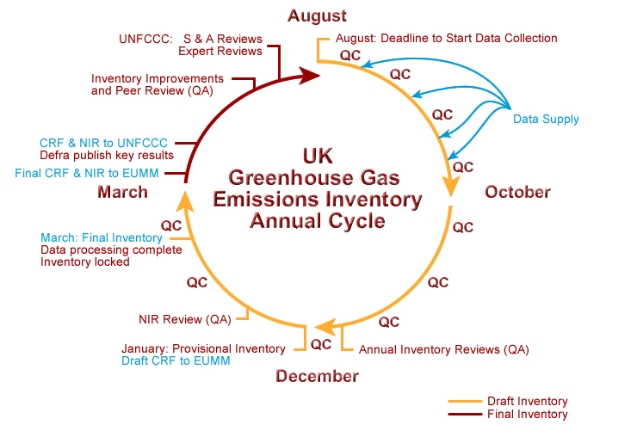
Example – Annual compilation cycle of the UK’s Inventory

Slide 8
Checking procedures
1. Choosing
2. Using
3. Applying
4. Producing
5. Reporting
What data / emission factors (EFs) have you chosen and why? Is it suitable? Relevant?
How is the data being used? Has it been manipulated/processed?
How have you applied the data / EFs to calculations? What methods?
How are the outputs used and reported? Are they consistent?
How have you undertaken calculations? Are they accurate?
Are there errors?
Notes:
These are the basic checking stages and key questions to ask and resolve. Errors can occur at any stage

Slide 9
QC checks in practice
Data gathering, input, and handling activities
Check a sample of input data for transcription errors
Consider suitability of data and emission factors
Identify spreadsheet modifications that could provide additional controls or checks
Ensure that there are adequate version control procedures for electronic files
Data documentation
Check that assumptions and criteria for selection of boundaries, base years, methods, activity data, emission factors, and other parameters are documented
Check that changes in data or methodology are documented
Calculating emissions and checking calculations
Check whether emission units, parameters, and emission factors are correct, appropriately labeled and consistent
Check the data processing steps (e.g., equations) in the spreadsheets – check formulae are looking in right cells. Test some calculations manually.
Check the aggregation of data across source categories, sectors, etc.
Check consistency of time series inputs and calculations (draw a graph!)

Slide 10
Key Concepts of Quality Assurance
Reviews, preferably by independent third parties, should be performed upon a finalised inventory following the implementation of QC procedures. These:
Verify that measurable objectives were met
Support the effectiveness of the QC programme
Ensure that the inventory represents the best possible estimates of emissions and removals given the current state of scientific knowledge and data availability
Notes:
The key is that the people used as ‘independent third parties’ should 1) be suitably qualified 2) have not been directly involved in the GHG inventory preparation

Slide 11
QA activities and procedures
Quality assurance comprises activities outside the actual inventory compilation. Good practice for QA procedures includes:
Informal
Formal
Reviews
Audits
To ensure that the inventory’s results, assumptions, and methods are reasonable
Should involve reviewers that can conduct an unbiased review of the inventory and who may have a different technical perspective
May be used to evaluate how effectively the inventory complies QC specifications
Doesn’t focus on the result of the calculation but in-depth analysis of the procedures and documentation
May also provide verification
Use QA reviewers that have not been involved in preparing the inventory – other sector experts or colleagues

Slide 12
Summary
Quality control involves regular and adequate checking of data and information; Quality assurance involves regular independent reviews
QA/QC is necessary to avoid errors, and to ensure an efficient, transparent and credible inventory
Three components to QA/QC; planning, implementation, and documentation & archiving
Data and emission factors included in the inventory have to be assessed as high, medium or low quality
Data documentation and archiving is essential in avoiding common data management problems
Embed a system of checking procedures (QC) from the beginning and set up a central system for storing data, transparently documenting data activities
Consider the most appropriate form of review (QA) from the beginning
Data quality is ensured when it can be demonstrated that the data sets are relevant, complete, consistent, reliable, current, accurate and objective

Slide 13
Additional technical content
IPCC 2006 GLs – Vol. 1 General Guidance and Reporting
https://www.ipcc-nggip.iges.or.jp/public/2006gl/vol1.html
EMEP/EEA Guidebook – 6. Inventory management, improvement and QA/QC
https://www.eea.europa.eu/publications/emep-eea-guidebook-2019/part-a-general-guidance-chapters/6-inventory-management-improvement-and/view

Slide 14
Thank you

Slide 15
What are key requirements of a GHG inventory system?
An inventory compilation, reporting and development plan covering QA/QC, timing, deliverables and stakeholder involvement
Good quality and consistent management to underpin the work
A functioning QA/QC system
Approaches to improve the quality of the inventory
Key Category Analysis (KCA)
Estimating and reducing uncertainty (of emissions/removals)

Slide 16
Quality criteria and principles
National GHG inventories must be prepared in accordance with the UNFCCC data quality principles (TACCC):
Transparency
Accuracy
Completeness
Comparability
Consistency

Slide 17
Quality control and principles
Set quality objectives based on the five principles:
Transparency
Accuracy
Completeness
Comparability
Consistency
Technical reviews
QC Activities
Approved standardized procedures for emissions calculation
Accuracy checks
Notes:
Note: QC needs to relate to these principles, particularly completeness and accuracy.
These are also all important for comparability, between years and countries

Slide 18
Ensuring data quality
Some simple templates can improve the quality of input data
QC information required | Description of information required
Compiler | Who compiled this data?
Date created | When was this data created/compiled?
Source of data | Where has this data come from?
Data provided to | Who has this data been provided for?
Data purpose | What has this data been provided for? Does this affect its use?
Quality check | Has this data been checked by anyone? How has it been checked?
Quality assessment | H, M, L ?
Data range | Time (e.g. date range) Geographic scope Installations/activities
Notes/disclaimers | Any other important information that the data recipient should be aware of? Are there missing years? Is this an estimate? Is this confidential?

Slide 19
Data Quality Assessment
An indicative assessment of data quality for each emission factor and activity data must be included
Uncertainty is not specifically calculated like in national inventories; it is indicative from the data quality assessment
The data has to be assessed as high, medium or low
Data quality | Activity data | Emission factor
High (H) | Detailed activity data | Specific emission factors
Medium (M) | Modelled activity data using robust assumptions | More general emission factors
Low (L) | Highly-modeled or uncertain activity data | Default emission factors

Slide 20
Indicators of data quality
Indicator | Example
Technological representativeness | Does it cover the right vehicle types? Is it relevant to your waste disposal treatment method?
Temporal representativeness | Does the dataset year match the inventory year? If not, has it been scaled?
Geographical representativeness | Does the dataset year match the inventory boundary? If not, has it been scaled? Is it specific to your region/country?
Completeness | Does it cover all relevant locations and activities?
Reliability (Quality) | Is this data from a credible source? Has supporting information been provided to give credibility?

