Slide 1

Day 1, 22nd of February 2022:
PATPA Anglophone African Regional Group
Virtual workshop on adaptation reporting through the Biennial Transparency Report (BTR)
February 22nd – 24th, 2022
Welcome, we will begin shortly
©Christina Morillo/Pexels

Slide 2

Before we begin, a few technical details…
Netiquette
Avoid
distractions
Be
comfortable
Mute
yourself
Turn off your camera if band width does not allow
Turn on your camera when talking
Engage and participate

Slide 3


Before we begin, a few technical details…
Digital tools
Chat box
MS Forms
Questions
Polls

Slide 4

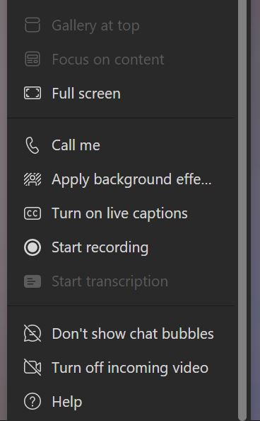
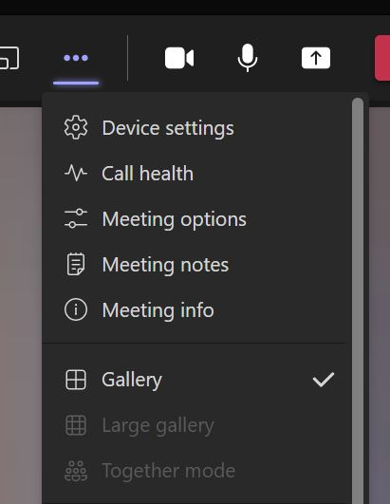
Using MS Teams during the meeting…
view
participants
chat
box
function
camera on / off
mic on / off
leave call
raise
hand
function
share
screen
function
additional
functions

Slide 5

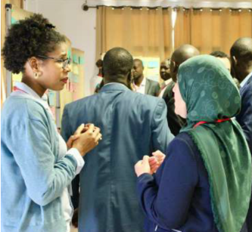
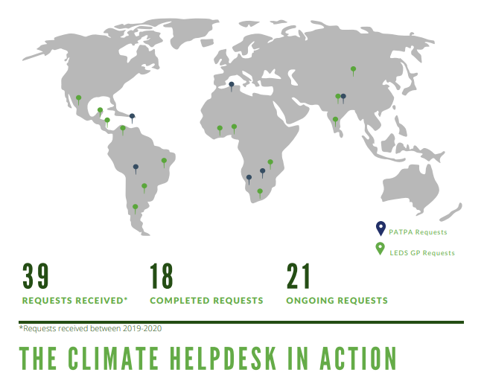

Background on the Partnership on Transparency in the Paris Agreement (PATPA)
PATPA activities
Launched in May 2010 by South Africa, Republic of Korea and Germany
The PATPA seeks to
support successful negotiations on transparency by fostering dialogue and trust between countries.
promote the implementation of the Enhanced Transparency Framework (ETF) through providing demand-driven capacity development and enabling mutual learning in South-South-North exchange formats.
identify and disseminate good practices and lessons learnt
Global
Regional
National
Knowledge Products
©GIZ

Slide 6
Virtual Workshop: 3 hours stretched over 3 days
Day 1
- Overview of the iterative adaptation process
- Questions and exchange about countries’ journey along this process
- Overview of planning instruments which feed into the BTR
- How to collect the information to develop them, and barriers faced
- Overview of the report-orientated instruments which feed into the BTR
- How to monitor and evaluate progress on planning
- Countries’ options for monitoring
- Country experiences
- Country experiences
Day 2
Day 3
> Through an interactive format and peer-learning

Slide 7
Today’s agenda – day 1
Opening // Catarina Tarpo, PATPA and Clémence Moinier, Ricardo E&E
Welcome speech // Maesela Kekana, DFFE (South Africa)
Overview of UNFCCC mechanisms for adaptation reporting // Funanani Muremi, Adaptation Committee
Q&A // All participants and Funanani Muremi
Reporting to the UNFCCC through BTR // Thomas W. Dale, UNEP DTU/ ICAT
Q&A // All participants and Thomas W. Dale, UNEP DTU/ ICAT
Interview // Tlou Ramaru (South Africa) and Juliana Bempah (Ghana)
Facilitated discussion in break-out groups
NDC adaptation component as the ADCOM // Tlou Ramaru (South Africa)
‘Standalone’ ADCOM // Juliana Bempah (Ghana)
Evaluation & Feedback
Wrap up and the way forward // Clémence Moinier, Ricardo E&E

Slide 8
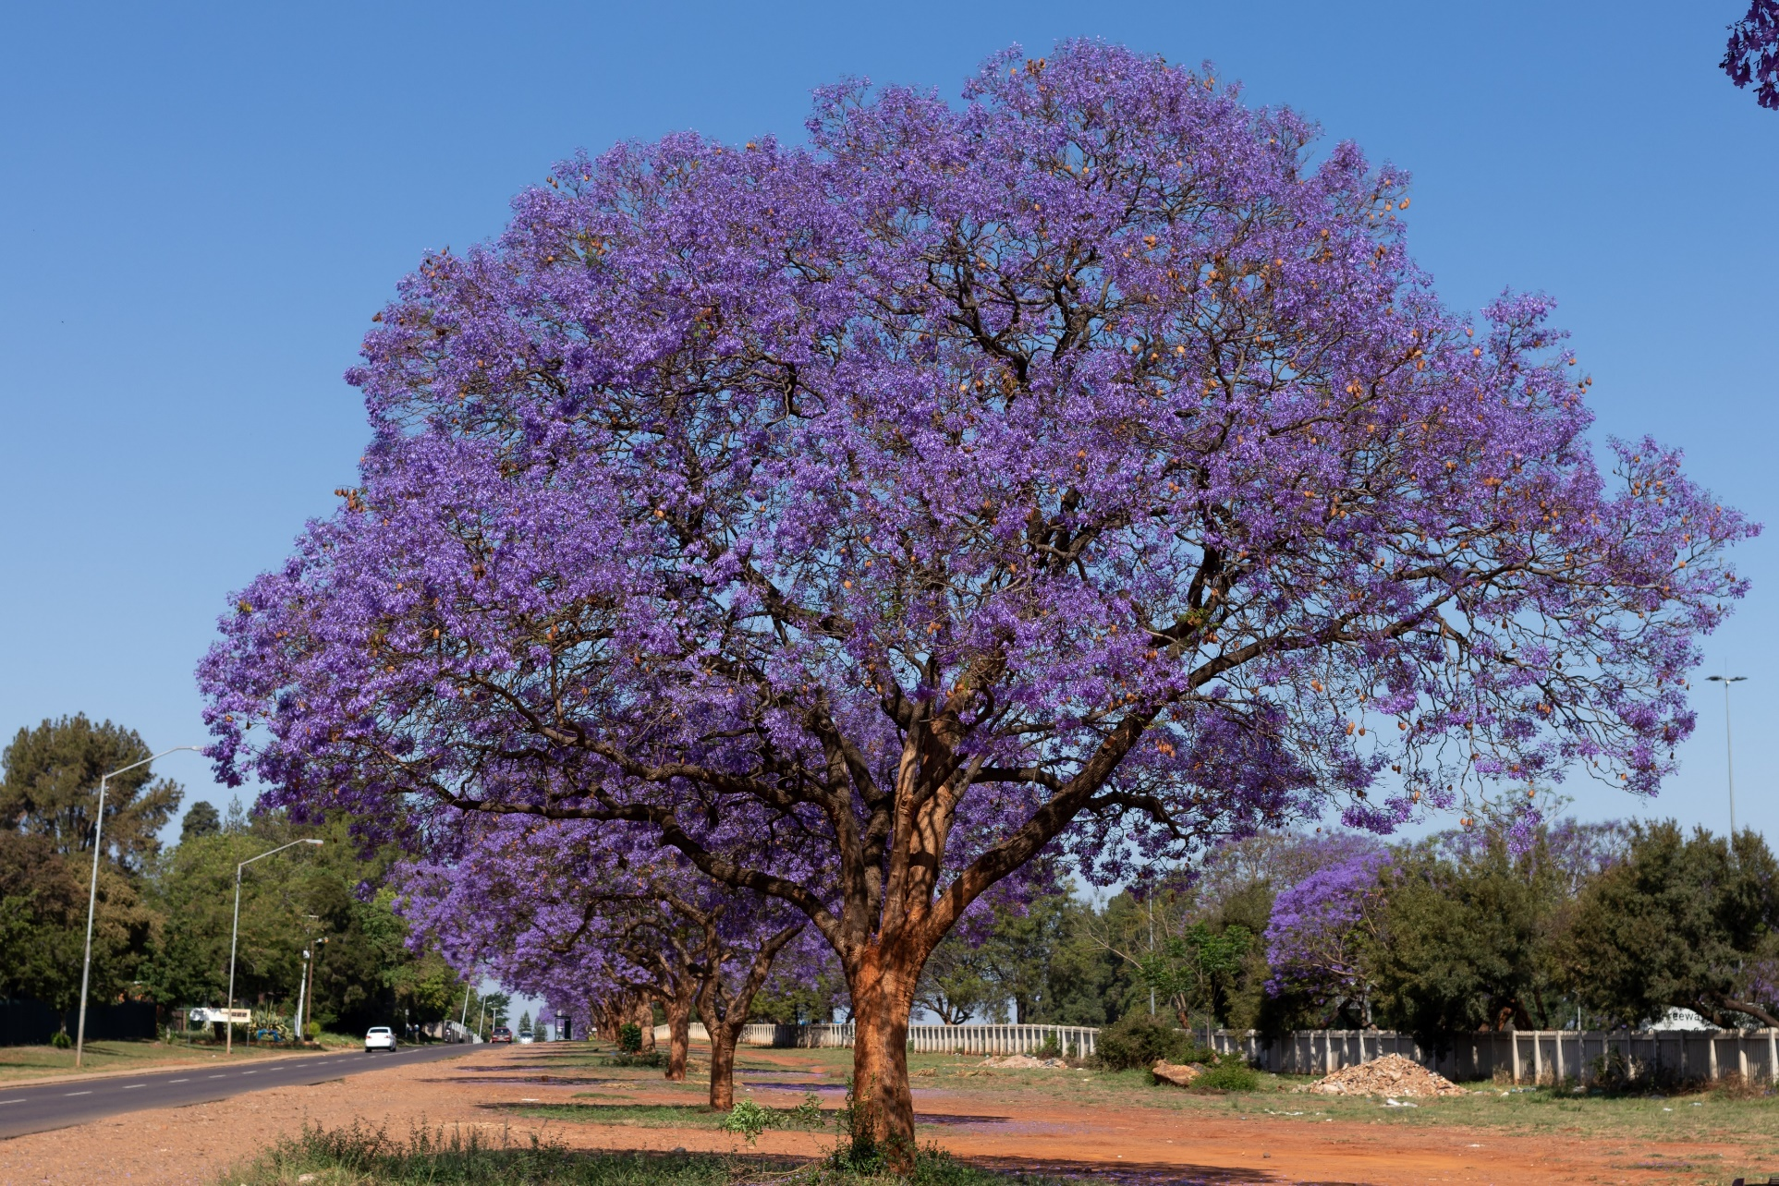
Welcome
Mr. Maesela Kekana
Department of Forestry, Fisheries and the Environment (DFFE), South Africa
©Clayton/Pexels

Slide 9



Overview of UNFCCC mechanisms for adaptation planning, communication and reporting
©GIZ
+ Q&A
Funanani Muremi
Adaptation Committee

Slide 10
PATPA workshop on Adaptation reporting through the biennial transparency reports Adaptation information arrangements under the UNFCCC and the Paris Agreement, and related work by the Adaptation Committee
22-24 February 2022

Slide 11
UNFCCC AND PARIS AGREEMENT ARRANGEMENTS INVOLVING ADAPTATION INFORMATION
REPORTING AND COMMUNICATION WITH ADAPTATION-SPECIFIC GUIDELINES
1999: National communications of annex I Parties (FCCC/CP/1999/7)
2019: new guidelines (6/CP.25)
NC portal
2002: National communications of non-annex I Parties (17/CP.8)
NC portal
2015/2018: ADCOMs (PA Art 7 + 9/CMA.1)
Public registry
2015/2018: BTRs (PA Art 13 + 18/CMA.1)
UNFCCC website
NATIONAL-LEVEL ADAPTATION PROCESSES WITH REPORTING / COMMUNICATION ASPECTS
2001: NAPAs
UNFCCC website
2010: NAPs (5/CP.17)
NAP Central
OTHER INFORMATION CHANNELS
2014: Adaptation components of INDCs/NDCs (1/CP.20)
NDC registry
Low-emission development strategies (PA Art 4.19)
UNFCCC website

Slide 12
UNFCCC AND PARIS AGREEMENT ARRANGEMENTS DESIGNED FOR REPORTING AND COMMUNICATING ADAPTATION INFORMATION
 | Guidance | Purpose | Timeframes | Process | Other information
NCs of Annex I Parties | - Decision 6/CP.25, paras 46-47 | - Enhance transparency, consistency and comparability - Enable review and assessment of implementation - Monitor progress on UNFCCC goals | Every 4 y (8th NCs due on 31 Dec 2022) | - Secretariat posts NCs on UNFCCC website - Compilation and synthesis
NCs of non-Annex I Parties | - Decision 17/CP.8, paras 3-4 and 26; section B (paras 28-36) | - Encourage consistency, transparency and comparability - Policy guidance to operating entities of financial mechanism - Ensure COP has sufficient information for assessing implementation | Determined by the COP – generally every 4 y | - Secretariat posts NCs on UNFCCC website | - Guidelines under revision by SBI
ADCOM | - PA Art. 7.10-11 - Decision 9/CMA.1 | - Visibility and profile of adaptation, balance with mitigation - Strengthen adaptation action/support - Input to GST - Enhance learning and understanding of adaptation needs and actions - Contribute to reviewing progress towards global goal on adaptation | Submit in time to inform each GST | - Submitted as components or in conjunction with other documents (e.g. NC, NDC, NAPs, BTRs) - Recorded in registry - Synthesized for GST - Take stock of guidance in 2025 and revise if needed | - Country-driven, flexible; not a burden or basis of comparison/review - Information may be “tailored” to vehicle documents - Parties invited to include “ex ante information” / provide information on elements (a-d), and additionally (e-i)
BTRs | - PA Art 13.8 - Decision 18/CMA.1 | - Understand adaptation action, good practices, priorities, needs and gaps, to inform GST - Could facilitate recognition of adaptation efforts of developing countries | Every 2 y, starting 31 Dec 2024 | - Secretariat posts BTRs on web and synthesizes them - Synthesized for GST | - Parties may cross-reference adaptation information in other documents, and focus on updates

Slide 13
DRAFT SUPPLEMENTARY GUIDANCE FOR ADCOMS: WORK SO FAR
9/CMA.1
AC to develop, by June 2022, draft guidance for communicating information on the elements of ADCOMs
AC 15-17
Agreed on a timeline
AC 18-19
Considered successive drafts
Engagement of IPCC WG II and using existing guidance as a starting point
For consideration by SBs at SB57 (Nov 2022) in context of consideration of AC report
June 2021
Webinar to discuss the guidance with Parties and experts
August 2021
Draft published on 31 August
AC 19
AC considered draft and agreed to enhance engagement with IPCC and other stakeholders
Considered a mapping of existing guidance and initial outline of draft guidance
19 August: AC discussion on the draft guidance
Draft shared with IPCC, along with specific questions

Slide 14
DRAFT SUPPLEMENTARY GUIDANCE FOR ADCOMS: OVERVIEW OF THE CURRENT DRAFT
Chapter | Sections | Types of content
Chapter 1 | Mandate, approach, overview of content
Chapter 2 (Part I): guidance relevant for the ADCOMs | 2.1: Existing guidance for ADCOMs in Paris Agreement and CMA decisions 2.2: Submitting an ADCOM as a component of, or in conjunction with, other communications and/or documents: relevant guidelines and considerations 2.3: Scope of, and information synergies with, existing guidelines for the main vehicle documents 2.4: Considerations and observations | Existing guidance for ADCOMs and vehicle documents, ways in which an ADCOM can be submitted, and synergies between the various guidelines.
Chapter 3 (Part II): supplementary guidance to facilitate the preparation of information on specific elements | 3.1. Communicating information on possible elements of an adaptation communication: relevant linkages, existing approaches and methodologies 3.2. National circumstances, institutional arrangements and legal frameworks 3.3. Impacts, risks and vulnerabilities 3.4. National adaptation priorities, strategies, policies, plans, goals and actions 3.5. Implementation and support needs of, and provision of support to, developing country Parties 3.6. Implementation of adaptation actions and plans 3.7. Adaptation actions and/or economic diversification plans, inc. those that result in mitigation co-benefits 3.8. How adaptation actions contribute to other international frameworks and/or conventions 3.9. Gender-responsive adaptation action and traditional knowledge, knowledge of indigenous peoples and local knowledge systems related to adaptation 3.10. Any other information related to adaptation | For each element of ADCOMs identified in 9/CMA.1: (a) what the element can be understood to encompass; (b) how information on the element appears in other UNFCCC reporting guidelines; (c) what information sources are available to inform the preparation of information on that element.
Chapter 4: concluding observations |  | Observations and suggestions by the AC.
Annex I: examples of national processes for preparing an ADCOM |  | Examples of how ADCOMs have been prepared, based on submitted ADCOMs.
Annex II: comparison of types of adaptation-related information under UNFCCC guidelines |  | Detailed comparison of how adaptation-related information features in guidelines for ADCOMs, NCs, NAPs and BTRs.

Slide 15
DRAFT SUPPLEMENTARY GUIDANCE FOR ADCOMS: NEXT STEPS
15 March
Next draft published
22 March (TBC)
Expert meeting with stakeholders, including IPCC
28-31 March
Consideration of draft by AC 21
March – June
Revision and finalization of guidance

Slide 16
Thank you! ac@unfccc.int

Slide 17
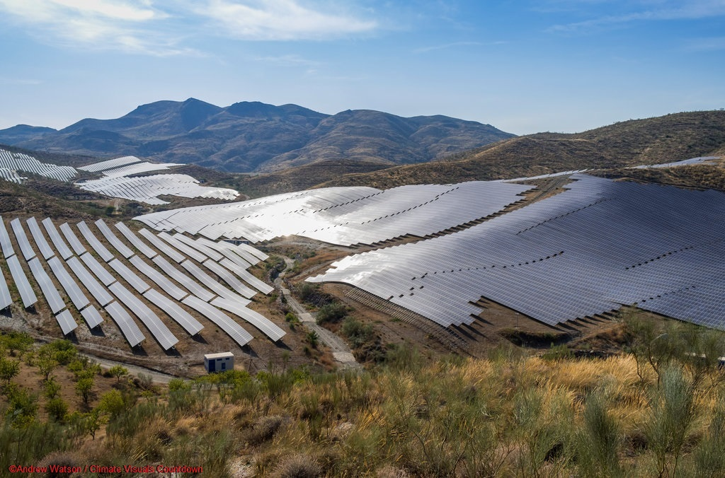
Reporting to the UNFCCC through the BTR, in comparison to other reporting documents
+ Q&A
Thomas W. Dale
Initiative for Climate Action Transparency (ICAT)
UNEP DTU Partnership

Slide 18



A closer look at adaptation reporting through the BTR Thomas W. Dale UNEP DTU Partnership
©Elettra Stefani/ Unsplash

Slide 19

Purpose of the presentation
This presentation aims to answer the following questions:
What role is reporting on adaptation in the BTR intended to play in the UNFCCC process?
What information are countries expected to provide in the adaptation sections of their BTRs?
How can countries avoid undue burdens associated with adaptation reporting?

Slide 20
1. What role is reporting on adaptation in the BTR intended to play in the UNFCCC process?

Slide 21
1. What role is reporting on adaptation in the BTR intended to play in the UNFCCC process?
The core function of the A-BTR is to allow countries to provide the UNFCCC with information about:
Your country's vulnerability to climate change
Your country's goals and priorities relating to adaptation
The adaptation actions your country has chosen to implement to realise its adaptation goals
The results achieved so far by these actions
The challenges, barriers and gaps your country is facing, and what support needs you have
The information provided by countries in their A-BTRs should inform the COP negotiations and help form the global climate agenda.

Slide 22
1. What role is reporting on adaptation in the BTR intended to play in the UNFCCC process?
Reporting on adaptation via the BTR will allow countries to:
Get recognition of adaptation action that they are undertaking
Learn from each other
Communicate with NGOs, civil society, donors, and other important stakeholders outside of the UNFCCC

Slide 23
1. What role is reporting on adaptation in the BTR intended to play in the UNFCCC process?
The functions of the BTR are very similar to the functions of the National Communication (Nat Com) and Adaptation Communication (Ad Com)
In light of this, it would be valid to ask:
1. What are the differences between these reports? and,
2. What value does the BTR add for adaptation?

Slide 24
1. What role is the A-BTR intended to fill in the UNFCCC process?
What are the differences between the three reports?
National communication (Nat. Com):
Larger report – covers the key topics relevant to the convention
Submitted every four years
Biennial Transparency Report (BTR):
Lighter report – should focus on providing updates relating to mitigation, adaptation and support
Submitted every two years (although in practice it should dovetail the Nat Com)
Adaptation Communication (Ad Com):
A flexible instrument that aims to bring greater visibility to the adaptation-related information a country is communicating
Can be used by countries in different ways depending on their need

Slide 25
1. What role is the A-BTR intended to fill in the UNFCCC process?
What value does the BTR add for adaptation?
The BTR enables countries to report on adaptation every two years
Its introduction provides (much needed) updated guidance for reporting that better reflect the present informational needs of the UNFCCC – this guidance should lead to better and more complete adaptation reporting by countries

Slide 26
2. What information are countries expected to provide in the adaptation sections of their BTRs?

Slide 27
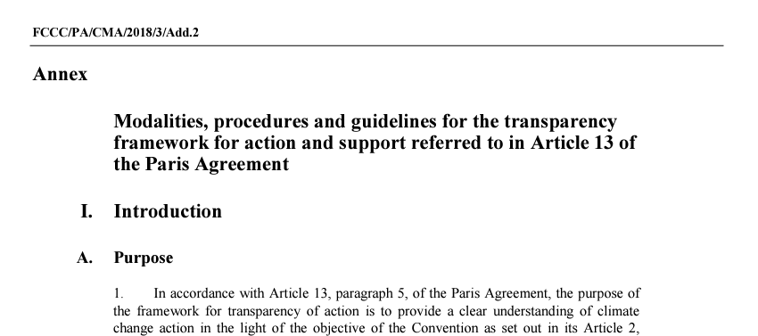
What is the biennial transparency report? And why is it relevant to reporting on adaptation?
2. What information are countries expected to provide in the adaptation sections of their BTRs?
Guidelines relating to what to include in a BTR is provided in the annex of decision 18/CMA.1, an output of COP24 (2018).

Slide 28
What is the biennial transparency report? And why is it relevant to reporting on adaptation?
2. What information are countries expected to provide in the adaptation sections of their BTRs?
Before looking at the guidelines themselves, it is important to note:
Including an adaptation section in one's BTR is voluntary, as such all elements of the guidelines are also voluntary meaning preparing an A-BTR is a "country-driven" exercise.
The majority requests made by the guidelines use the prefix "Parties should" – meaning that Parties are suggested to fulfil the request (if they can) but not are obligated to.
Requests that do not use the prefix "Parties should", use the prefix "Parties may", which is less stringent and means that the request is considered optional and not necessarily suggested.

Slide 29
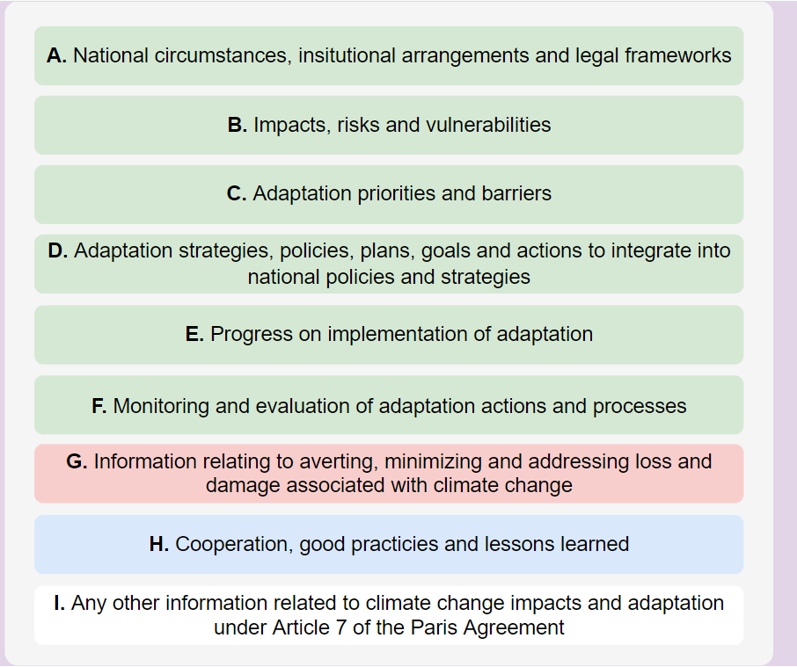
What is the biennial transparency report? And why is it relevant to reporting on adaptation?
2. What information are countries expected to provide in the adaptation sections of their BTRs?
The titles of the guidance's nine sections provide a good indication of what information should to be included.
Together, these guidelines cover:
Adaptation
Loss and damage
Good practices and lessons learned
Any other information

Slide 30
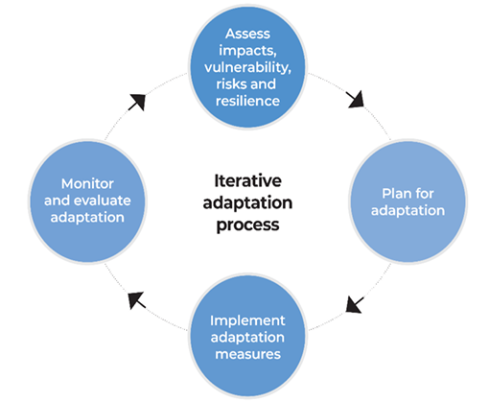
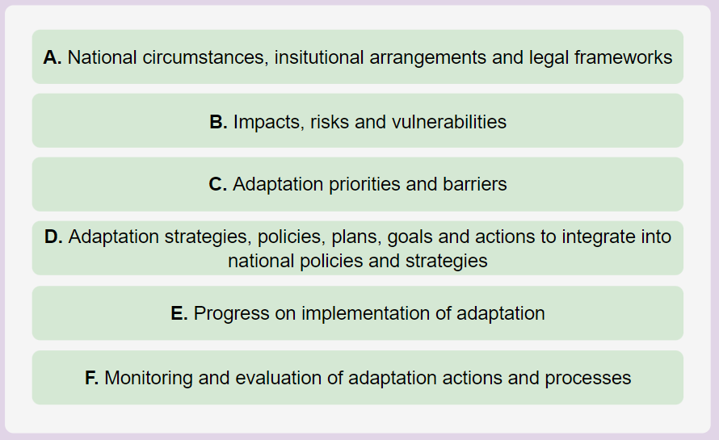
What is the biennial transparency report? And why is it relevant to reporting on adaptation?
2. What information are countries expected to provide in the adaptation sections of their BTRs?

Slide 31
3. How can countries avoid undue burdens associated with adaptation reporting?

Slide 32
3. How can countries avoid undue burdens associated with adaptation reporting?
Reporting on your country's national adaption process is a big task that can represent a significant burden, particularly to countries with limited resources.
This burden can be lightened through doing the following when preparing BTRs and other UNFCCC reports and communications:
Narrowing the focus of adaptation reporting
Exploiting synergies between the BTR and other UNFCCC reports

Slide 33
Narrowing the focus of adaptation reporting
In past national communications, some countries have chosen to provide extensive information about climate impacts, vulnerability, and adaptation actions on a sector-by-sector basis.
This can be constructive, however doing this well requires significant effort and it can lead to reports being very large and difficult to read.
If we view the BTR as a lighter update report, countries might consider narrowing the focus to reporting on progress in preparing and implementing national-level instruments that have a "whole-of-government" focus, such as NAPs and national adaptation strategies.
High-quality information about these processes would be highly valued by the UNFCCC.

Slide 34
Exploiting synergies between the BTR and other UNFCCC reports
For the majority of countries, preparing separate BTRs, Nat Coms, and Ad Coms will constitute a significant burden that has relatively little pay-off – i.e. an undue burden.
As such, where appropriate, countries can reduce this burden by taking advantage of the significant and obvious synergies between these reports…

Slide 35
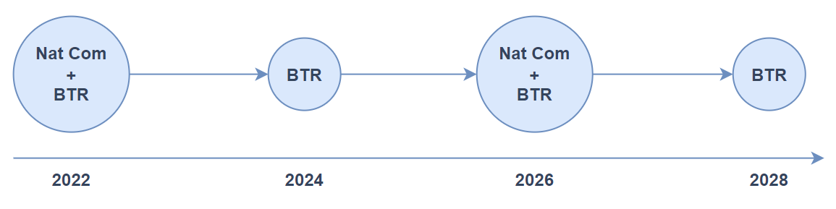
Exploiting synergies between the BTR and other UNFCCC reports
The most obvious means of doing this would be to combine these reports when their submission timetables align – i.e. submit one report that serves as two or more reports.
This can clearly be done with the Nat Com and BTR, the submission deadlines for which overlap every four years.

Slide 36
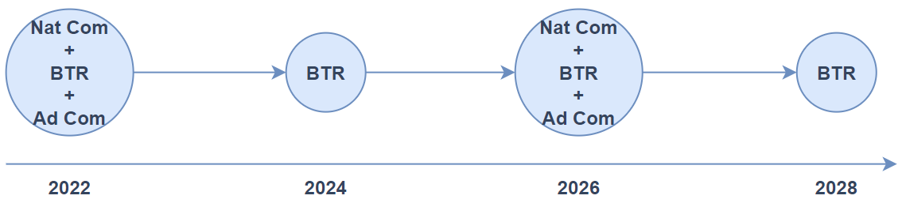
Exploiting synergies between the BTR and other UNFCCC reports
Countries could also choose to submit a combined Ad Com–BTR (or a combined Ad Com–BTR–Nat Com)
Doing this would only make sense, if countries wanted to use their Ad Com as a more in-depth report that provides a detailed account of their national adaptation process and adaptation support needs.
For countries that would rather use their Ad Com as a shorter, more high-level document, combining it with the BTR and/or Nat Com would not really make sense.

Slide 37
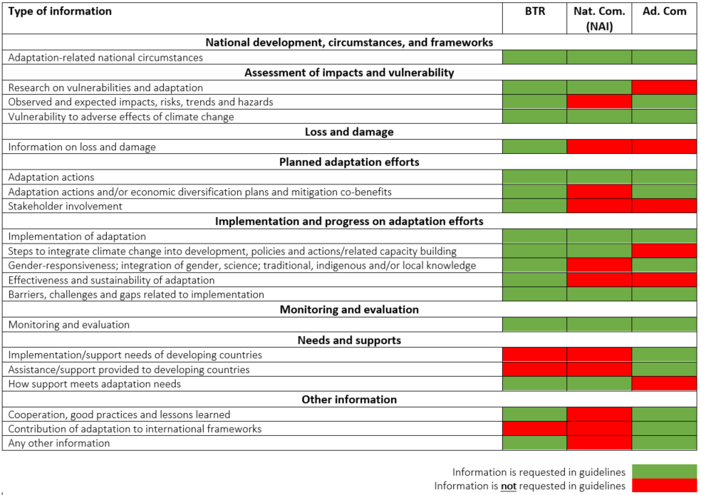
Exploiting synergies between the BTR and other UNFCCC reports
Streamlining adaptation reporting
The table visualises the overlap in the adaptation-relevant guidelines between the BTR, Nat Com and Ad Com.
Source: adapted from Adaptation Committee (2019)

Slide 38
Thank you! Thomas W. Dale UNEP DTU Partnership towida@dtu.dk
©Elettra Stefani/ Unsplash

Slide 39
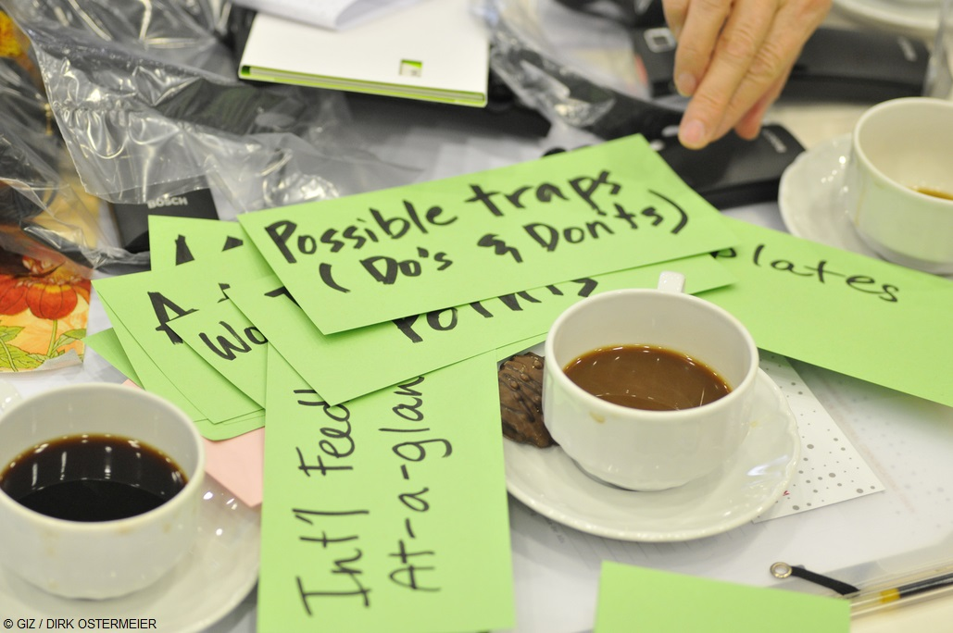
Coffee break
Short break of 5 minutes. Please don’t leave this call but turn your camera off and mute yourself.
©GIZ/Création9

Slide 40

Interviews
Tlou Ramaru, South Africa Juliana Bempah, Ghana

Slide 41

TLOU RAMARU Chief Director: Climate Change Adaptation
South Africa’s Monitoring, evaluation and reporting for adaptation

Slide 42

Where is South Africa in the planning and reporting process at the moment and which document does it use to report progress?
- South Africa chose to communicate the adaptation communication through the NDC ;
- South Africa will continue to include the adaptation component of reporting into national communication;
Why has it chosen to use this vehicle for reporting?
- The vehicle offers flexibility for South Africa to cover amongst other elements;
- Trends and Climate Projections;
- Risk and vulnerability & impact assessments of key socio-economic sectors
- Analysis of adaptation options
What challenges have you encountered in this process and how did you overcome them?
- collection of data across various stakeholders
- SA developed the NCCIS to enable the collection and collation of the data and information for reporting purposes.

Slide 43
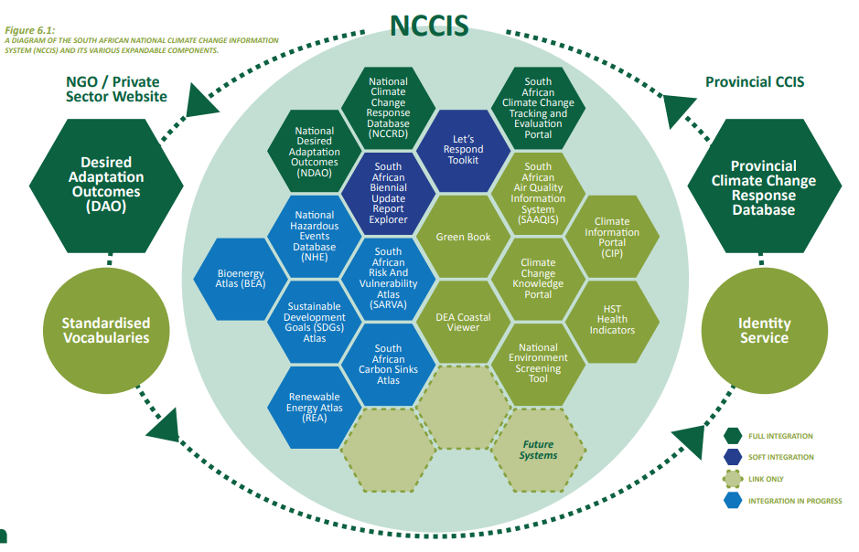
Notes:
• National Climate Change Response Database: a portal for capturing and reporting climate change projects and their details. • National Desired Adaptation Outcomes: designed as a monitoring and evaluation framework for climate change resilience through progress towards a series of adaptation goals. • Climate Information Centre: a collection of actionable data sets and information relevant to the South African climate change field, distributed as required by data providers and formal sources. • Tracking & Evaluation (T&E) Portal: a system which stores the data and information on the details of actions, indicators, impacts and related challenges, targets, and investments in climate change. This system also provides data visualisation, and provides outputs in formats required by the BUR. It will, therefore, assist the DFFE in producing BURs timeously. • Portfolio of online Atlases, decision support systems and tools. • Services, tools, static content, documentation including reports, policies and guidelines, and other digital objects developed by external partners and stakeholders. • Standardised vocabularies serving as a common frame of reference for climate change reporting and monitoring. • Search and discovery capabilities.

Slide 44
Virtual Workshop of the PATPA Regional Group Anglophone Africa
Juliana Bempah
Environmental Protection Agency- GhANA
22-24 February 2022

Slide 45
AdapTAtion Reporting in Ghana
Adaptation Vehicles in Ghana
NDCs- Updated and published November 2021
NAPs- Launched in 2020 and currently on-going
NATCOMs- May 2020
ADCOM- November 2021

Slide 46
‘Standalone’ ADCOM
Why the ‘Standalone’ ADCOM
Availability of Institutional structures, knowledge resources and governance arrangements
Approach
Multi-stakeholder inception session
Validation workshop
Funding Source
Government of the United Kingdom

Slide 47
Key Lessons Learnt
Identification of data gaps
Buy-in of stakeholders
Adaptation capacity building

Slide 48
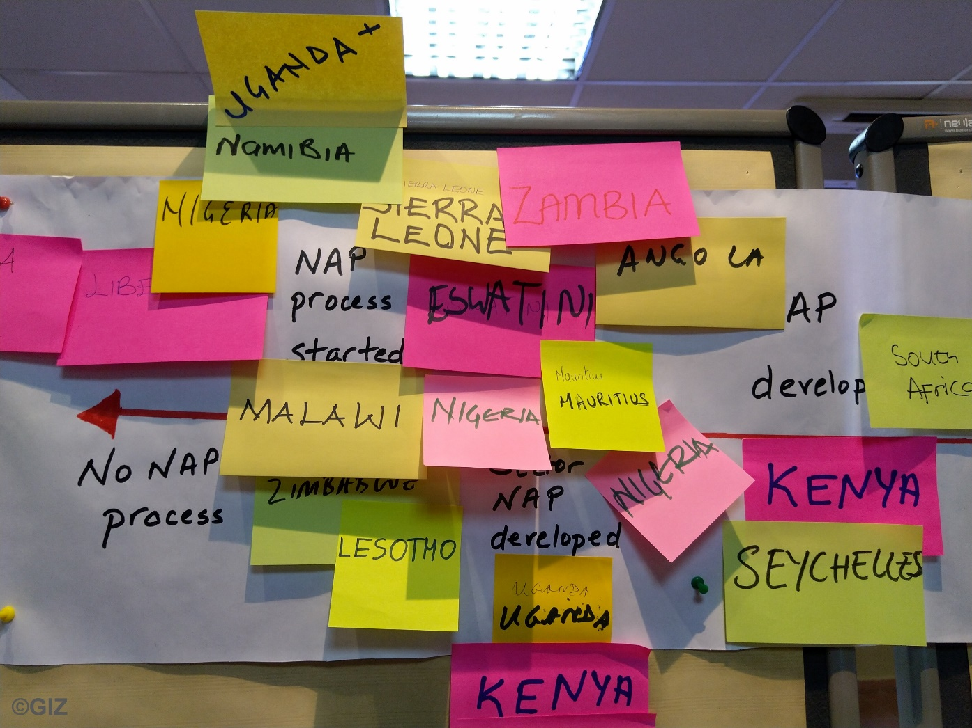
Break-out groups
NDC adaptation component as the ADCOM: Tlou Ramaru, South Africa
‘Standalone’ ADCOM: Juliana Bempah, Ghana

Slide 49

Evaluation & Feedback
©Pixabay/Pexels​

Slide 50
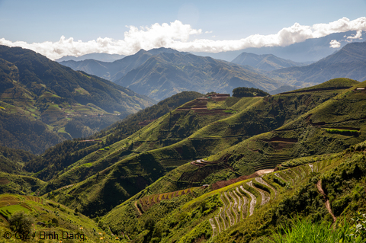
Wrap up & way forward
Clémence Moinier
Ricardo E&E

Slide 51

Contact
Catarina Tarpo (PATPA)
catarina.tarpo@giz.de

Slide 52






With the financial support of
This workshop was realized with technical contributions of
Adaptation Division,
UNFCCC secretariat
We would like to thank all country speakers for their valuable contributions

