Slide 1

Day 3, 24th of February 2022:
PATPA Anglophone African Regional Group
Virtual workshop on adaptation reporting through the Biennial Transparency Report (BTR)
February 22nd – 24th, 2022
Welcome, we will begin shortly
©Christina Morillo/Pexels

Slide 2
Virtual Workshop: 3 hours stretched over 3 days
Day 1
- Overview of the iterative adaptation process
- Questions and exchange about countries’ journey along this process
- Overview of planning instruments which feed into the BTR
- How to collect the information to develop them, and barriers faced
- Overview of the report-orientated instruments which feed into the BTR
- How to monitor and evaluate progress on planning
- Countries’ options for monitoring
- Country experiences
- Country experiences
Day 2
Day 3
> Through an interactive format and peer-learning

Slide 3
Today’s agenda – day 3
Opening remarks // Catarina Tarpo, PATPA and Clémence Moinier, Ricardo E&E
Brief overview: M&E in the BTR and input to the Global stocktake // Clémence Moinier, Ricardo E&E
Lessons learned on ADCOM development // Maik Winges, GIZ Climate Policy Support Project
Q&A // All participants and Maik Winges, GIZ
Adaptation M&E for reporting in ADCOM and in BTR // Timo Leiter, Grantham Research Institute on Climate Change and the Environment, London School of Economics
Interview // Lerenten Lelekoitien (Kenya)
Facilitated discussion in break-out groups
Timo Leiter
Lerenten Lelekoitien (Kenya)
Summary overview of the BTR development process // Clémence Moinier, Ricardo E&E
Evaluation & Feedback // Clémence Moinier, Ricardo E&E
Support available – Climate Transparency Helpdesk // Mijako Nierenkoether, PATPA
Outlook on COP 27 and closing remarks // Mkhutazi Steleki, DFFE (South Africa)

Slide 4

M&E in the BTR and input to the Global stocktake
Clémence Moinier
Ricardo E&E

Slide 5
M&E in the BTR and input to the Global stocktake
Core question: What are the outcomes and impacts of the adaptation actions your country has implemented?
How effective and sustainable have they been? How replicable are they?
What are the capacities, capabilities, and characteristics of your national M&E system for adaptation?
Global stocktake: Assessment of global collective progress on: adaptation, mitigation and means of implementation and support
First one from 2021 to 2023 (every 5 years)

Slide 6
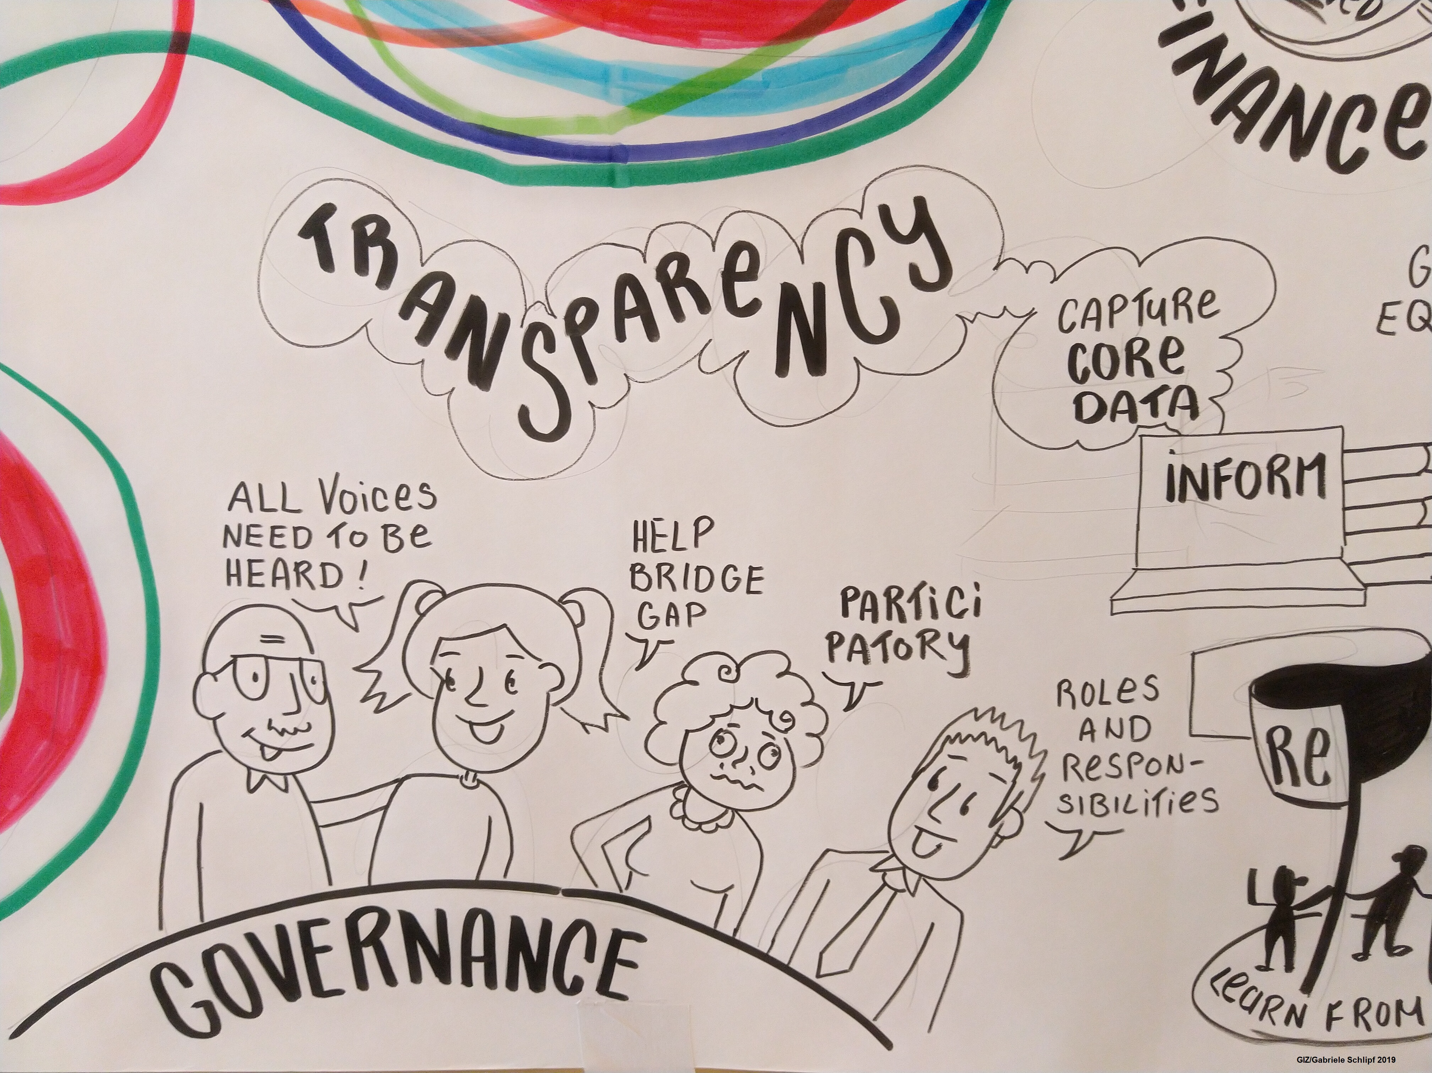
Lessons learned on ADCOM development
©GIZ
+ Q&A
Maik Winges
Deutsche Gesellschaft für Internationale Zusammenarbeit (GIZ)

Slide 7
Adaptation Communications (ADCOMs) Country experiences and lessons learnt
Climate Policy Support Programme with support from the NAP Global Network

Slide 8
What is an Adaptation Communication?
The adaptation communication is an important instrument under the Paris Agreement (Art. 7)
It is a mechanism for countries to report “priorities, implementation and support needs, plans and actions, without creating any additional burden for developing country Parties”
It aims at keeping track on national-level adaptation planning processes and reporting on progress made.
It was established to
increase the visibility and profile of adaptation
inform the global stocktake
strengthen adaptation action and support for developing countries
enhance learning and understanding of adaptation needs, plans and actions.
It serves as a voluntary instrument that countries can submit if they choose to do so.
It is not a one-off – submitted periodically over time

Slide 9
What information can be included in an ADCOM?
ADCOMs can include information such as:
National context: including climate impacts and risks, relevant institutions, and legal and policy frameworks
National adaptation priorities and plans
Implementation and support needs
Other information, as appropriate
A full list of elements that Parties are invited to include information on can be found in Decision 9/CMA.1 (2018).

Slide 10
How to submit an ADCOM?
An Adaptation Communication is not intended to pose an additional burden on developing countries – they can be as short or long as a country wishes and should build on existing work.
The Paris Agreement sets out three different options for submitting and updating an ADCOM:
As a standalone document
As a component of “vehicle document” (e.g., NAP, NDC, NatCom, BTR)
In conjunction with a vehicle document (ADCOM + vehicle document submitted together)

Slide 11
Trends from support on ADCOMS (provided by NAP Global Network
Country partners are avoiding creating a parallel process and draw on adaptation planning efforts already underway
Countries should take stock of the existing adaptation plans and reports (i.e., NAPs, NDCs, NatComs, NAPAs) before preparing information for an ADCOM
The process to develop an ADCOM can serve as opportunity to convene adaptation stakeholders to collect information on adaptation progress, needs, and priorities that have not yet been captured and synthesized elsewhere in adaptation planning, and to raise profile, awareness, and understanding of adaptation.
Notes:
The NAP Global Network has supported 20 developing countries in preparing their Adaptation Communications.

Slide 12
Trends from support on ADCOMS (provided by NAP Global Network), ctd.
Countries are leveraging their NAP processes strategically to develop their ADCOMs – regardless of where they are in the NAP process
Some countries (e.g., Burkina Faso, Grenada, Saint Lucia) that have NAP documents are linking ADCOMs to NAP progress reporting, emphasizing learning on adaptation.
Other Countries are leveraging the outputs of their National Adaptation Plan processes so far and using ADCOMs as a shorter-term report on the status of adaptation
Notes:
The NAP Global Network has supported 20 developing countries in preparing their Adaptation Communications.

Slide 13
Trends from support on ADCOMS (provided by NAP Global Network), ctd.
The flexibility of options and approaches for developing an adaptation communication is useful but can lead to confusion
Standalone ADCOM emphasize its role in profile-raising of adaptation (i.e., to avoid adaptation being “buried” in longer documents
Embedded ADCOM are chosen to reduce reporting burden, or to embed adaptation in a document that has political profile (i.e., the NDC).
Countries saw ADCOMs’ role as providing input to the GST as an important function and rationale for developing it in 2021, but there was lack of awareness of the timelines associated with the GST
Notes:
The NAP Global Network has supported 20 developing countries in preparing their Adaptation Communications.

Slide 14
Trends from support on ADCOMS (provided by NAP Global Network), ctd.
Some countries used the AdComms as an opportunity include to emerging trends, including impacts of the Covid-19 pandemic on adaptation, not captured to date in other adaptation plans or communications.
Some countries (e.g., Nigeria, Haiti, Liberia) have included in their ADCOM a repository of adaptation projects and activities implemented to date, which
Reference for donors and stakeholders / highlight good practices and lessons
Highlighting regional and sectoral disparities
Notes:
The NAP Global Network has supported 20 developing countries in preparing their Adaptation Communications.

Slide 15
Trends from support on ADCOMS (provided by NAP Global Network), ctd.
Countries have included information on the four voluntary elements such as “Gender-responsive adaptation action and Traditional Knowledge, knowledge of Indigenous Peoples, and local knowledge systems related to adaptation” .
Many countries are including an aggregate estimated cost of adaptation in the country
The amounts estimated to be needed vary widely – Namibia for example estimates that USD 1.72 billion is needed from 2021 to 2030, while Somalia estimates USD 48.5 billion for the same period.
Collecting information (especially at the sub-national level) is challenging without an M&E system for national adaptation in place
Notes:
The NAP Global Network has supported 20 developing countries in preparing their Adaptation Communications.

Slide 16
AdComm-Drafting Assistance Tool (AdComm-DAT)
Offers non-prescriptive step by step guidance
Supports countries that specifically decide to prepare and submit a stand-alone document rather than choosing one of the existing communication vehicles
Reduces the reporting burden to a minimum by offering a structure that builds on the guidance provided in Decision 9/CMA.1
Available from: https://adcomm-dat.org/

Slide 17
AdComm-Drafting Assistance Tool (AdComm-DAT) – Lessons Learnt
With GIZ support, the NAP Global Network has piloted the AdComm-DAT via technical assistance to Vietnam and Mexico. Lessons from that support include:
The AdComm-DAT can help guide the collection of data and information from existing sources – having a monitoring and evaluation system for adaptation is vital for collecting information.
Though an international reporting mechanism, ADCOMs can serve as an important national-level and sub-national resource on adaptation. Clarifying the value-add at the national level is valuable at the beginning of the process
Adaptation stakeholder mapping is another essential step at the outset of the ADCOM development process, and the AdComm-DAT can be used to structure questions for stakeholder consultation and input.

Slide 18




Contact
Kristin Diederich
Junior advisor
Climate Policy Support Programme
Kristin.Diederich@giz.de
With special thanks to
Dr Maik Winges
Advisor
Climate Policy Support Programme
Maik.Winges@giz.de
Amina Schild
Advisor
Climate Policy Support Programme
Amina-Laura.Schild@giz.de
info@napglobalnetwork.org

Slide 20
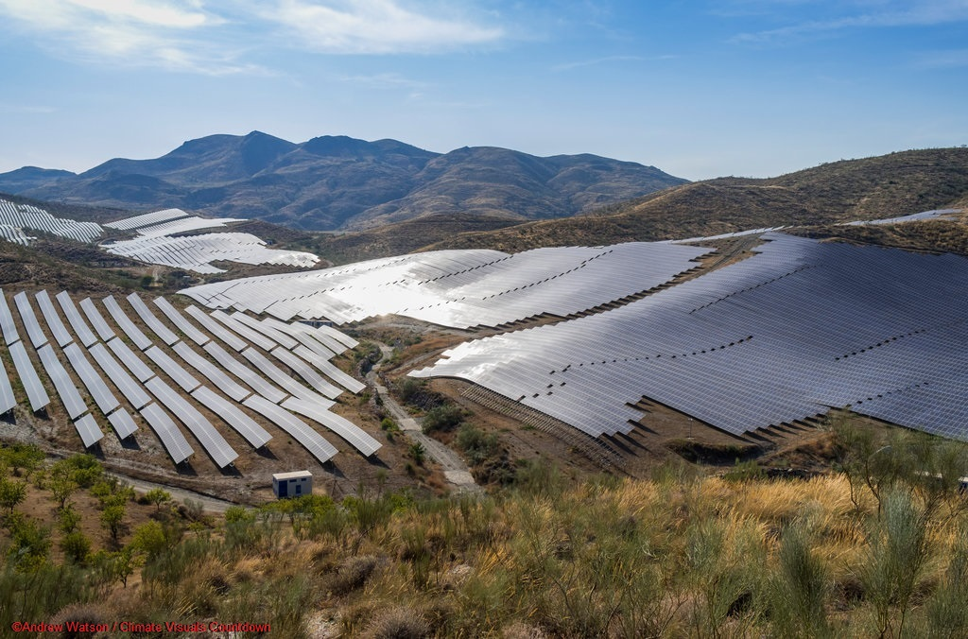


Adaptation M&E for reporting in ADCOM and in BTR
+ Q&A
Timo Leiter
Grantham Research Institute on Climate Change
and the Environment (London School of Economics)

Slide 21


Adaptation M&E and adaptation reporting
PATPA Regional Group
Anglophone Africa,
22-24 February 2022
Timo Leiter
Researcher & PhD candidate
Grantham Research Institute on Climate Change and the Environment
T.L.Leiter@lse.ac.uk
@TimoLeiter

Slide 22
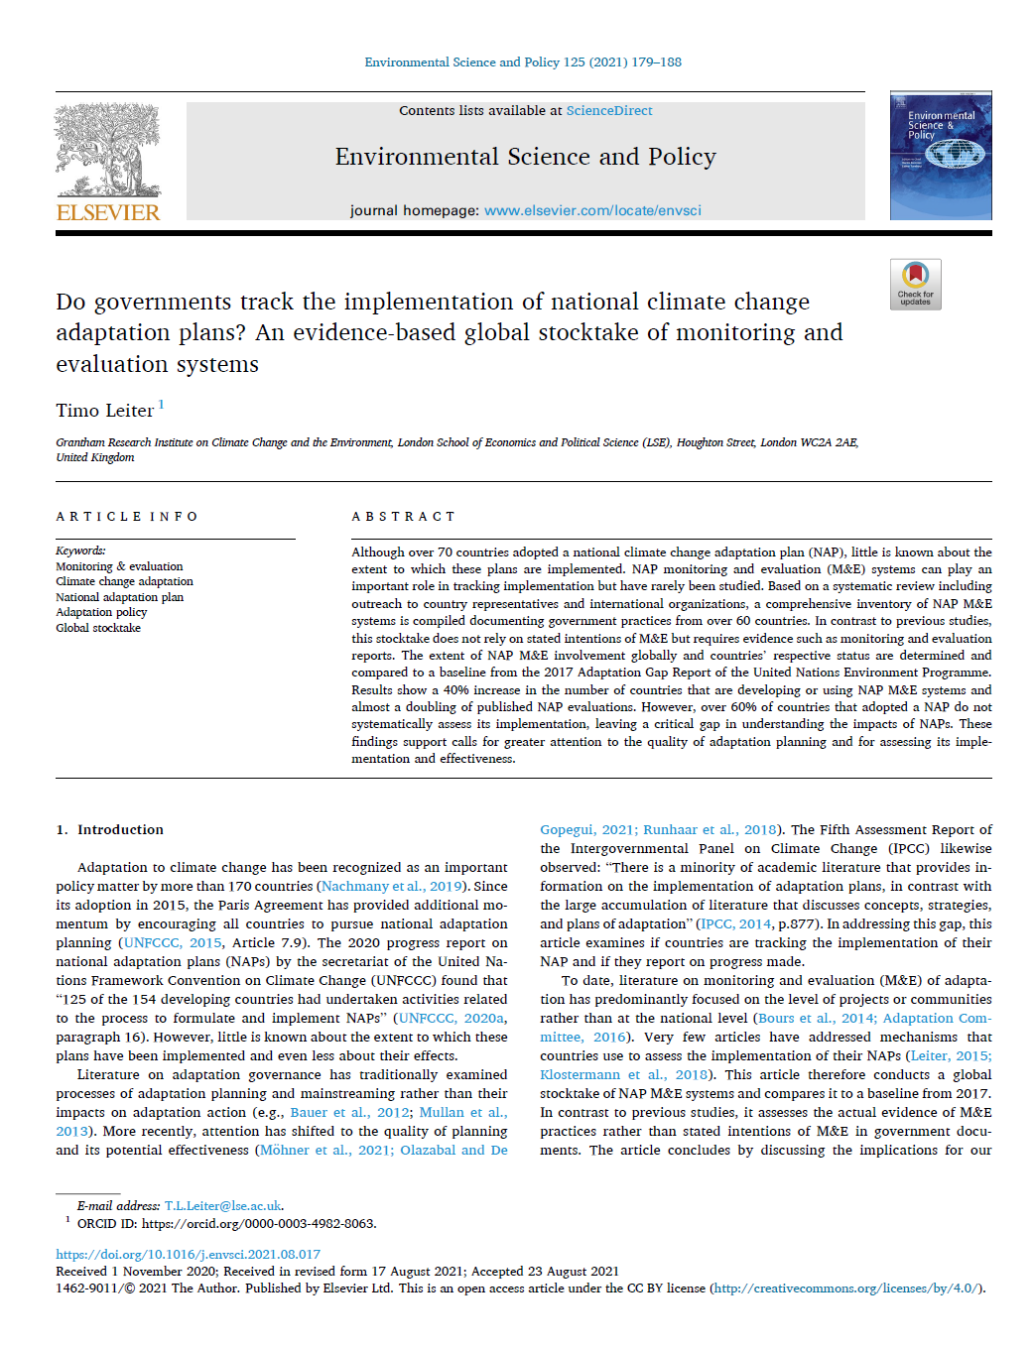

What role for M&E?
Adaptation reporting
NAP progress report published: 23* | NAP evaluation published: 15
Austria, Belgium (Flanders), Brazil, Burkina Faso, Cambodia, Chile, Cyprus, France, Germany, Japan, Kenya, Kiribati, Lithuania, Mexico, Netherlands (Delta Programme), Norway, Portugal, Slovakia, Spain, South Africa, South Korea, Switzerland, United Kingdom *+ Sweden = 24 | Belgium, Cambodia, Chile, Czech Republic, Finland, France, Germany, Ireland, Mexico, Netherlands, Philippines, South Korea, Spain, Switzerland, United Kingdom
How to get information for reporting?
Reporting on adaptation via any vehicle requires gathering information
A national adaptation M&E system is a way of gathering that information
27 countries are already using it, >30 are developing one (Leiter, 2021)
M&E of implementation:
What is/has been done?
What effects has it had?
M&E is backward-looking
As of 1 August 2021
@TimoLeiter
NAP M&E systems in operation & under development as of 2021 (Leiter, 2021): https://www.sciencedirect.com/science/article/pii/S1462901121002379

Slide 23
What does M&E cover?
BTR: “Information related to climate change impacts and adaptation”(section IV of COP24 rulebook)
A: National circumstances
B: Impacts, risks and vulnerabilities
C: Priorities & barriers
D: Strategies, policies, plans, goals and actions
H: Cooperation, good practices, experience and lessons learned
E: Progress on implementation
F: M&E of actions and processes
G: Information on L&D
◆ Without adaptation M&E, adaptation topics in BTRs cannot be completed
Colour code:
Green: Fully requires M&E
Lilac: Partially requires M&E
Grey: Can be linked to monitoring adaptation outcomes
White: Information not gathered through M&E of implementation
@TimoLeiter
NAP M&E systems in operation & under development as of 2021 (Leiter, 2021): https://www.sciencedirect.com/science/article/pii/S1462901121002379

Slide 24
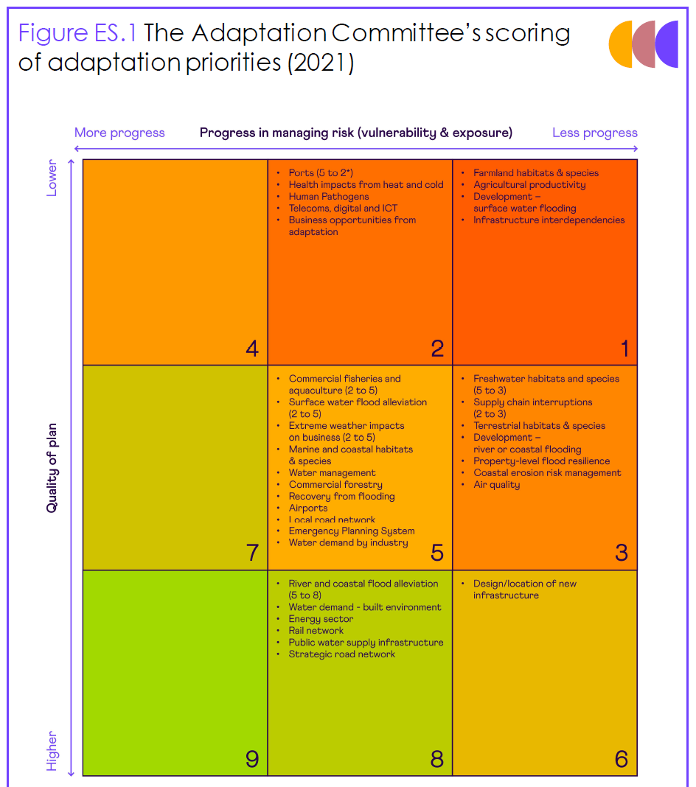
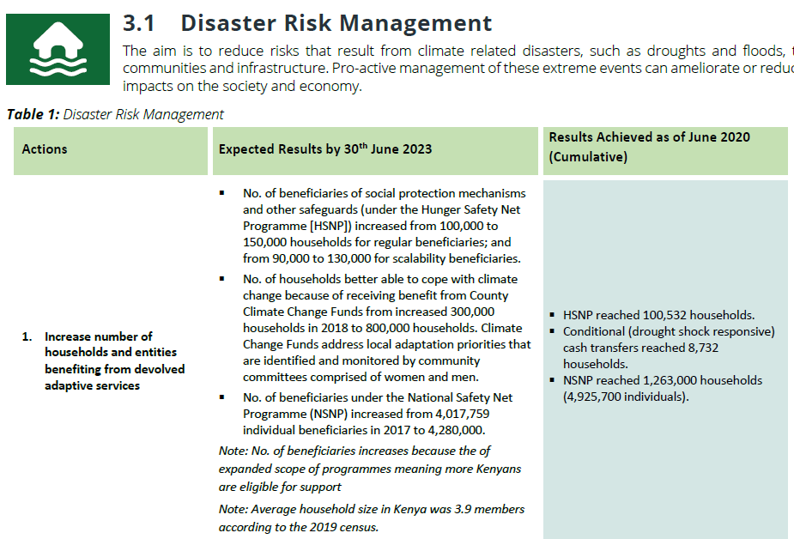
Examples of what is being monitored
UK: Implementation and effect
Kenya: Implementation progress
Source: Kenya MoEF (2021). Second Implementation Status Report for the FY 2019/2020.
@TimoLeiter
Source: CCC (2021). Progress in adapting to climate change. 2021 Report to Parliament.

Slide 25

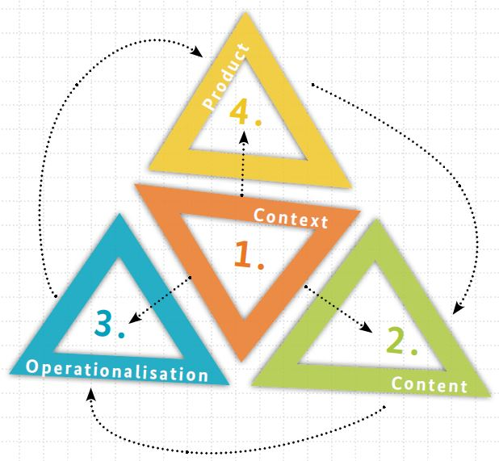
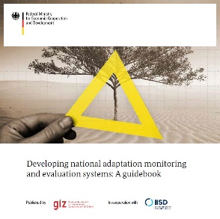
National adaptation M&E systems
Adaptation Gap Report 2017, chapter 4
NAP M&E systems
Differ widely between countries (mandate, arrangements, data used, etc.)
Need to be tailored to national context
No blueprint
Need to consider available resources
NAP supplementary guidance on M&E
Developed by GIZ in 2015 in collaboration with the LEG and the Adaptation Committee
Outlines four building blocks of NAP M&E systems
Context
Content
Operationalisation
Communication (Product)
Available in English, French and Spanish
@TimoLeiter
NAP M&E guidebook (GIZ, 2015): https://www.adaptationcommunity.net/monitoring-evaluation/national-level-adaptation/

Slide 26
Summary: M&E and adaptation reporting
M&E of adaptation is essential
To track implementation, assess results and gather lessons learned
Irrespective of the chosen reporting vehicle
Almost 30 countries already using it, another 30 in the process
Benefits for well-informed domestic decision making
National adaptation M&E systems
Differ from country to country
Approaches/methods depend on:
Purpose, information needs, available resources
Can start simple and improve over time
Online tools/IT can help in gathering and communicating M&E information
M&E is element D of the NAP process
@TimoLeiter
NAP M&E systems in operation & under development as of 2021 (Leiter, 2021): https://www.sciencedirect.com/science/article/pii/S1462901121002379

Slide 27






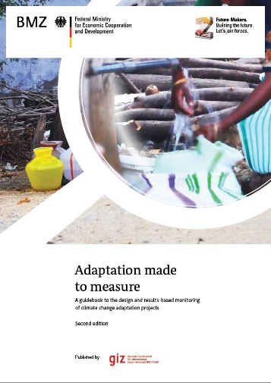



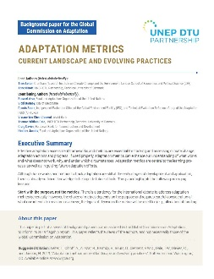
More information
ResearchGate: Timo Leiter
www.researchgate.net/profile/Timo_Leiter
◆ Under Monitoring & Evaluation
@TimoLeiter

Slide 28
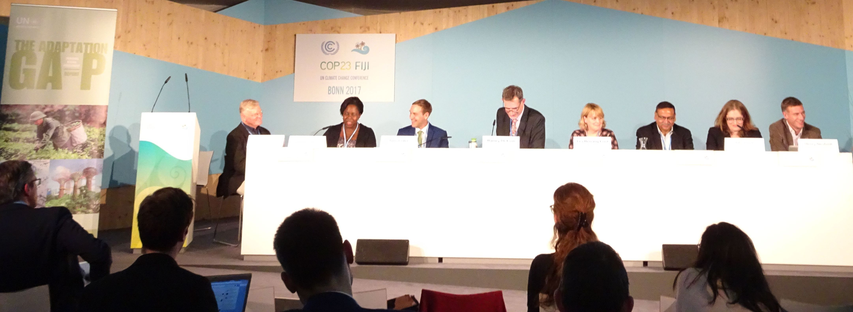


Thank you! T.L.Leiter@lse.ac.uk
©Timo Leiter
Publications on ResearchGate: Timo Leiter
@TimoLeiter
www.researchgate.net/profile/Timo_Leiter

Slide 29

Interview
Lerenten Lelekoitien
Kenya

Slide 30



Kenya’s NAP progress Report
Presentation by:
Lerenten Lelekoitien
Deputy Director, Climate Change Adaptation
February, 2022
PRESENTATION IN THE VIRTUAL PATPA WORKSHOP

Slide 31
Outline
What is monitored in the M&E system
Methodologies and systems
Which challenges have you encountered and how did you overcome them (or not)
Addressing challenges and Lessons learnt

Slide 32

What is monitored
The NDC, NAP
Vehicle is NCCAP
Identify priority actions
Identify targets
Timelines
All sectors

Slide 33
Methodology - System
Annual NCCAP Progress report
Development of online system – reach wider audience
Awareness creation – inclusivity in tools development and awareness on the tool
submissions
Report compilation
Report validation
Continuous capacity building

Slide 34
Challenges
Climate change coordination units- Weak or non-existent
Coordination – inadequate – all sectors need to report
Inadequate awareness on the NCCAP implementation and reporting process
Inadequate financial resources to support full implementation of NCCAP
Low submissions from stakeholders
Duplication of data – project implemented at both national and sub national level.

Slide 35
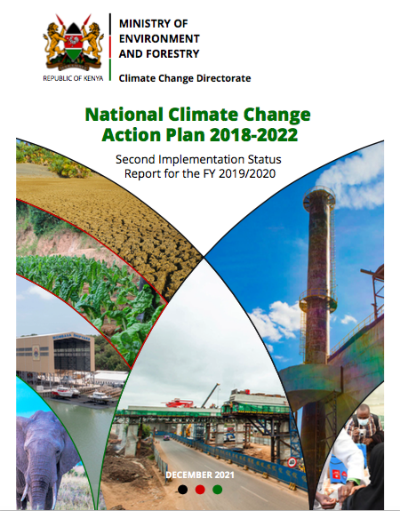
Lessons Learnt/ Overcoming the challenges
Effective coordination of the various stakeholders is key – both intra and extra the institution
Enabling legal and policy environment is important
Support the implementation of the NCCAP is key
Enhanced awareness, sensitization and capacity building
Encourage sector level coordination and monitoring
Develop national level MRV+ system

Slide 36
Thank You
Ashe Oleng

Slide 37
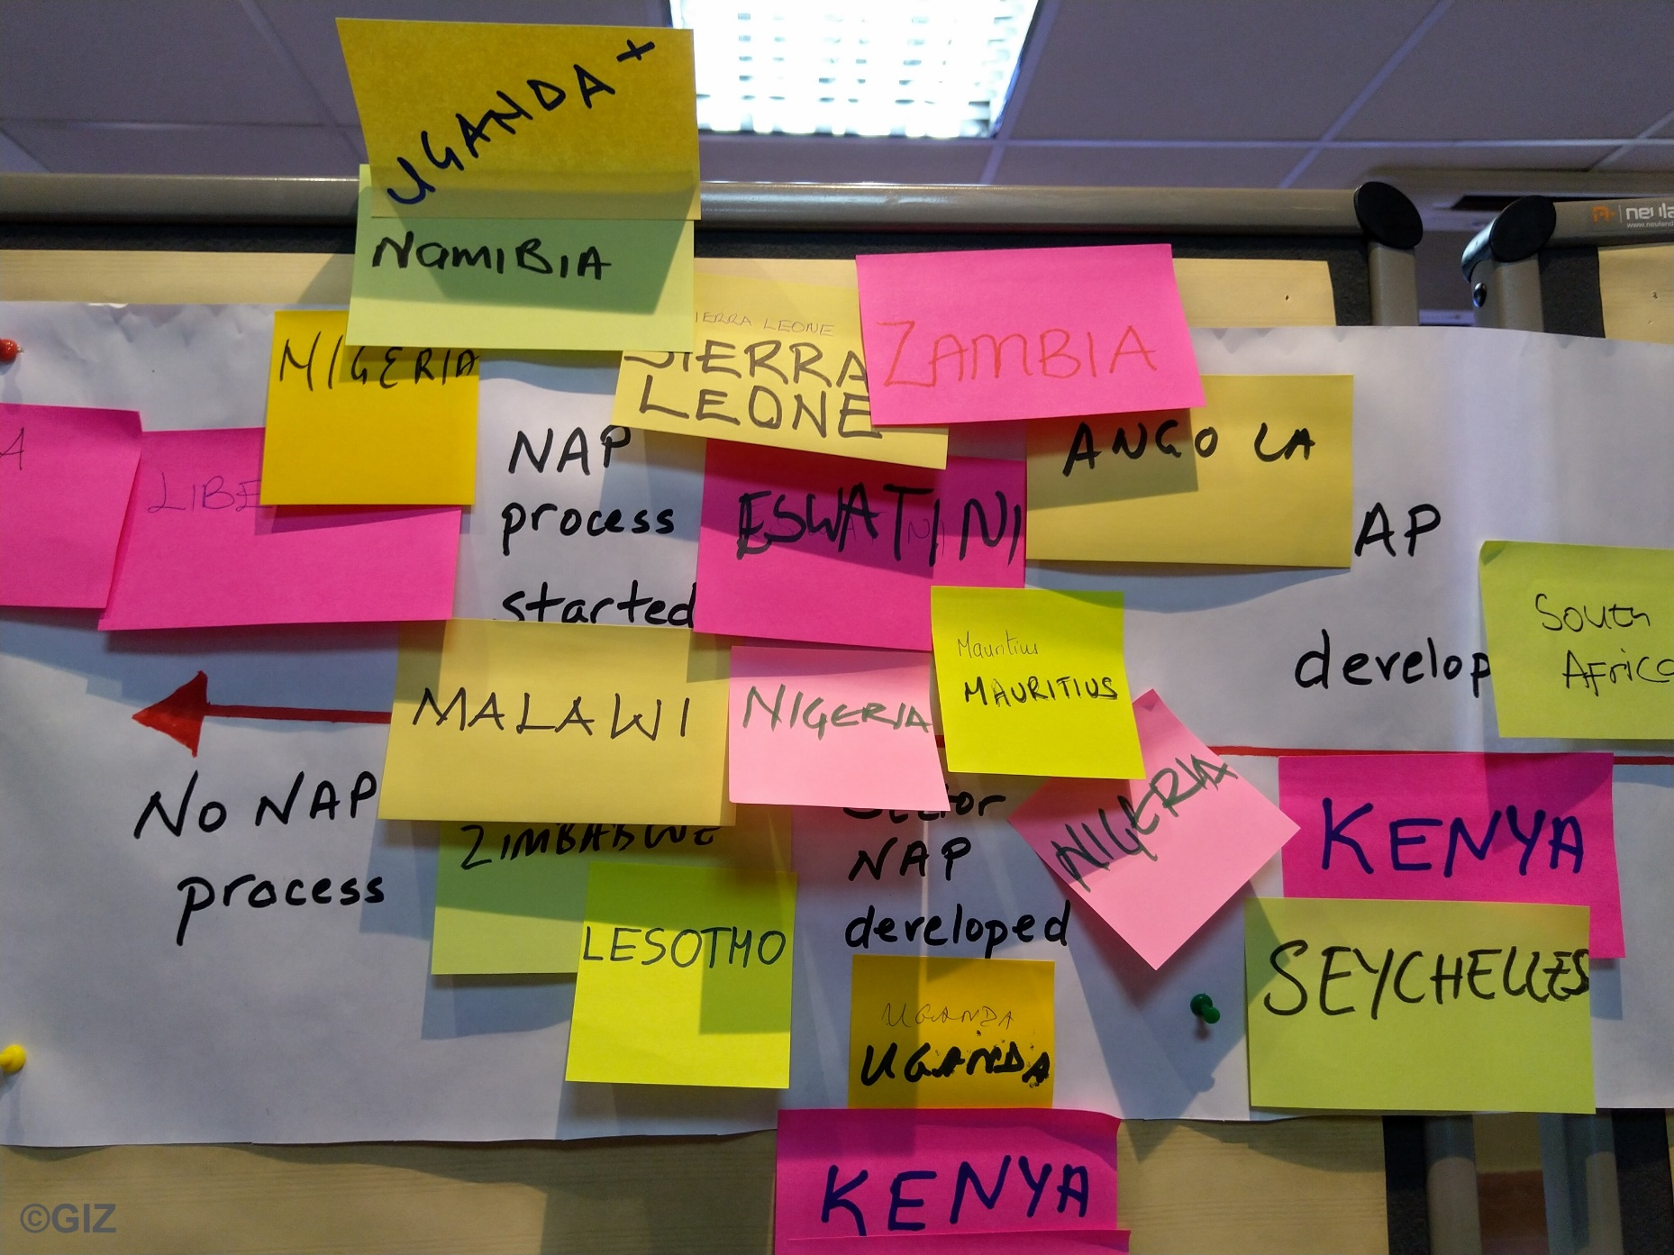
Break-out groups
Timo Leiter
Lerenten Lelekoitien – Kenya

Slide 38

Guiding questions for the BOG
What do you monitor and evaluate?
How do you monitor results?
What challenges have you encountered and how did you overcome them?
What is required to overcome those challenges?
How frequently do you conduct M&E activities?
What does it take to involve all necessary stakeholders?

Slide 39

Summary overview of the BTR development process and how to complete the document

Slide 40



1. What role is reporting on adaptation in the BTR intended to play in the UNFCCC process?
Reporting on adaptation via the BTR will allow countries to:
Get recognition of adaptation action that they are undertaking
Learn from each other
Communicate with NGOs, civil society, donors, and other important stakeholders outside of the UNFCCC
Slide taken from the presentation “A closer look at adaptation reporting through the BTR” provided by Mr. Thomas W. Dale, UNEP DTU Partnership on day 1 (22.02.22) of the workshop

Slide 41
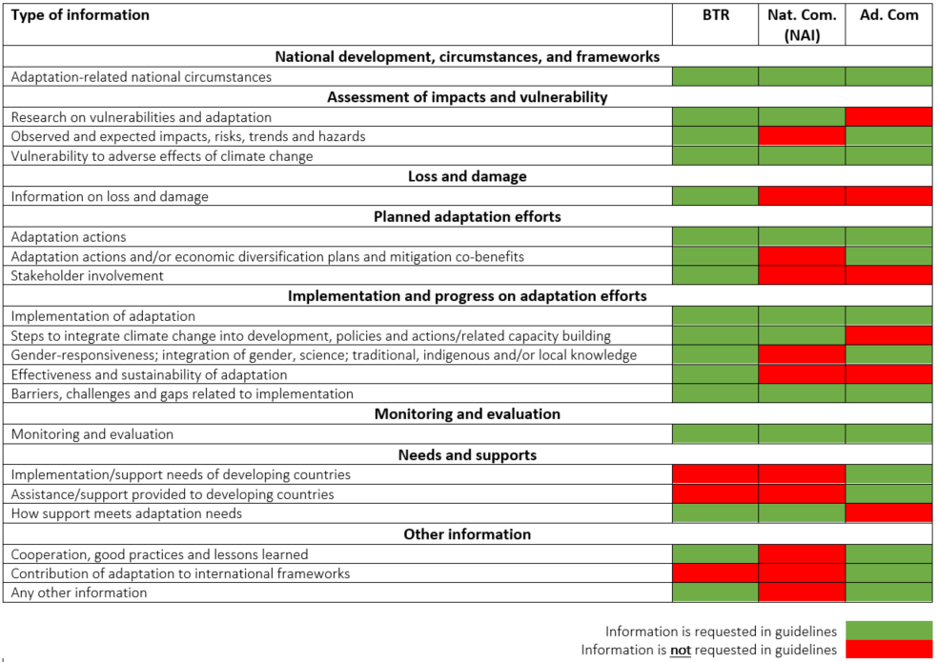
Exploiting synergies between the BTR and other UNFCCC reports
Streamlining adaptation reporting
The table visualises the overlap in the adaptation-relevant guidelines between the BTR, Nat Com and Ad Com.
Source: adapted from Adaptation Committee (2019)
Slide taken from the presentation “A closer look at adaptation reporting through the BTR” provided by Mr. Thomas W. Dale, UNEP DTU Partnership on day 1 (22.02.22) of the workshop

Slide 42
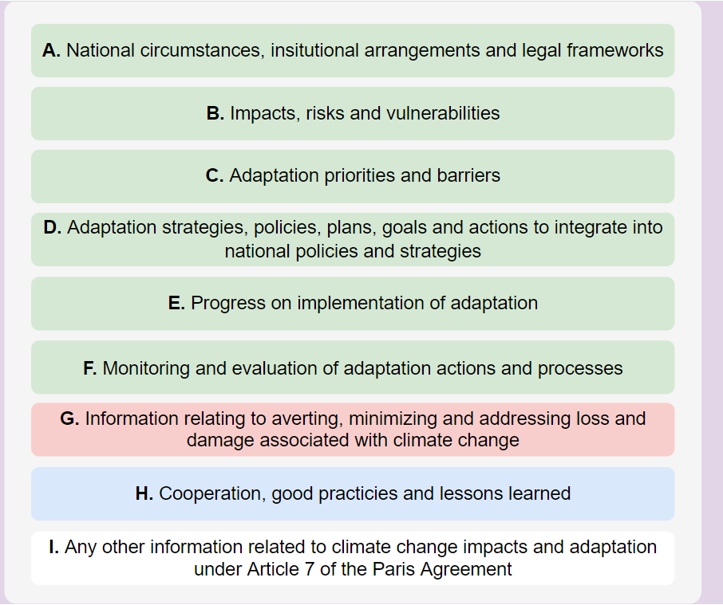
What is the biennial transparency report? And why is it relevant to reporting on adaptation?
2. What information are countries expected to provide in the adaptation sections of their BTRs?
The titles of the guidance's nine sections provide a good indication of what information should to be included.
Together, these guidelines cover:
Adaptation
Loss and damage
Good practices and lessons learned
Any other information
Slide taken from the presentation “A closer look at adaptation reporting through the BTR” provided by Mr. Thomas W. Dale, UNEP DTU Partnership on day 1 (22.02.22) of the workshop

Slide 43

Evaluation & Feedback
Was today’s session (Day 3) useful to you?
Strongly Agree (5) | Agree (4) | Neutral (3) | Disagree (2) | Strongly Disagree (1)
©Pixabay/Pexels​

Slide 44
The Climate Transparency Helpdesk
Examples of Assistance Provided
Expert guidance and technical review of climate related policies, plans and programs
Preparation for the submission in the future of Biennial Transparency Report (BTR)
Reviewing GHG inventories for specific sectors
Preparation of countries for the ETF
Adaptation reporting
In-country workshops for national staff and experts
Sharing of studies, analysis, reports, tools, guidance documents
providing rapid, high quality, short-term technical assistance for developing countries
To request support, email to climate.helpdesk@giz.de
www.transparency-partnership.net/climate-helpdesk

Slide 45
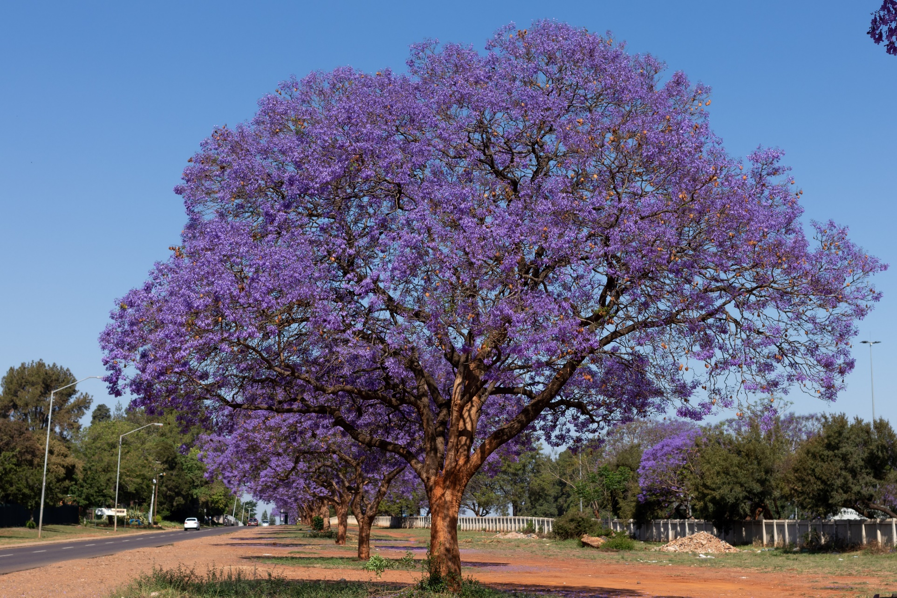
Outlook on COP27 in Egypt and closing remarks
Mkhuthazi Steleki
Department of Forestry, Fisheries and the Environment (DFFE), South Africa
©Clayton/Pexels

Slide 46

Contact
Partnership on Transparency in the Paris Agreement (PATPA)
Catarina Tarpo
catarina.tarpo@giz.de
The workshop report and the presentations will be available under News (transparency-partnership.net)

Slide 47






With the financial support of
This workshop was realized with technical contributions of
Adaptation Division,
UNFCCC secretariat
We would like to thank all country speakers for their valuable contributions
Notes:
Federal Ministry for the Environment, Nature Conservation, Nuclear Safety and Consumer Protection

